Slide 1
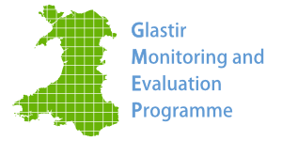
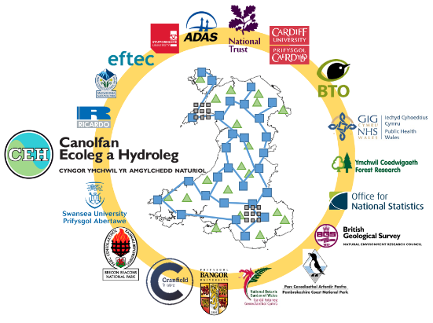
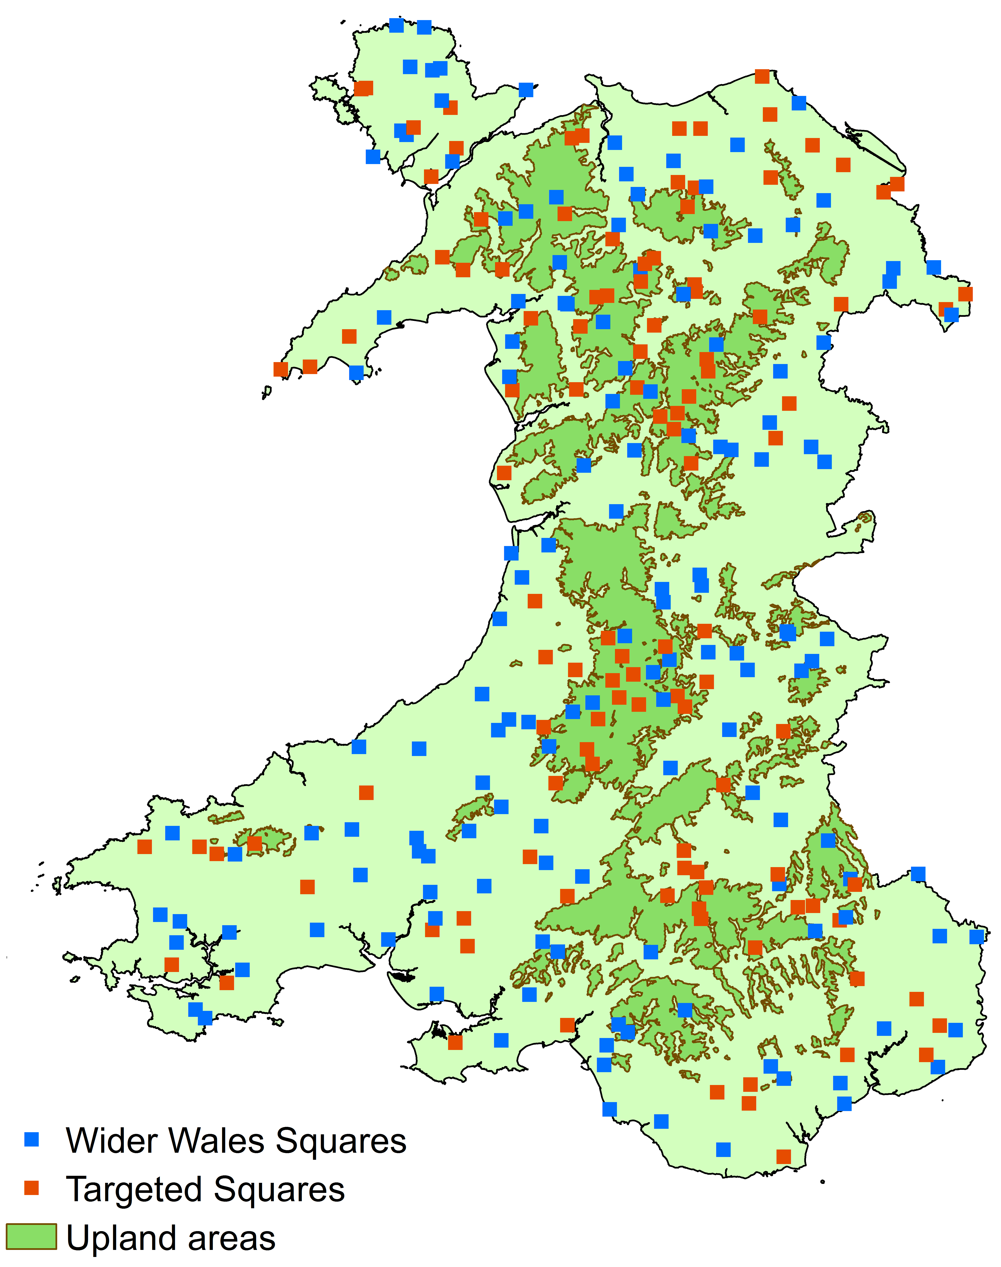
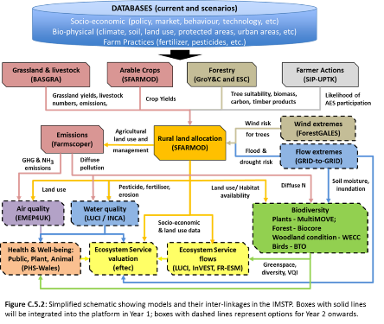
ERAMMP: Generating and utilising evidence in Wales
Aim: Develop policies that build social, economic and environmental resilience.
Project embedded in the Brexit policy planning team
Builds on GMEP project www.gmep.wales
Partnership approach covering agriculture to human health, economics to land-sea interface.
Modelling frameworks to develop new payment schemes
National integrated field survey to track progress and report into State of Natural Resources Report through national co-located field survey exploiting and combining new technologies
National scale monitoing
Modelling frameworks
Data Science Frameworks and Virtual Data Labs

