Slide 1
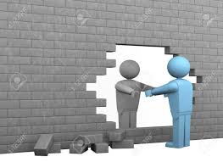
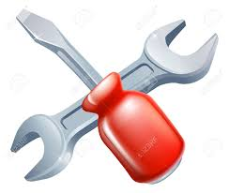
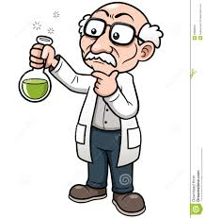
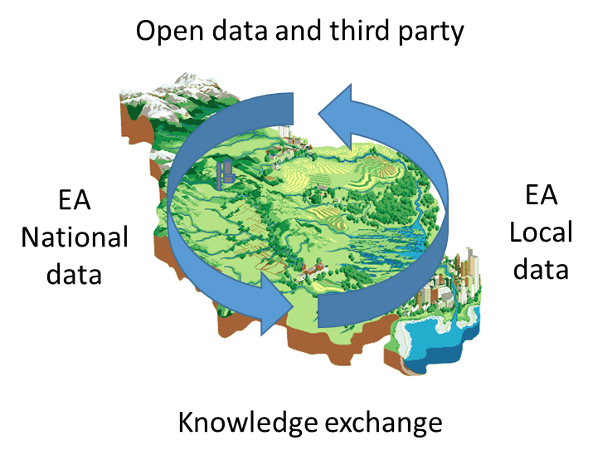
Improving our approach to assess catchment condition, pressure and risk
Where we are
Where we want to be
Challenges
What we are doing
Target monitoring
Prioritise environmental planning decisions (condition)
Problems
Polarized by pressure
Static (non continuous)
Local intelligence NOT built in
- low confidence
No common catchment understanding
Improved and more integrated catchment understanding
Local intelligence built in
Dynamic (continuous)
Proactive management – mitigate impact and risk
Monitoring:
- Optimised
- Agile
- Long-term
Catchment partnerships
Organisation culture
Catchment diversity – consistency of approach
Cuts in budget
Third party data
Quantity of data and how to synthesise and interpret
Futures
Local intelligence
Remote sensing
Modelling
Diagnostic tools
Representative sites
Data interpretation approaches

