Slide 1
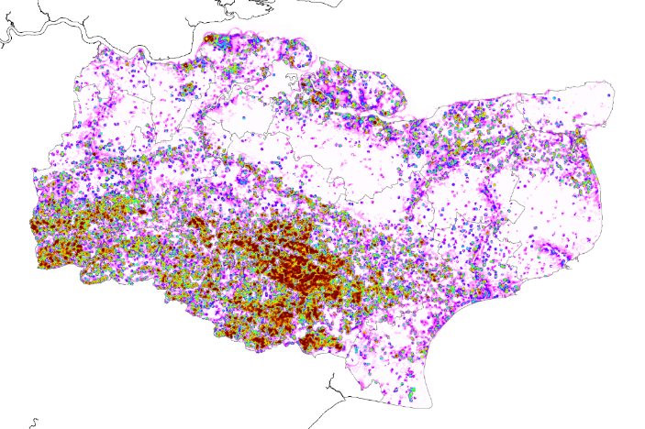
Great Crested Newts (GCN)
District Licensing Project
Dr Benjamin Payne (Ben.Payne@naturalengland.org.uk) @benlukepayne

Slide 2
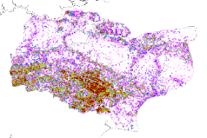

GCN District Licensing Project
What is district licensing?
  GCN are a protected therefore development licenses are required
  Current site-based mitigation is not working, expensive, and causes delays
  GCN are in decline
  District licensing is a tariff based system:
    Developers pay according to modelled damage inflicted on GCN
    Funds pay for conservation best suited to GCN across the
    district/county
  Move from site-based mitigation to landscape-scale habitat creation!
All based on predictive models
that are the core of licensing and conservation

Slide 3
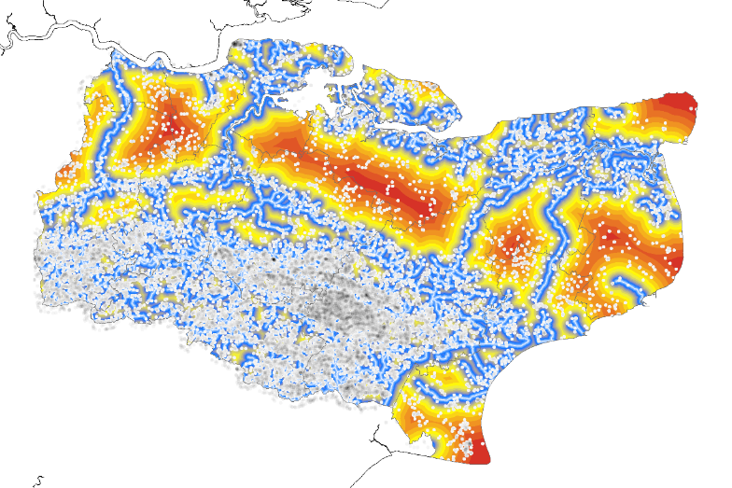
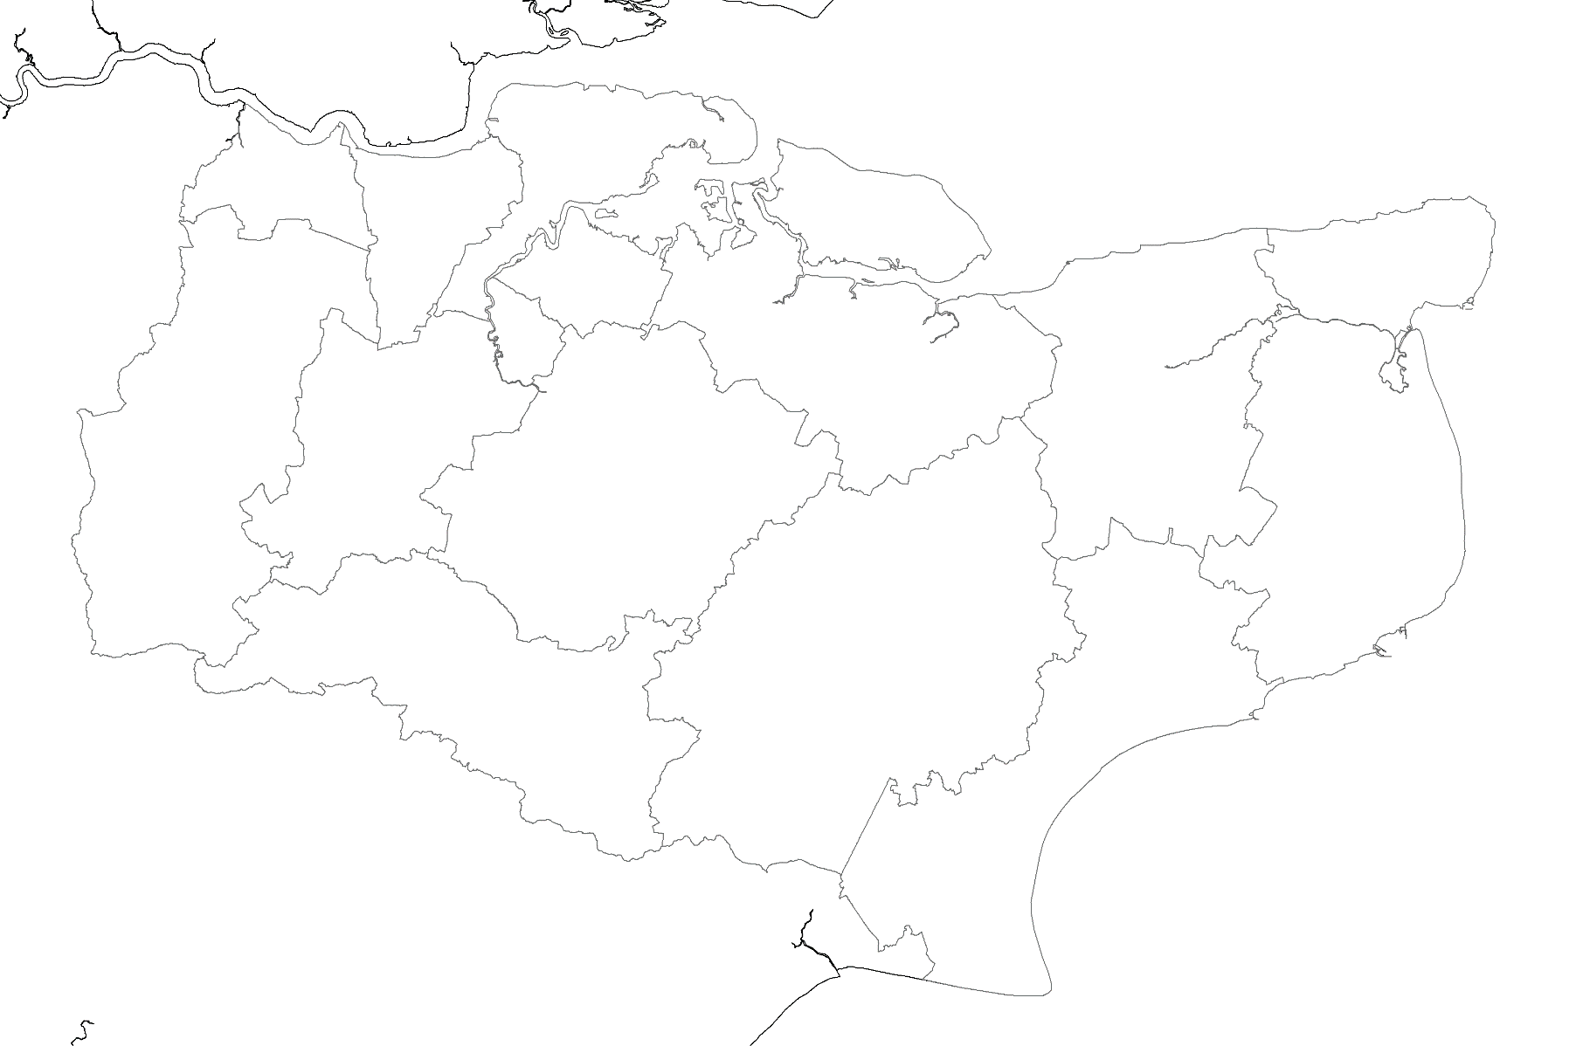
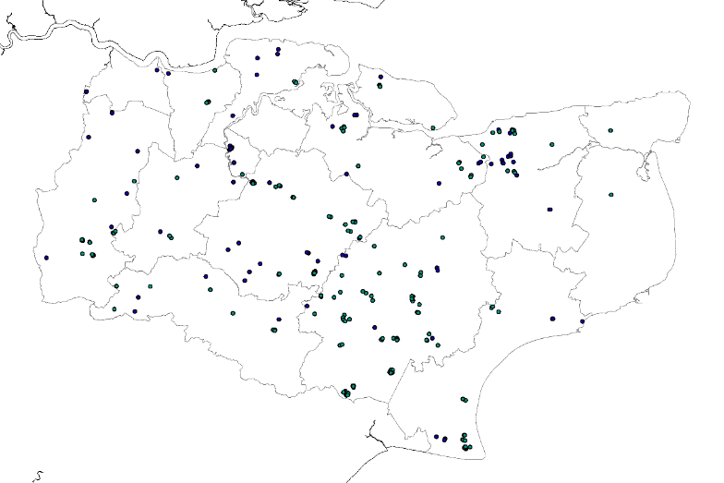
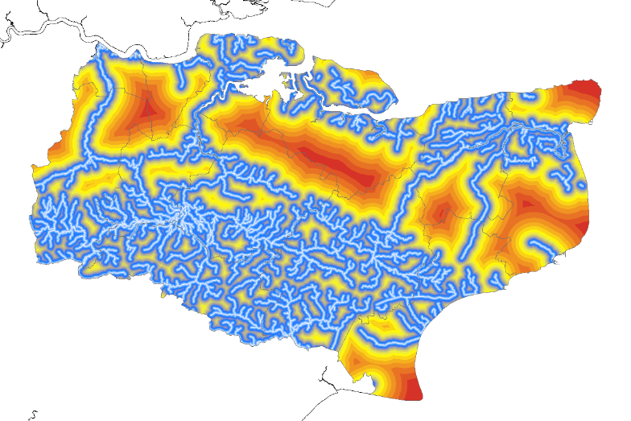
GCN species distribution models
predictor variables
Distance/density of habitat:
  Grassland
  Arable
  Deciduous
  Coniferous
  Urban
  etc.
Soil properties:
  Phosphorous
  pH
  Type
  etc.
Pond density
Distance from river
Elevation
Aspect
Slope
Climate
…

Slide 4
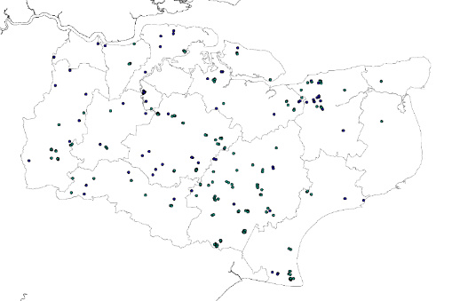
Maxent
GBM
Ensemble Species Distribution Model
RF
ANN
MARS
CTA
FDA
GAM
GLM
Ensemble

Slide 5
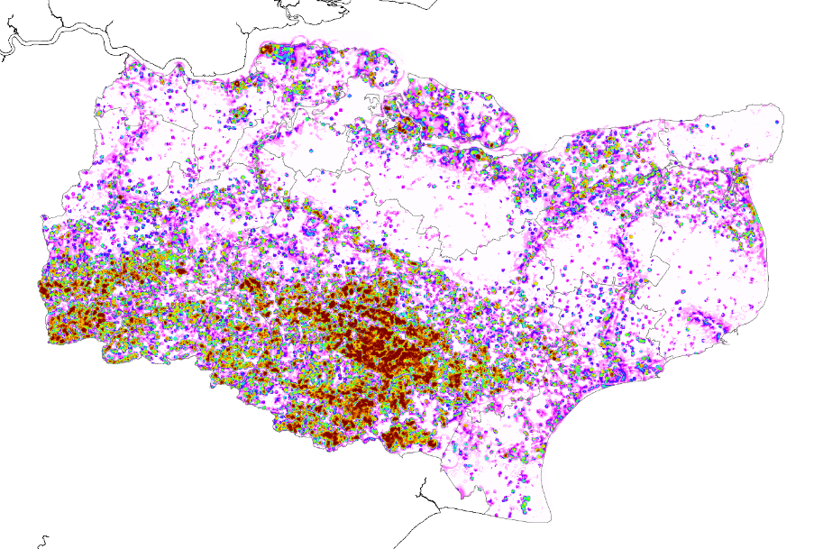
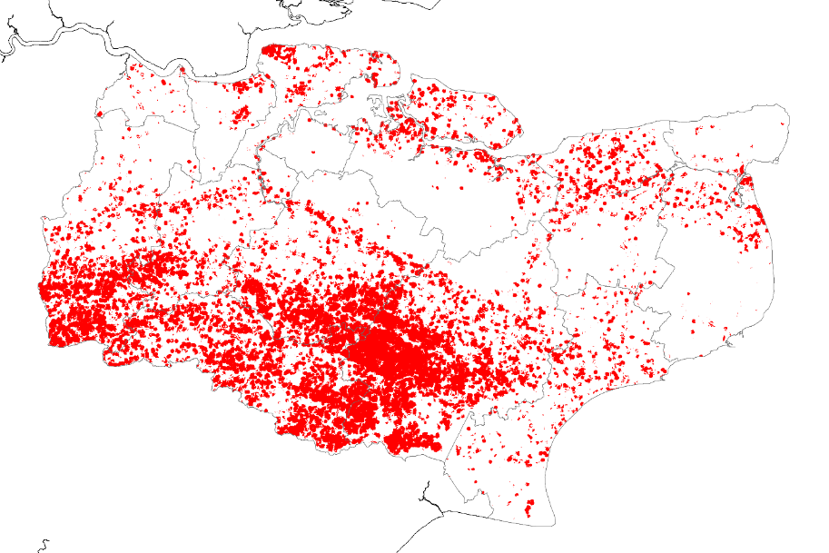
Predictions

Slide 6
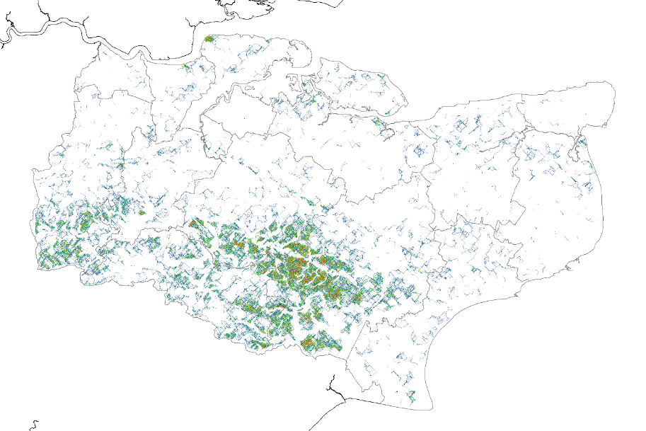
Connectivity

Slide 7

Risk Zones
Define cost to developers based on impacts to newts:
  Lots of newts present → £££
  Few newts present → £
Red Zone:
SSSIs (and other protected areas) with GCN as a feature (+500m)
Orange Zone:
Top 5% of connectivity (+500m)
Yellow Zone:
Predicted GCN distribution (from the model)
GCN presence points that fall outside the model
Remaining connectivity
All buffered 250m
Green Zone:
Remaining area (GCN not predicted)

Slide 8
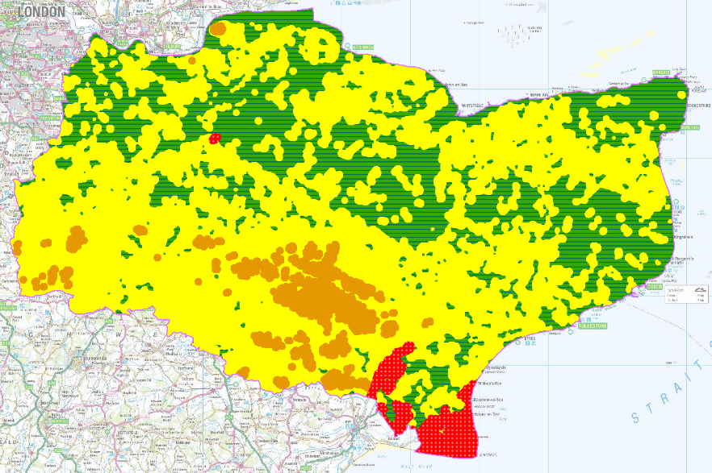
Final output: Risk Zones
£
££
£££
X

Slide 9
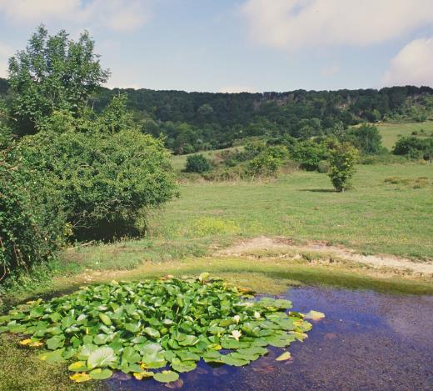
Mapping conservation priorities
Strategic Opportunity Areas
Priority areas for newt conservation
New ponds, pond restoration, new terrestrial habitat
Best for newts and people
Put money into land management not newt surveys

Slide 10
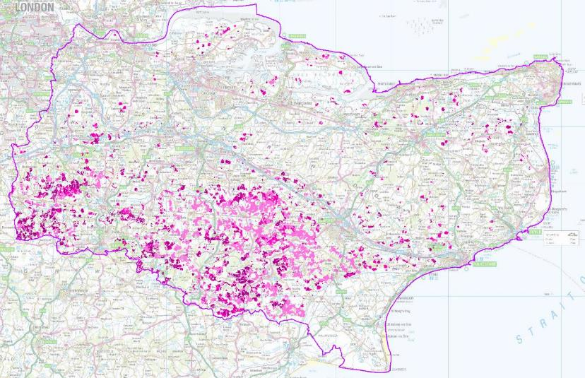
Strategic Opportunity Areas (SOAs)
Key areas for GCN conservation actions:
Input variables:
Model prediction
Pond density (no. within 250m)
    Ideal range: 2-7 ponds (+50m)
Habitat features: Score:
Grassland (+250m) 1
Woodland (+250m) 1
Rivers (100-1000m) 1
Arable -1
Urban (+400m) Exclude
Exclude:
Protected areas
Flood Zones
Aerodrome safeguarding areas
High/low pond densities

Slide 11
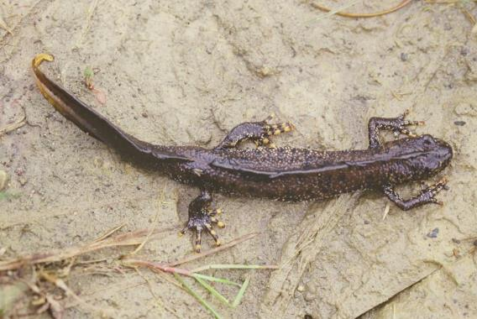
Thank you
Thanks to Lila Buckingham (GI Analyst: GCN; Natural England) for the Risk Zone, SOA slides

Slide 12
Additional Slides

Slide 13
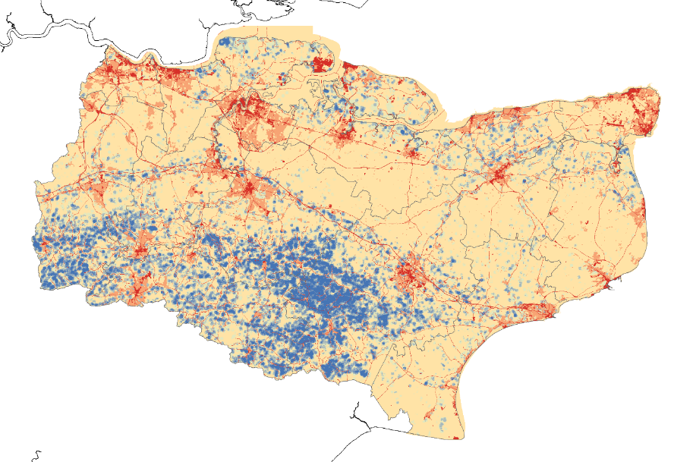
Resistance

Slide 14
Table 1: Variable importance of each of the models contributing to the ensemble model
GAM FDA GLM RF CTA ANN MARS GBM
Pond density 0.585 0.809 0.742 0.778 0.828 0.902 0.637 0.689
UIgrass dist 0.040 0.015 0.013 0.058 0.089 0.196 0.041 0.037
Arable dist 0.075 0.019 0.048 0.049 0.043 0.207 0.026 0.041
Deciduous dist 0.101 0.051 0.010 0.019 0.055 0.096 0.084 0.045
River dist 0.207 0.070 0.079 0.099 0.249 0.164 0.164 0.194
Caution: these values are specific to the model (GAM or FDA, etc.) They can’t be compared across models but give an indication of general importance

Slide 15
Model performance measured by Receiver Operating Characteristic (ROC) and True Skill Statistic (TSS) measured as 0-1.
GAM FDA GLM RF CTA ANN MARS Ensemble
ROC 0.898 0.882 0.865 0.929 0.890 0.888 0.893 0.915
TSS 0.679 0.629 0.599 0.707 0.701 0.699 0.670 0.728
ROC values > 0.9 are considered “high usefulness”, >0.8 are “useful” (Huntley et al, 2004).
TSS scores above >0.6 are good (Hodd et al, 2014)
Note: ROC values are also known as the AUC values (Area Under the ROC Curve)

Slide 16
Sensitivity and specificity
The models are trained using 70% of the data and evaluated using the remaining 30%
Two further measures of a model:
Sensitivity = true positive rate (i.e. % presence correctly predicted)
Ensemble model = 92.4%
Specificity = true negative rate (i.e. % absences correctly predicted)
Ensemble model = 80.4%

Slide 17
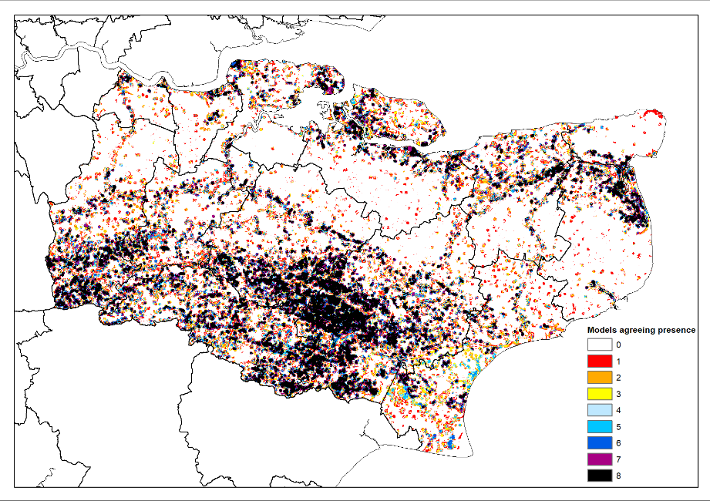
Predictions
GBM
RF
ANN
MARS
CTA
FDA
GAM
GLM
Maxent

