Slide 1
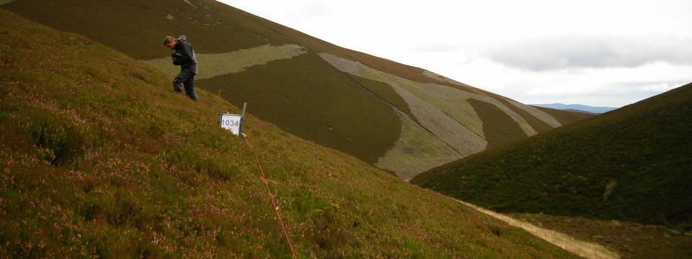
Mapping Natural Capital
Pete Henrys, Centre for Ecology & Hydrology
UKEOF Monitoring & Modelling Workshop
7th March 2018

Slide 2
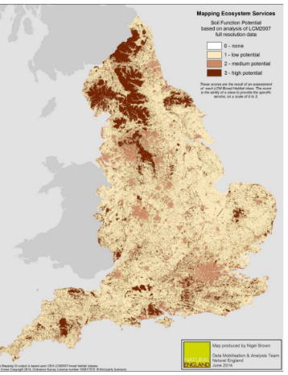
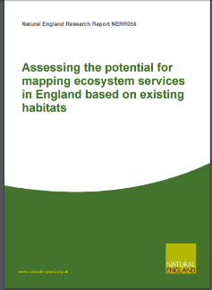
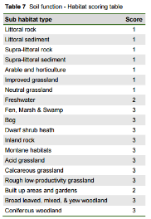
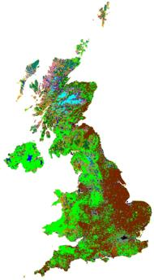
Natural England’s Approach
Notes:
2015 report published

Slide 3
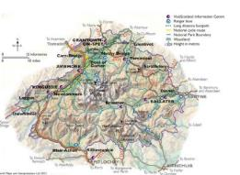

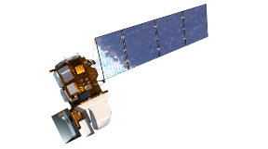
Considerations
Scale
Representative
Data Sources
Uncertainty

Slide 4
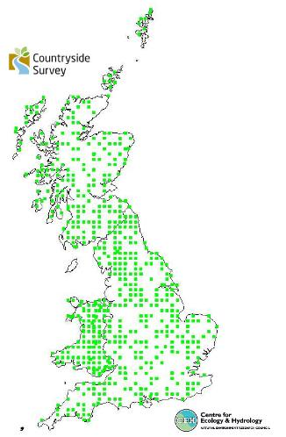
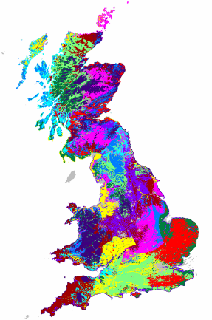
Countryside Survey
Sample is stratified by land classes
National estimates were design based until 2007
In 2007 model based estimates were introduced
Current reliance upon the balanced, stratified nature of the sample

Slide 5
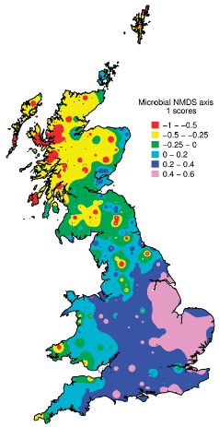
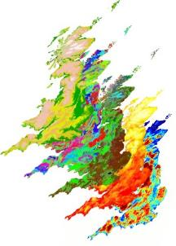
Mapping CS data
Spatial assessment based on CS data was typically done via Kriging based approaches
Or by GIS classification
However, we have a wealth of data and the tools required to make use of this to improve spatial predictions AND national estimates

Slide 6
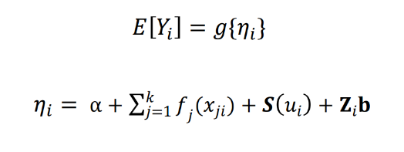








Model based Geostatistics
Diggle, P. J. et al. 1998. Model-based geostatistics (with discussion). J. R. Stat. Soc. C 47: 299–351.
$$Y$$
Response variable
$$f_{j}$$
Some function (potentially smooth) of covariate j
$$x_{j}$$
j=1,..,k Covariates
$$g$$
Link function
$$α$$
Intercept
$$Z$$
Grouping levels
$$b \sim N ( 0 , σ^{2})$$
iid variation for grouping levels defined by Z
$$S$$
Stationary Gaussian process. Locations u

Slide 7
Example
Soil invertebrate richness
  Water supply; nutrient cycling; flood mitigation; climate regulation
Covariates including:
  Propn Woodland, Arable, Semi-nat ; MAT ; N Deposition; Altitude
Random effects for samples from same 1km square
Spatial structure

Slide 8
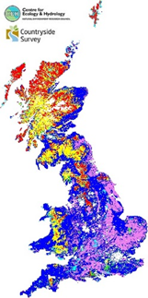

Model Results
 | mean | 0.025quant | 0.5quant | 0.975quant
intercept | 2.9602 | -28.0880 | 2.9598 | 33.9826
Alt | 0.0008 | 0.0001 | 0.0009 | 0.0019
MAT | 0.0000 | -0.0001 | 0.0000 | 0.0000
Ndep | 0.0168 | -0.0509 | 0.0129 | 0.1044
Wdl | 1.4671 | 0.5783 | 1.4667 | 2.4867
Ara | -0.7631 | -1.2812 | -0.7627 | -0.7815
Nat | 0.7300 | -1.3140 | 0.7295 | 1.7481
High richness
Significant effects of:
Altitude
Propn Woodland
Propn Arable land
Low richness

Slide 9
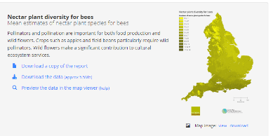
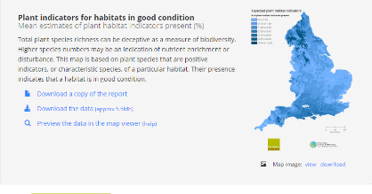
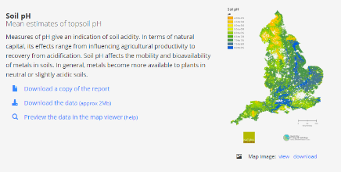
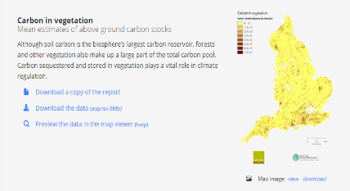
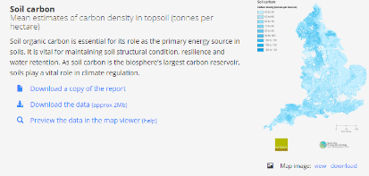
UK Natural Capital Data
Nectar plants for Bees
Plant Biodiversity
Soil pH
Carbon in Vegetation
Soil Carbon

Slide 10
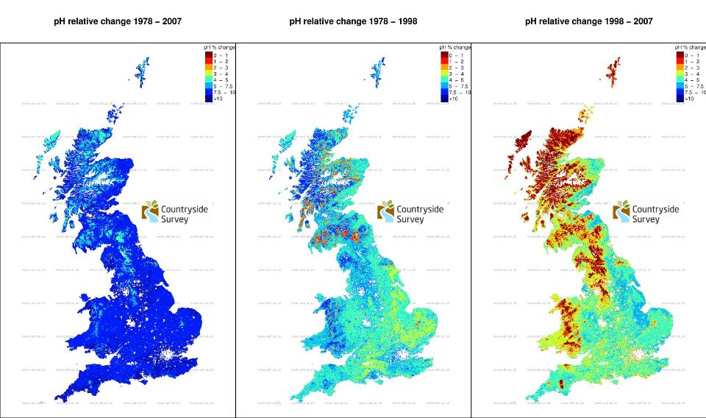
Mapping Change

Slide 11
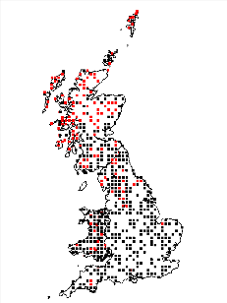
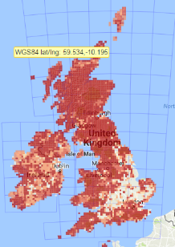
Vegetation species’ occurrence
CS randomly placed quadrats within each 1km square
BSBI ad hoc volunteer records as part of its Plant Atlas programmes
Take Calluna vulgaris (Heather) as an example

Slide 12


Simple joint distribution model
$C_{j}$presence or absence of species within CS square j with location $s_{j}$
$B_{j}$presence or absence of species within BSBI hectad i with location $s_{i}$
$$C_{j} \sim Bernoulli \left(A_{j}\right)$$
$$g\left(A_{j}\right)= α+ \sum_{k=1}^{Nk}{β_{k}X_{k,j}+γ\left(s_{j}\right)+δ{∙μ(s}_{j})+}ε_{j}$$
$$B_{i} \sim Bernoulli (P_{i})$$
$$g\left(P_{i}\right)= α_{0}+\sum_{l=1}^{Nl}{ρ_{l}V_{l,i}+μ\left(s_{i}\right)+ ω_{i}}$$

Slide 13
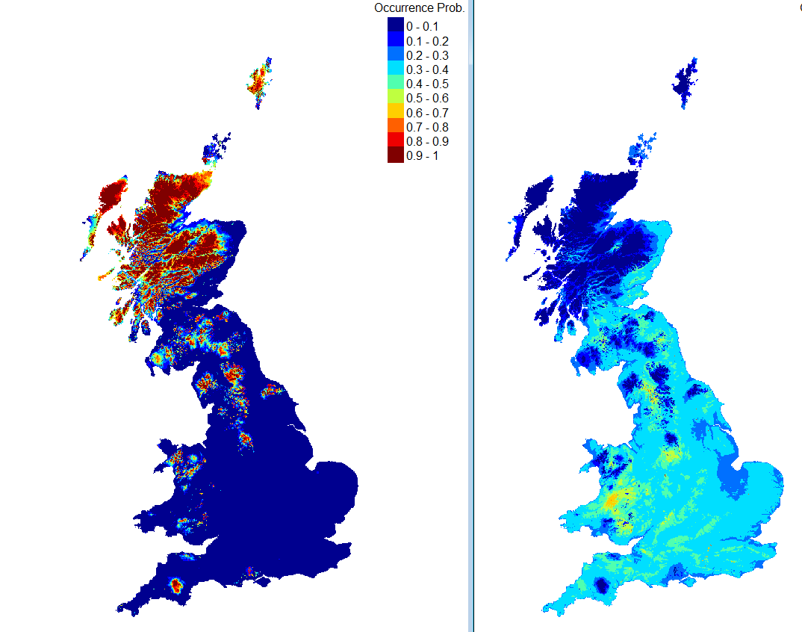
Occurrence Probability Map
Uncertainty Map
High uncertainty in mid-Wales where model (Heath and Altitude) does not explain variation and contribution from BSBI is poor

Slide 14
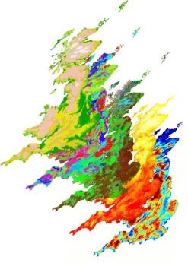
Integrated analysis plan
Data 1
Adaptive/Targeted Sampling
Data 2
Integrated Modelling
Identify & Extract
Predict & Extrapolate
Data products
Model Output
Transform & Process
Covariates

Slide 15
Conclusions
Novel statistical modelling allows us to make more use of information available
  Use covariate data
  Use multiple data sources
Models explicitly highlight where uncertainty is high and perhaps more data is required
Models potentially allow for understanding spatial and temporal relationships and interactions

