Slide 1
Using drones for monitoring biodiversity & mapping the environment
Estimating land use and ecological surveying
Paul Scholefield
NERC Centre for Ecology and Hydrology

Slide 2
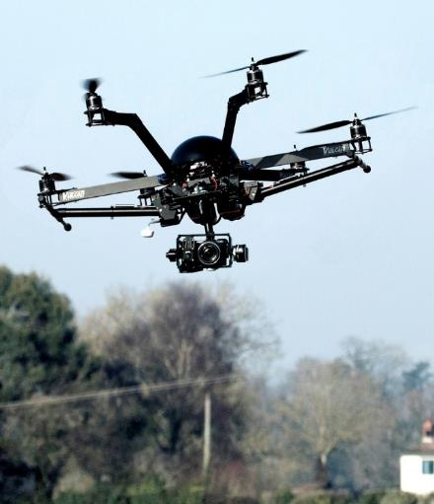
Drones are Taking-Off !
UAVs are a young and dynamic technology.
Autonomous flying robots.
Offer enormous potential benefits in many areas of research and teaching.
The ability to bring sensors into otherwise inaccessible environments, or uneconomic applications.

Slide 3
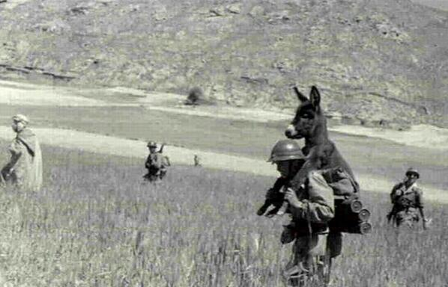
Why use UAVs for field survey?
Fields surveyors are always required for ground truth data.
But for difficult conditions and for extensive bog habitats, other approaches may have a reduced impact
For mosaiced habitats features can be missed at ground level due to obstructed views
Field work can be difficult in wet conditions

Slide 4
UAV systems - software and tools
Quest UAV 300
DJI Matrice
Rikola Hyperspectral Camera
Lumix LX5 or Canon C100 for NDVI or Canon 6D
Intervalometer
Agisoft Photoscan/Pix 4D
ESRI ArcGIS
Classification run in open source R

Slide 5
QUEST UAV 300 - £18k

Slide 6
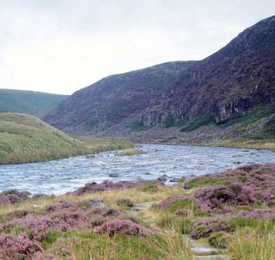
Moorhouse NNR
CEH Long term monitoring site, Environmental Change Network
Moor House-Upper Teesdale, is a nature reserve in the Pennine hills of northern England.
Large parts of it are upland blanket peatland

Slide 7
Moorhouse Survey
4 sq km survey
May and June 2015
4 hours of flying
7000 images

Slide 8
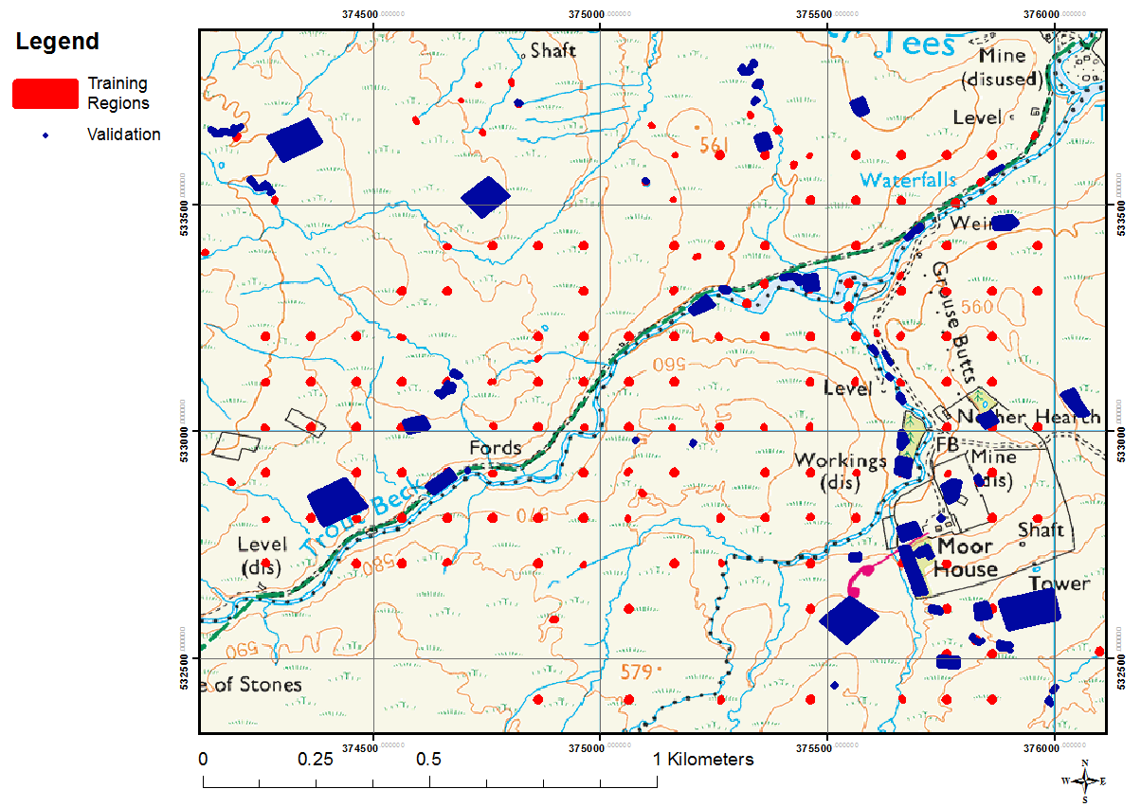
Training and validation plots

Slide 9
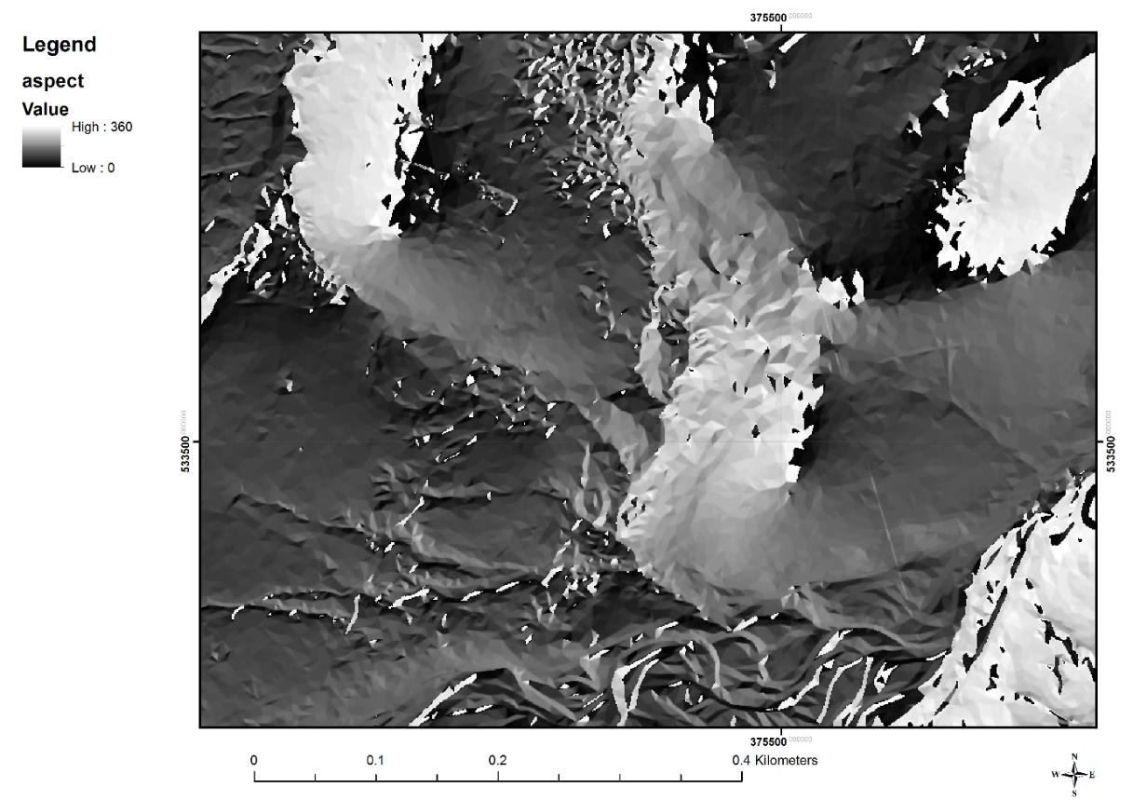
Aspect maps

Slide 10
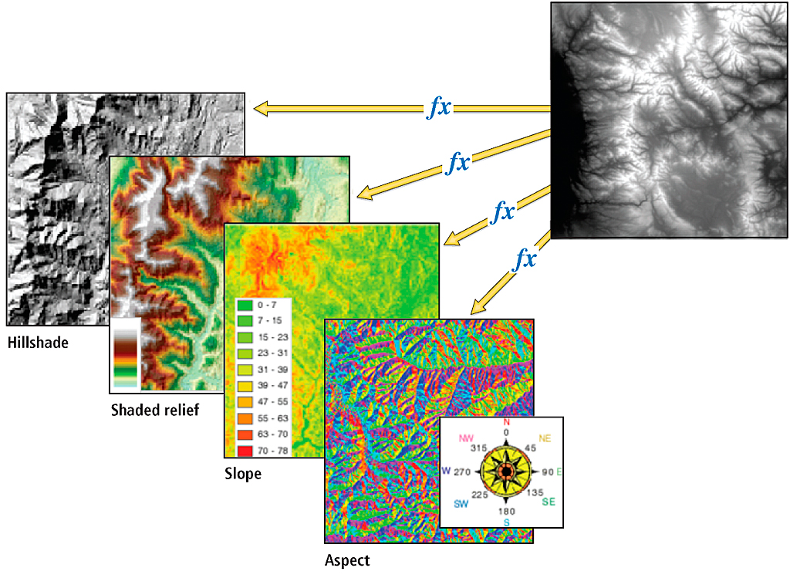
Multiband raster from topography

Slide 11
Random forest classification in R
Model uses the multiband raster values selected within the training plots
These values are used to create a random forest which can make predicitions
These extrapolated values are mapped using the rest of the raster data
These values are then used to classify the landscape

Slide 12
Steps to get the final classes…

Slide 13
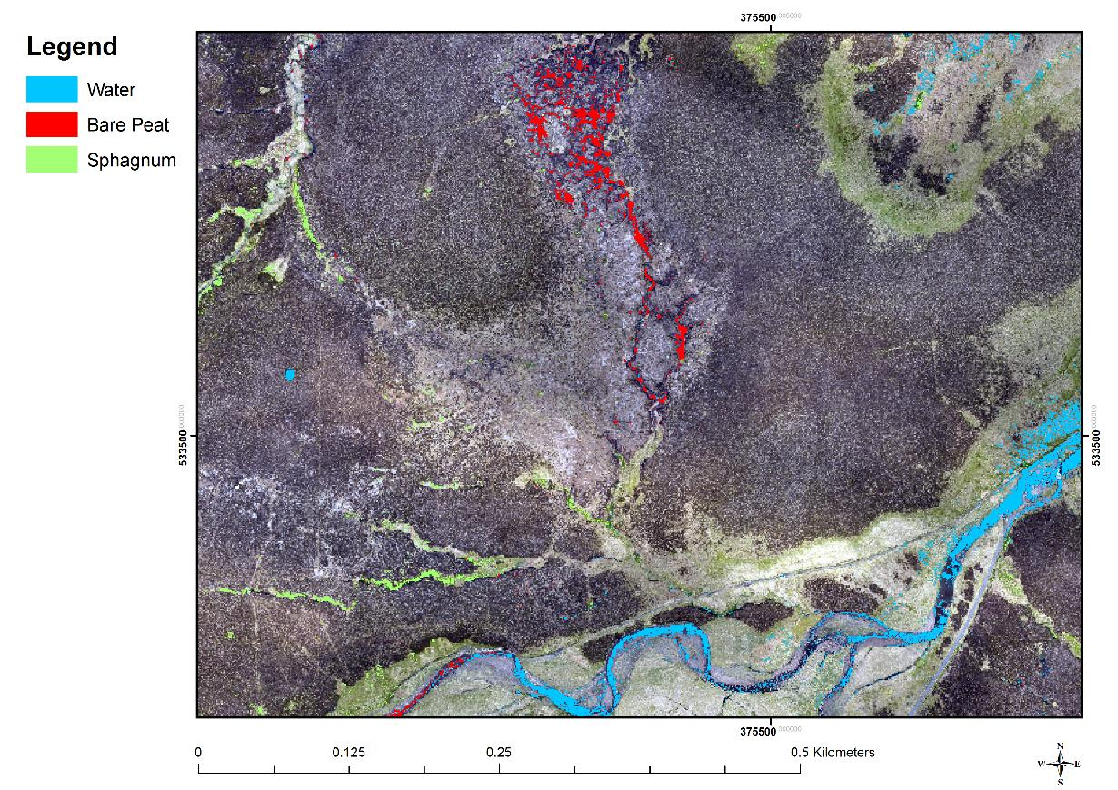
Final Classification

Slide 14
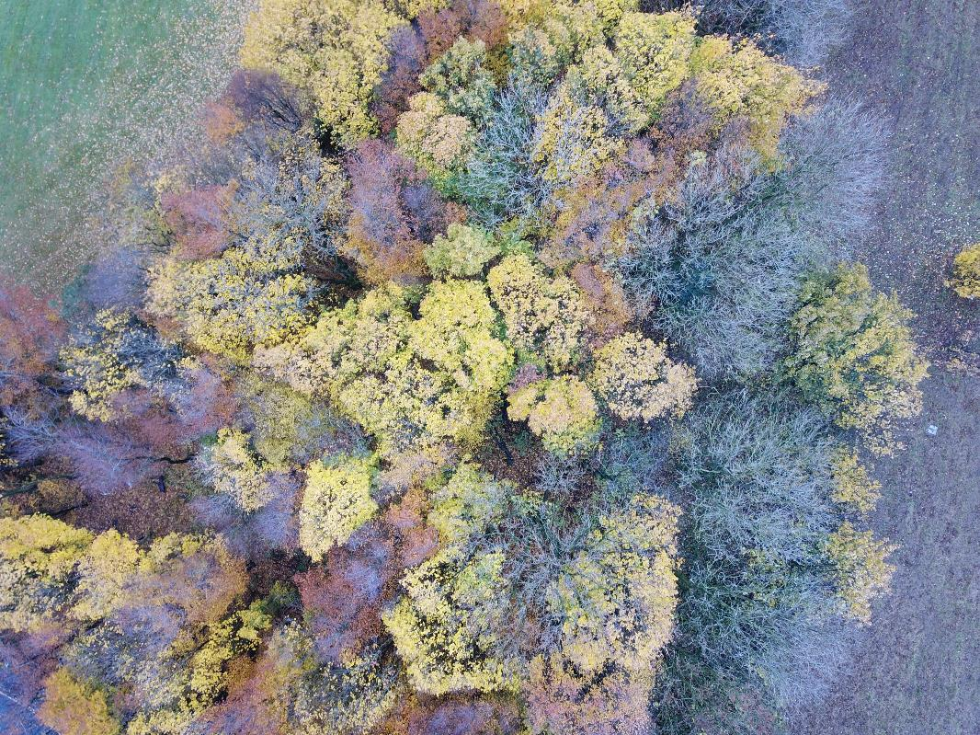
Forest Canopy Classification

Slide 15
Point cloud used to generate CHM
Canopy segmentation
Tree top ID
Heights, and crown width
Useful for habitat quality analysis

Slide 16
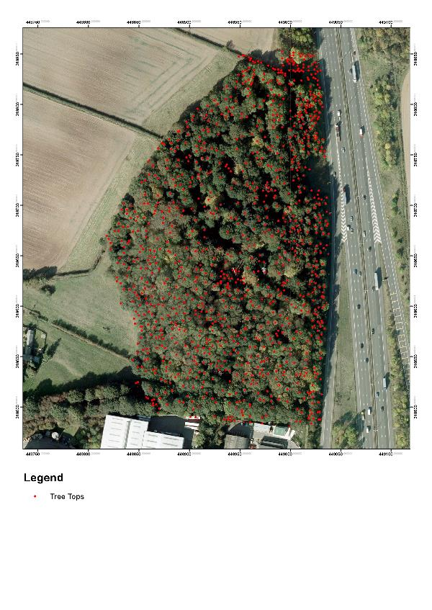
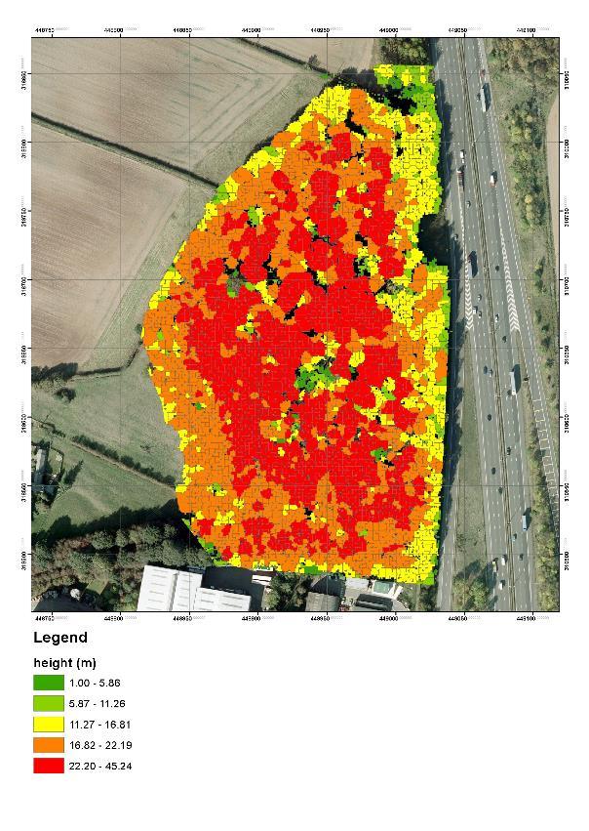
Comparable with LIDAR point clouds

Slide 17
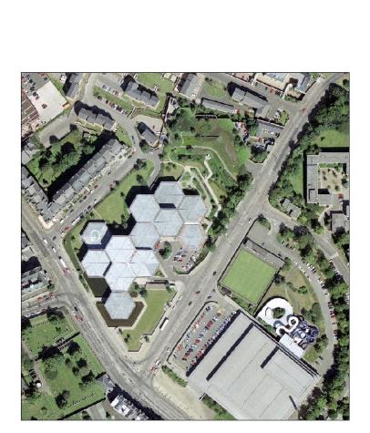
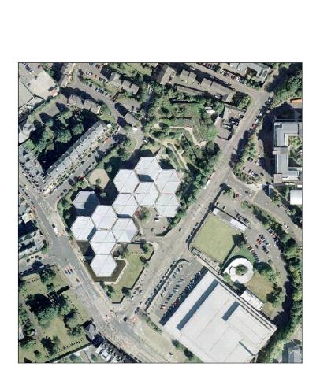
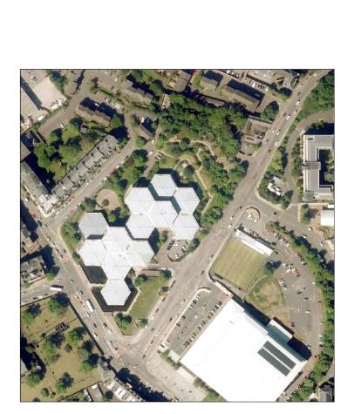
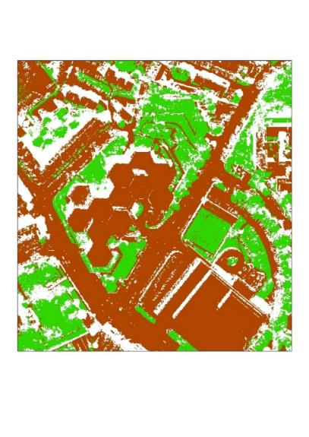
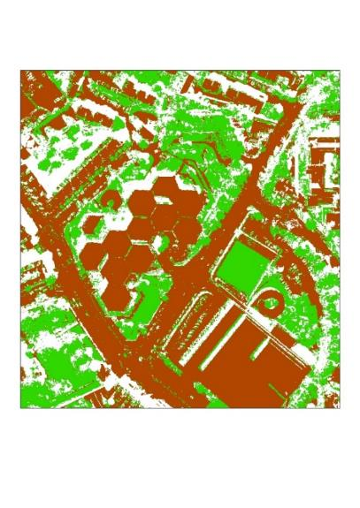
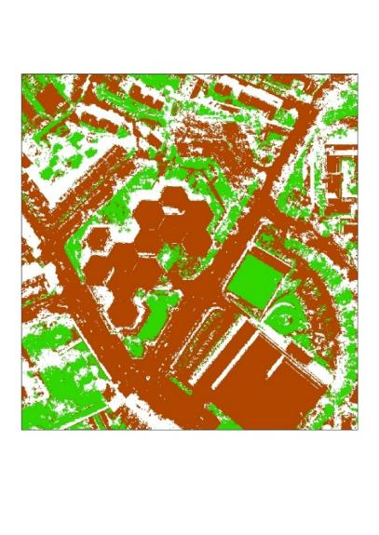
Image classification of Edinburgh
1990
2005
2015

Slide 18
Survey Development
Aber, Wales - Ground truthed data available

Slide 19
Survey Development – Sandscale Hawes

Slide 20
Survey Development Dengie NNR
Infra Red map Salt marsh vegetation

Slide 22
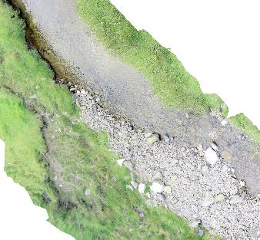
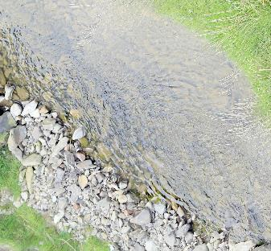
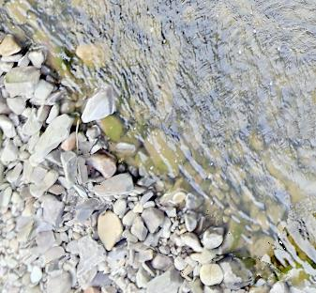
Don’t always need a UAV…
300 images taken at 2 second intervals using a Canon 6D with GPS Sub-cm resolution

Slide 23
FUTURE MONITORING NEEDS
Atmospheric trace gases in tree canopies
Air temperatures, wet bulb temperatures, meteorology – can be repeated unlike sondes
Bats calls are ultrasonic and can be detected spatially
Canopy dimensions and tree species identification
Crop disease and crop nutrient status

Slide 24
FUTURE SENSORS
Hyperspectral cameras are getting lighter
LIDAR systems now ready for UAV applciations
Infra red and UV cameras for animal behaviour studies
Wireless sensors for data transfer from remote sensors
Real time machine vision systems for object identification
Integrated systems / multi sensor platforms

Slide 25
FUTURE PLATFORMS
Swarms of monitoring devices
Integration with cloud processing
Low power and sustainable systems
Autonomous systems / artificial intelligence
Internet of things
Multi sensor platforms
Adaptive monitoring devices

Slide 26
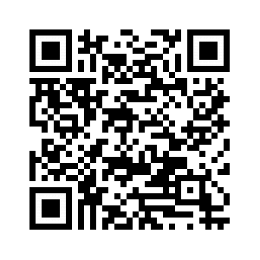
TRaining
Mapping with Drones – classification and data fusion course
17 - 18 July 2019.
CEH Wallingford, Maclean Building, Benson Lane Crowmarsh Gifford Wallingford Oxfordshire OX10 8BB

Slide 27
classification and data course
Gain skills to create high quality and spatially accurate habitat classification maps from data you have captured using your UAV platform.
Learn how to process these data to map the heights and locations of trees and vegetation or other features
Learn how to bring together the data collected by your aircraft into a spatially accurate and informative map suitable for mapping habitats and change.

Slide 28
Thankyou !!

