Slide 1
SEPA’s use of drones
Kirsten Davidson
kirsten.davidson@sepa.org.uk
sepa.uav@sepa.org.uk

Slide 2
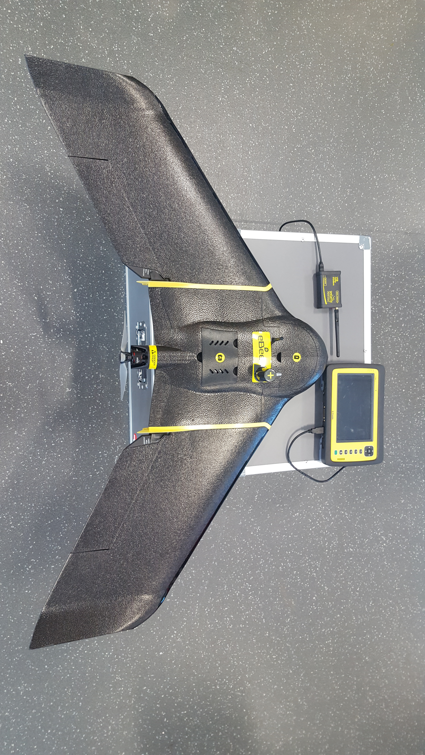
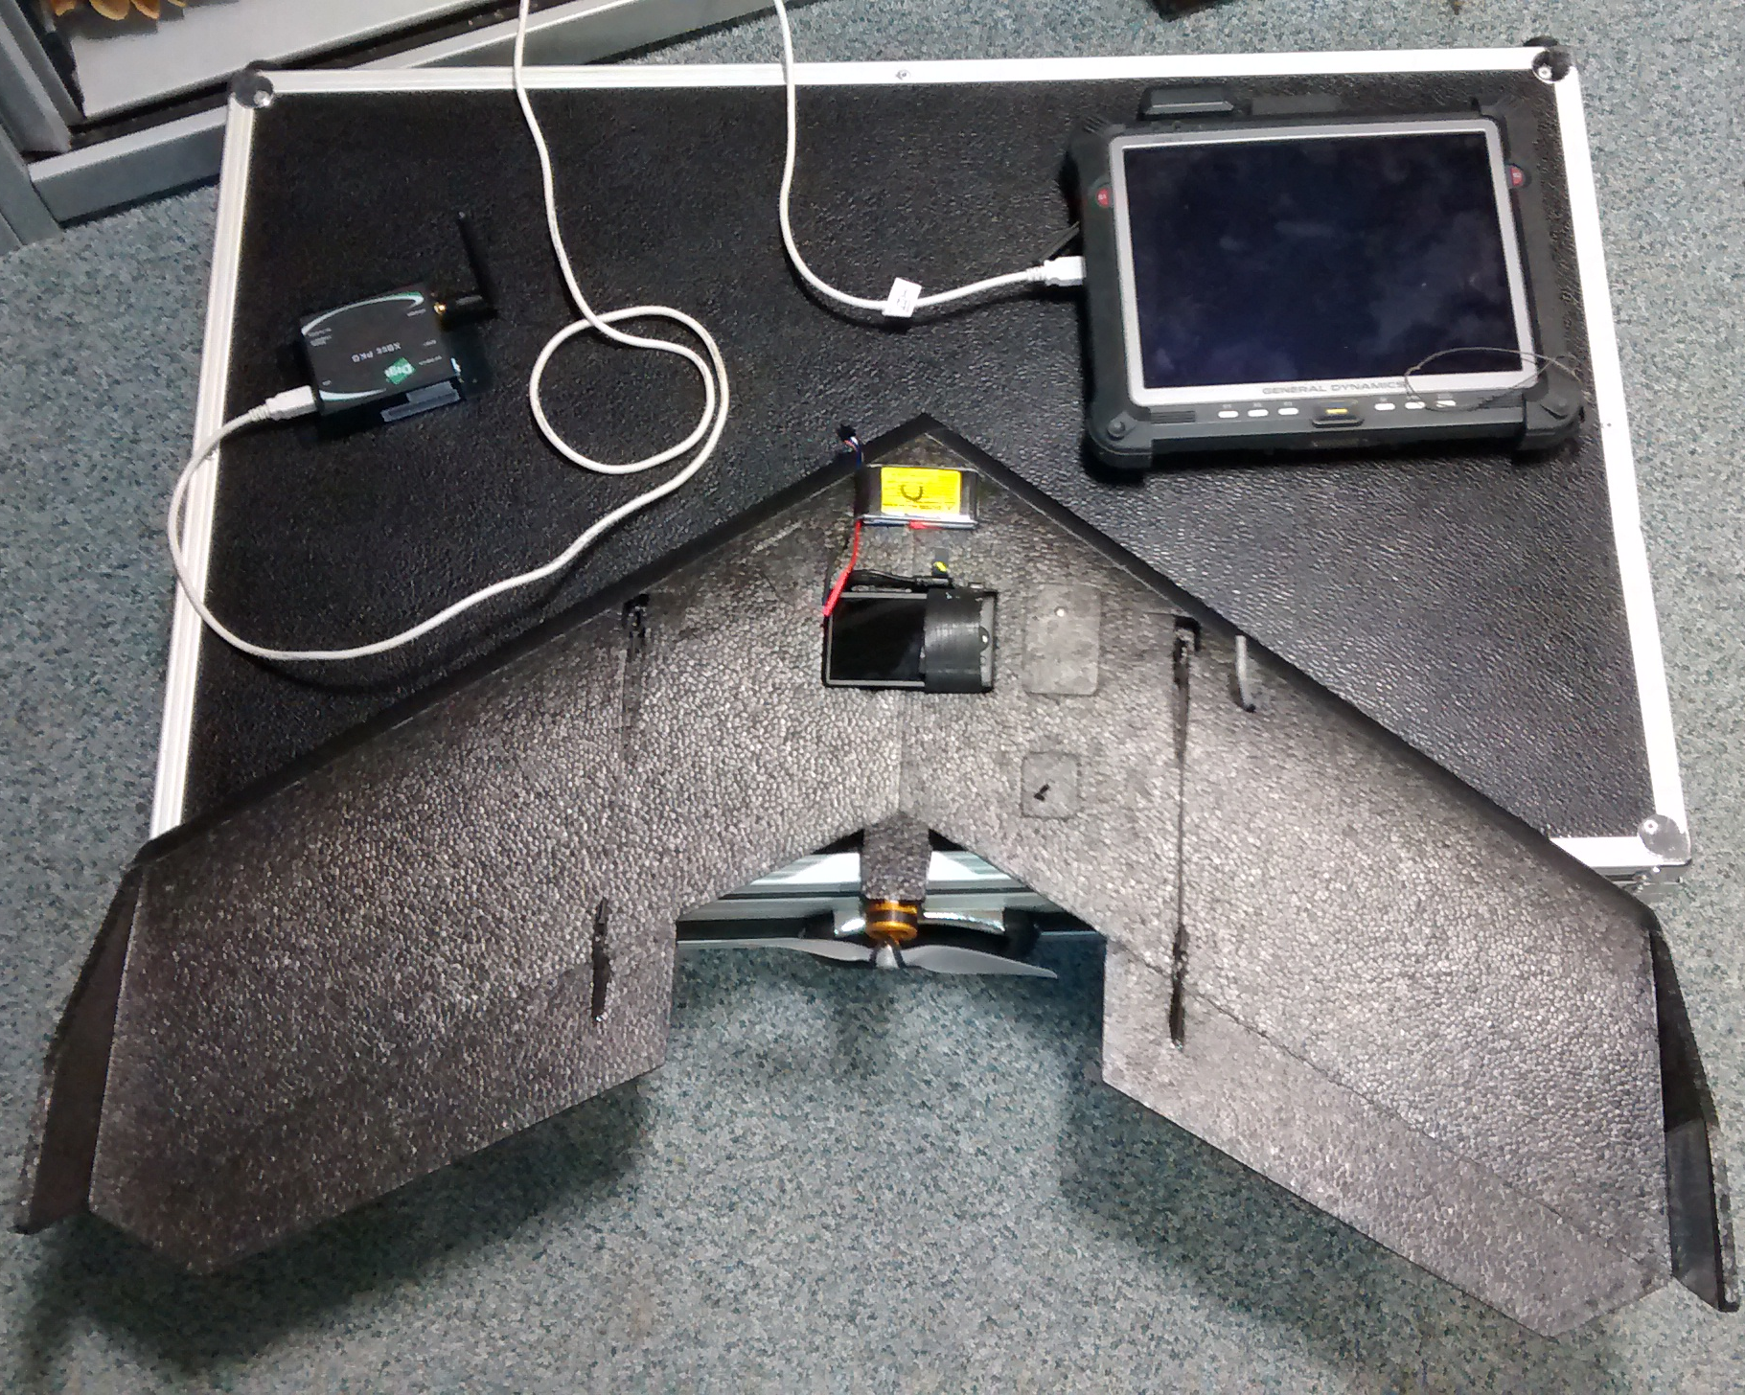
SEPA’s drones
Fixed wing
Sensefly
SwingletCAM
RGB camera
NIR camera
Sensefly eBEE+
S.O.D.A sensor

Slide 3
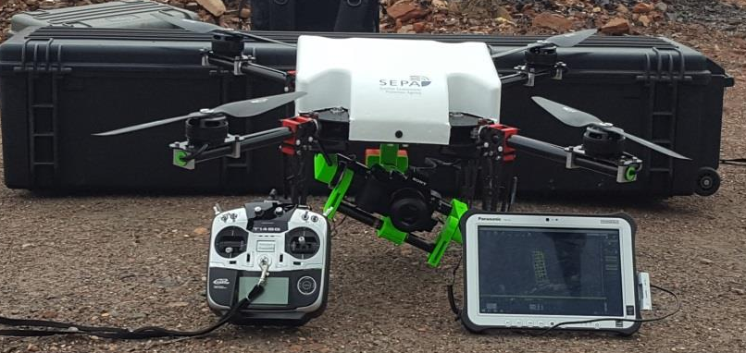
SEPA’s drones
Multi-Rotor
Custom built Quad-Copter airframe
True colour camera
stills + video
Multi-spectral camera

Slide 4
Background / History
Fixed wing
Started as a 2-pilot flight team, 2012
4 additional pilots qualified, 2016
New eBEE+ bought summer 2018
Multi-Rotor
1 qualified pilot, 2016
3 additional pilots qualified, 2018
Completed over
17 hours SwingletCAM flights
13 hours Quad-Copter flights
30 minutes eBEE+ flights (in development)

Slide 5
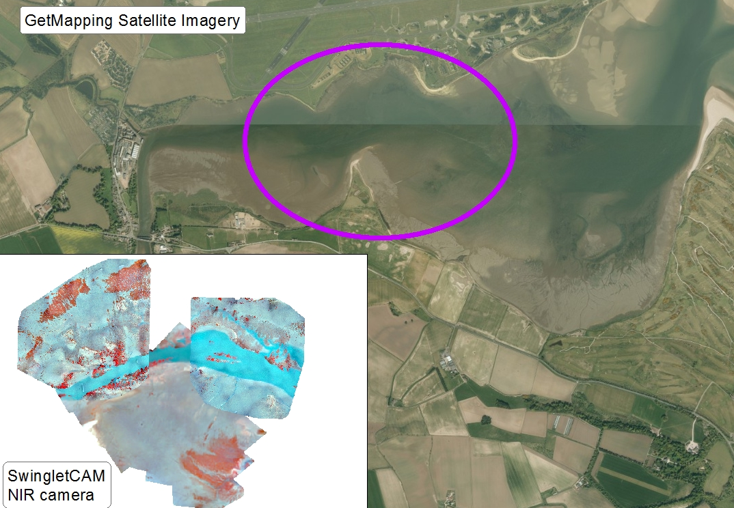
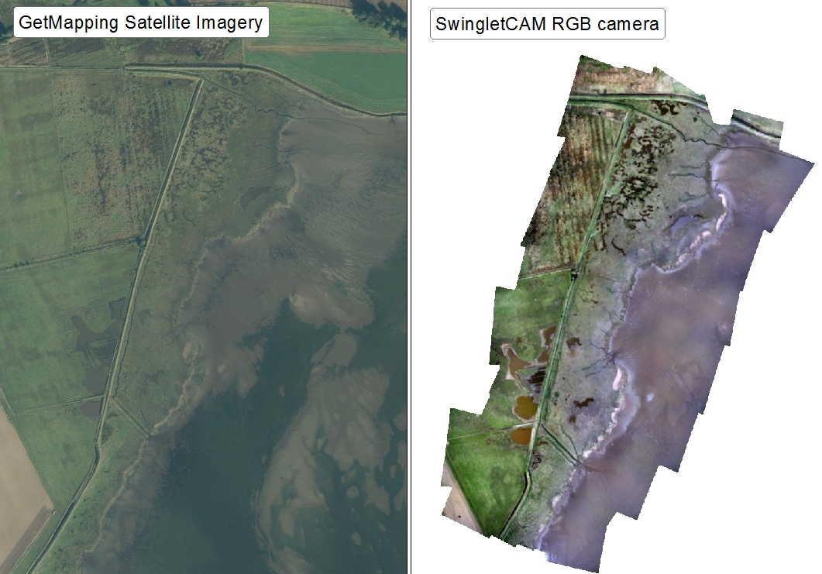
Marine Monitoring

Slide 6
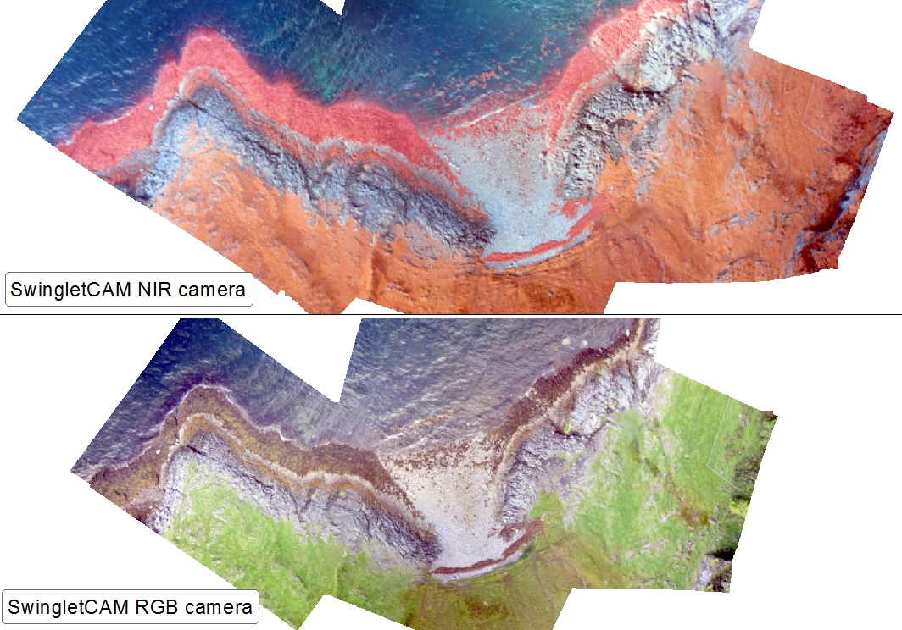
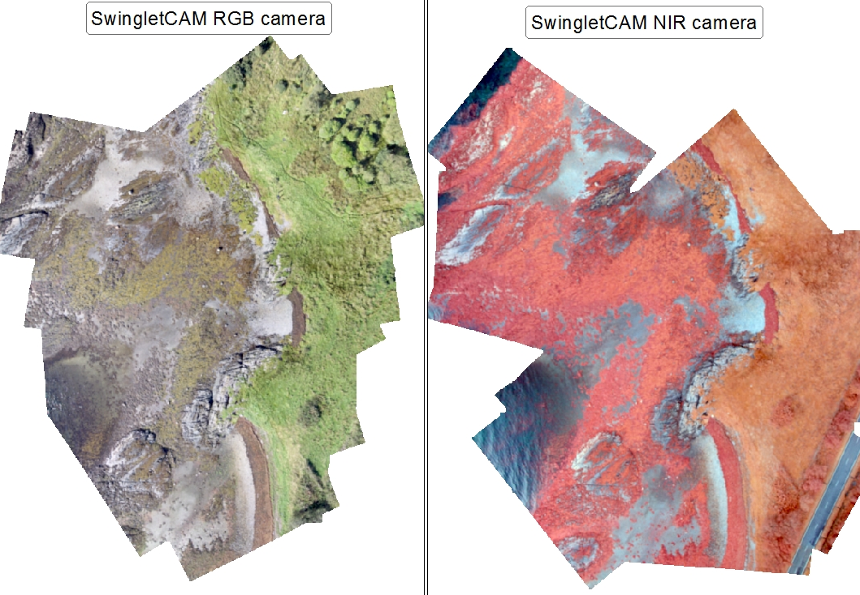
Marine Monitoring

Slide 7
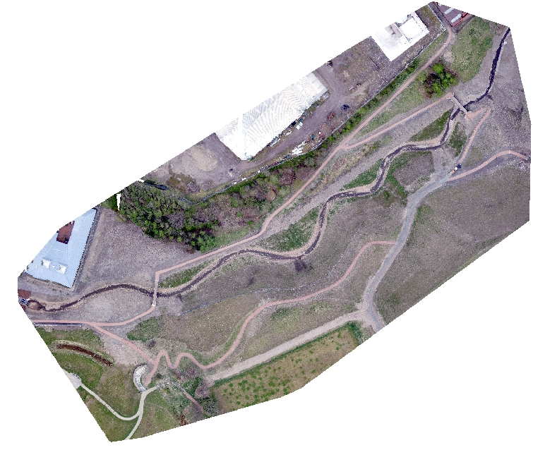
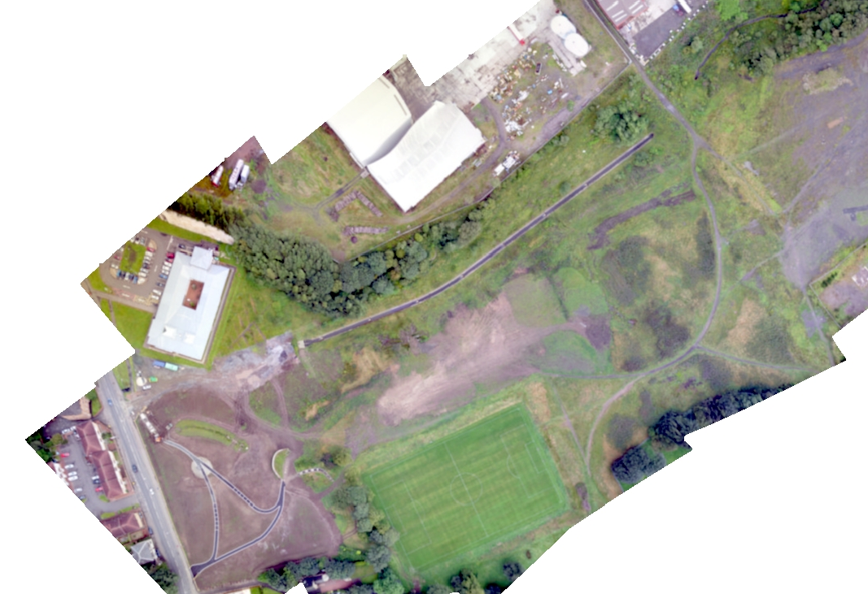
River Restoration Projects
Pre-works,
2014
Post-works,
2017

Slide 8
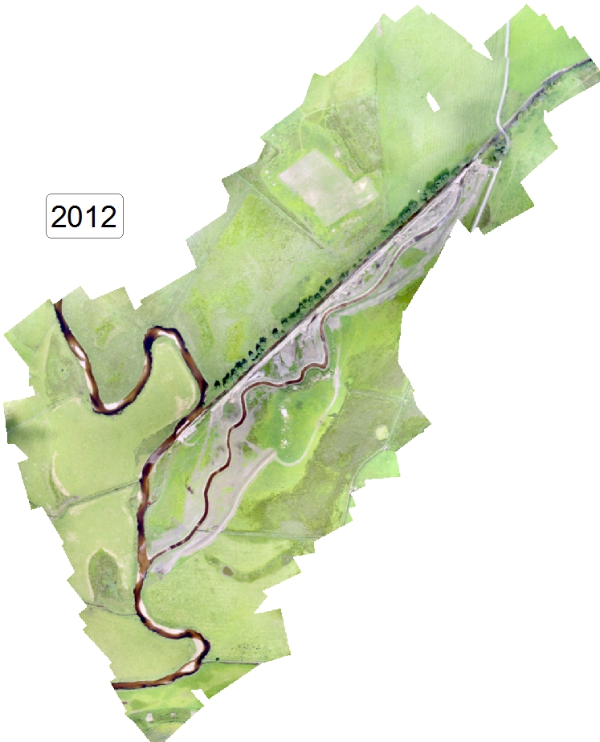
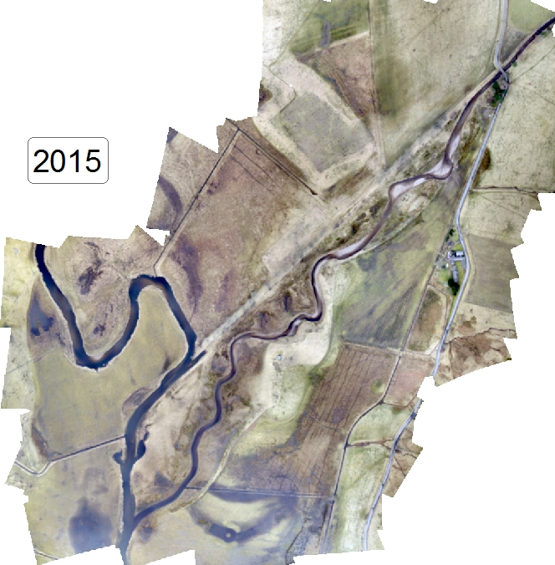
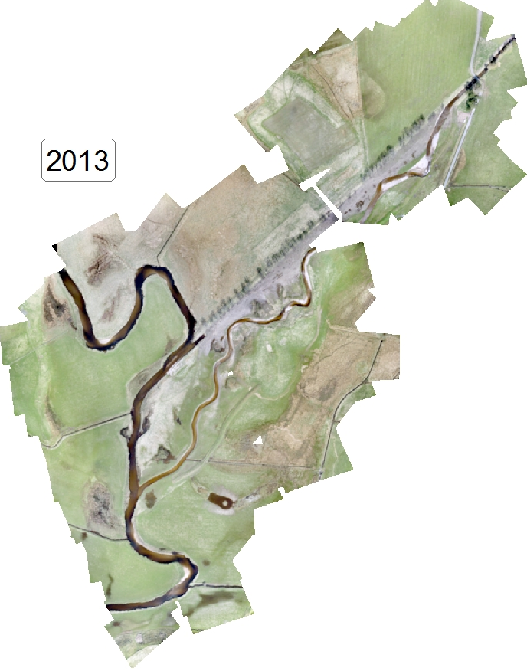
River Restoration Projects

Slide 9
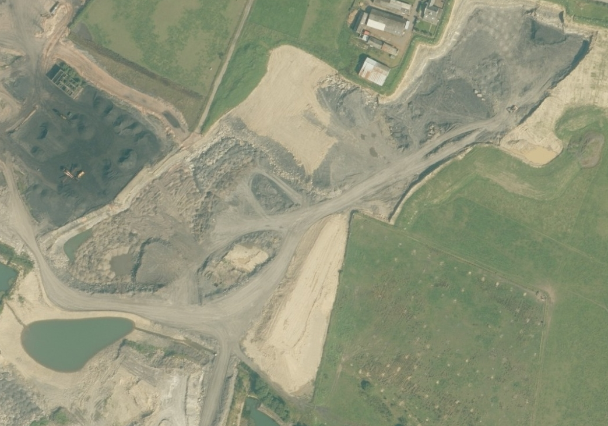
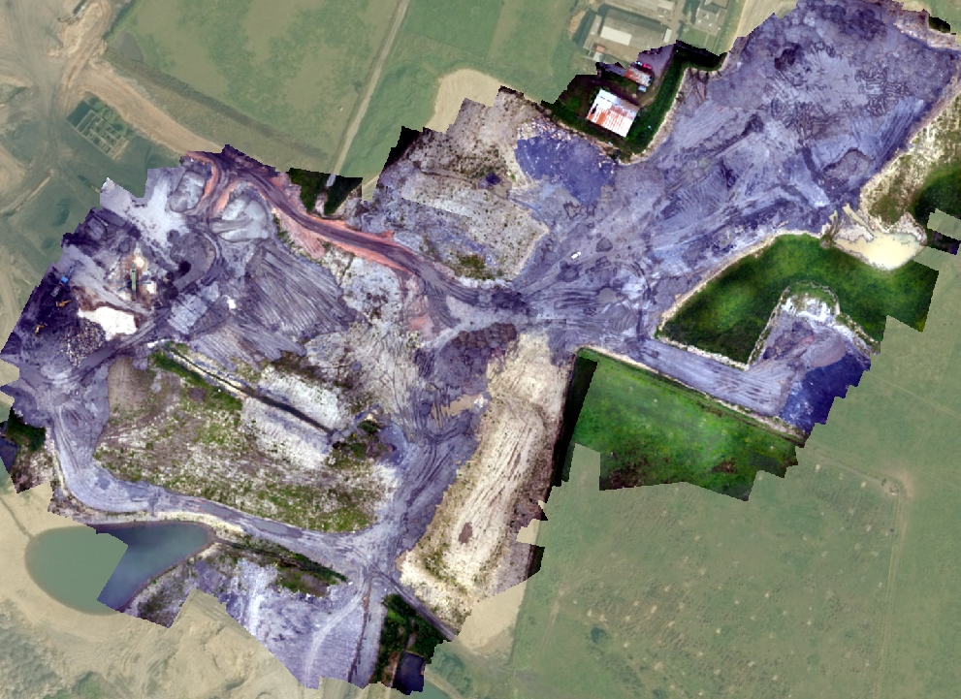
Site Investigations
Colliery works

Slide 10
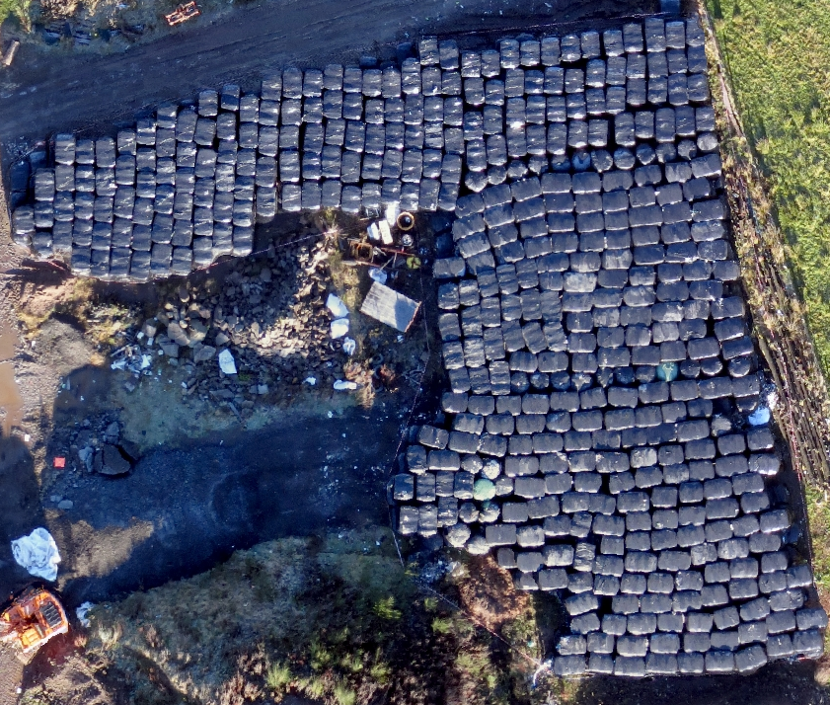
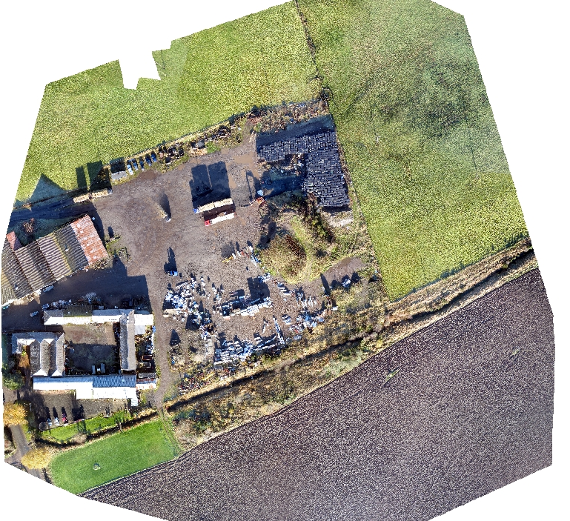
Site Investigations
Waste

Slide 11
Thank you ☺
Kirsten Davidson
kirsten.davidson@sepa.org.uk
sepa.uav@sepa.org.uk

