Slide 1
Overview of drone usage by Natural Resources Wales
Helena Sykes
Senior Remote Sensing Specialist
helena.sykes@naturalresourceswales.gov.uk

Slide 2
Introducing Natural Resources Wales
Formed April 1st 2013
      Countryside Council for Wales (CCW)
      Environment Agency Wales (EAW)
      Forestry Commission Wales (FCW)
      some functions of Welsh Government
April 2015
      Internal Drainage Boards (IDBs)
    Largest Welsh Government sponsored body, ~1900 staff
    Our purpose is to make sure that the environment and natural resources of Wales are sustainably maintained, sustainably enhanced and sustainably used, now and in the future.

Slide 3
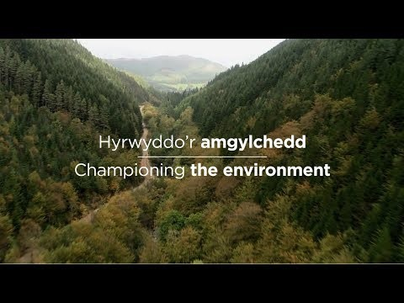

Slide 4
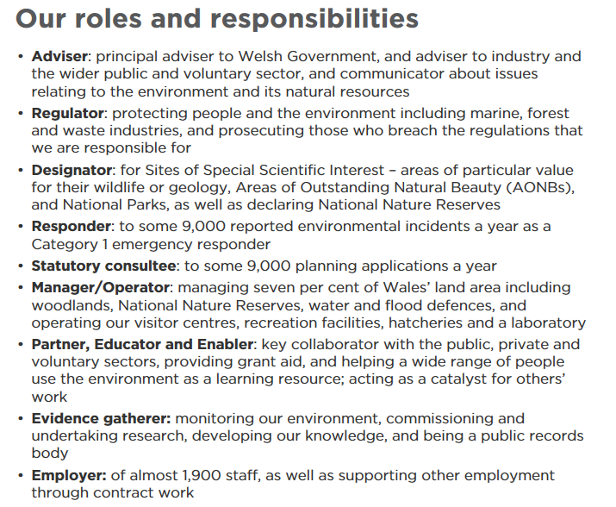

Slide 5
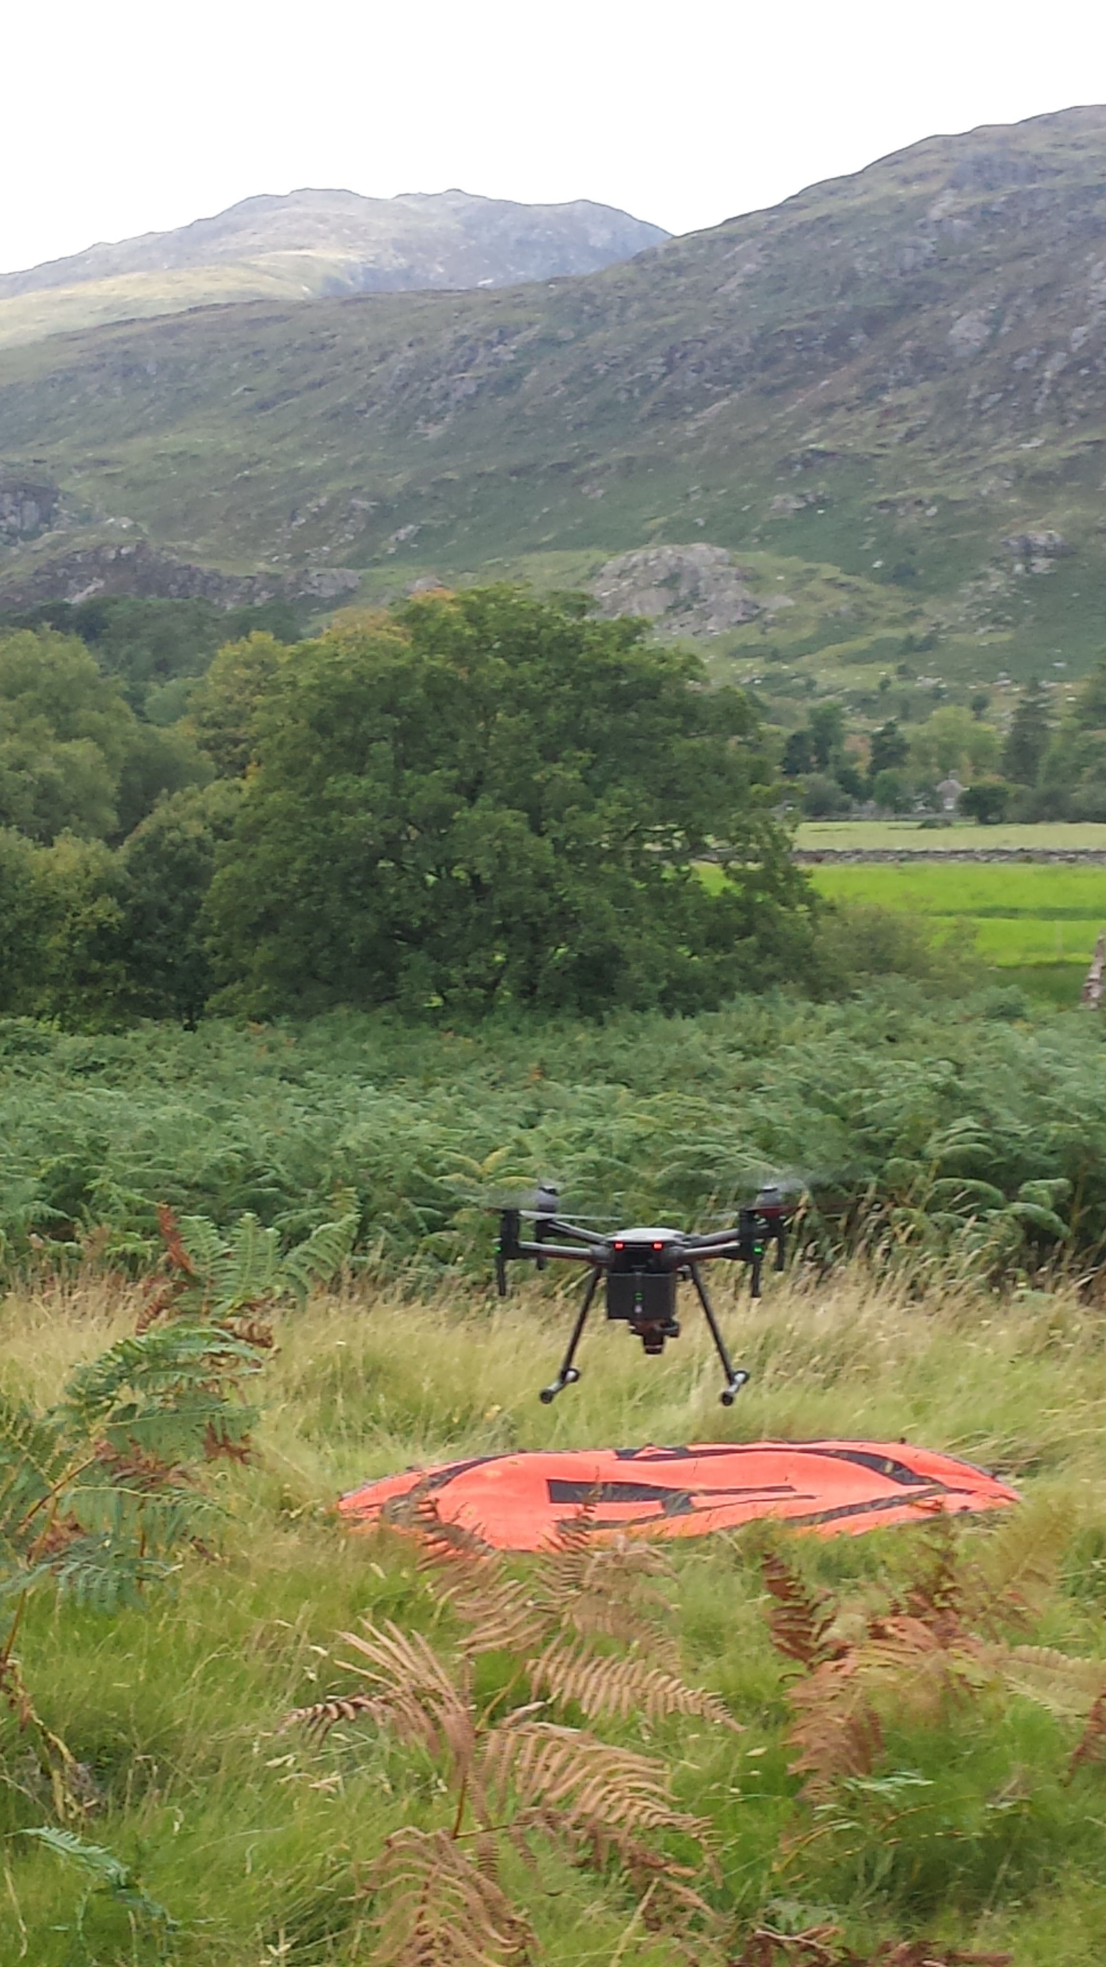
Internal drone use
5 pilots
    3 in North, 2 in South
4 drones
    Matrice 200, 2 DJI Mavic Air, DJI Phantom 3
16 trained visual observers (VOs)

Slide 6
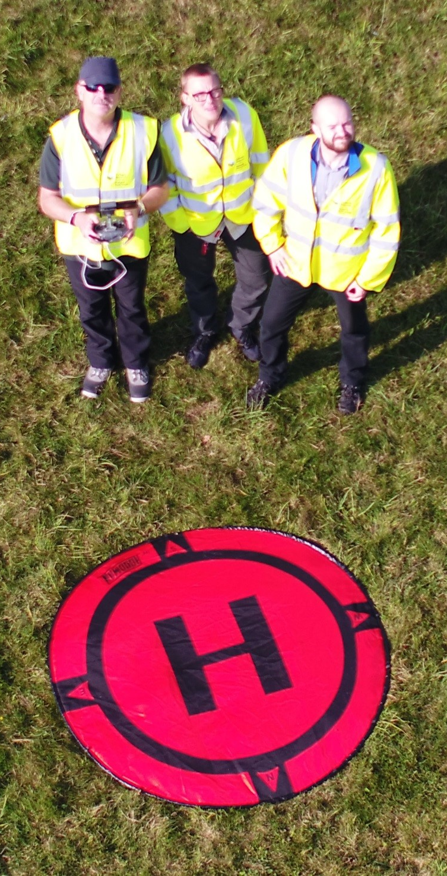
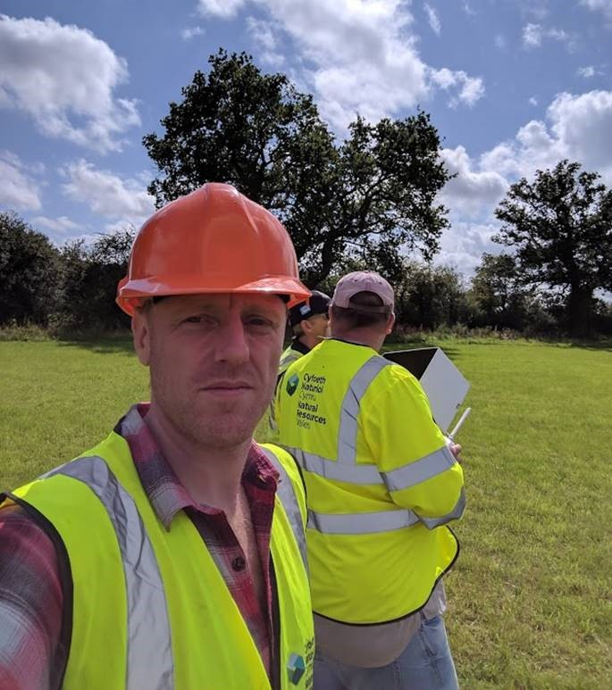
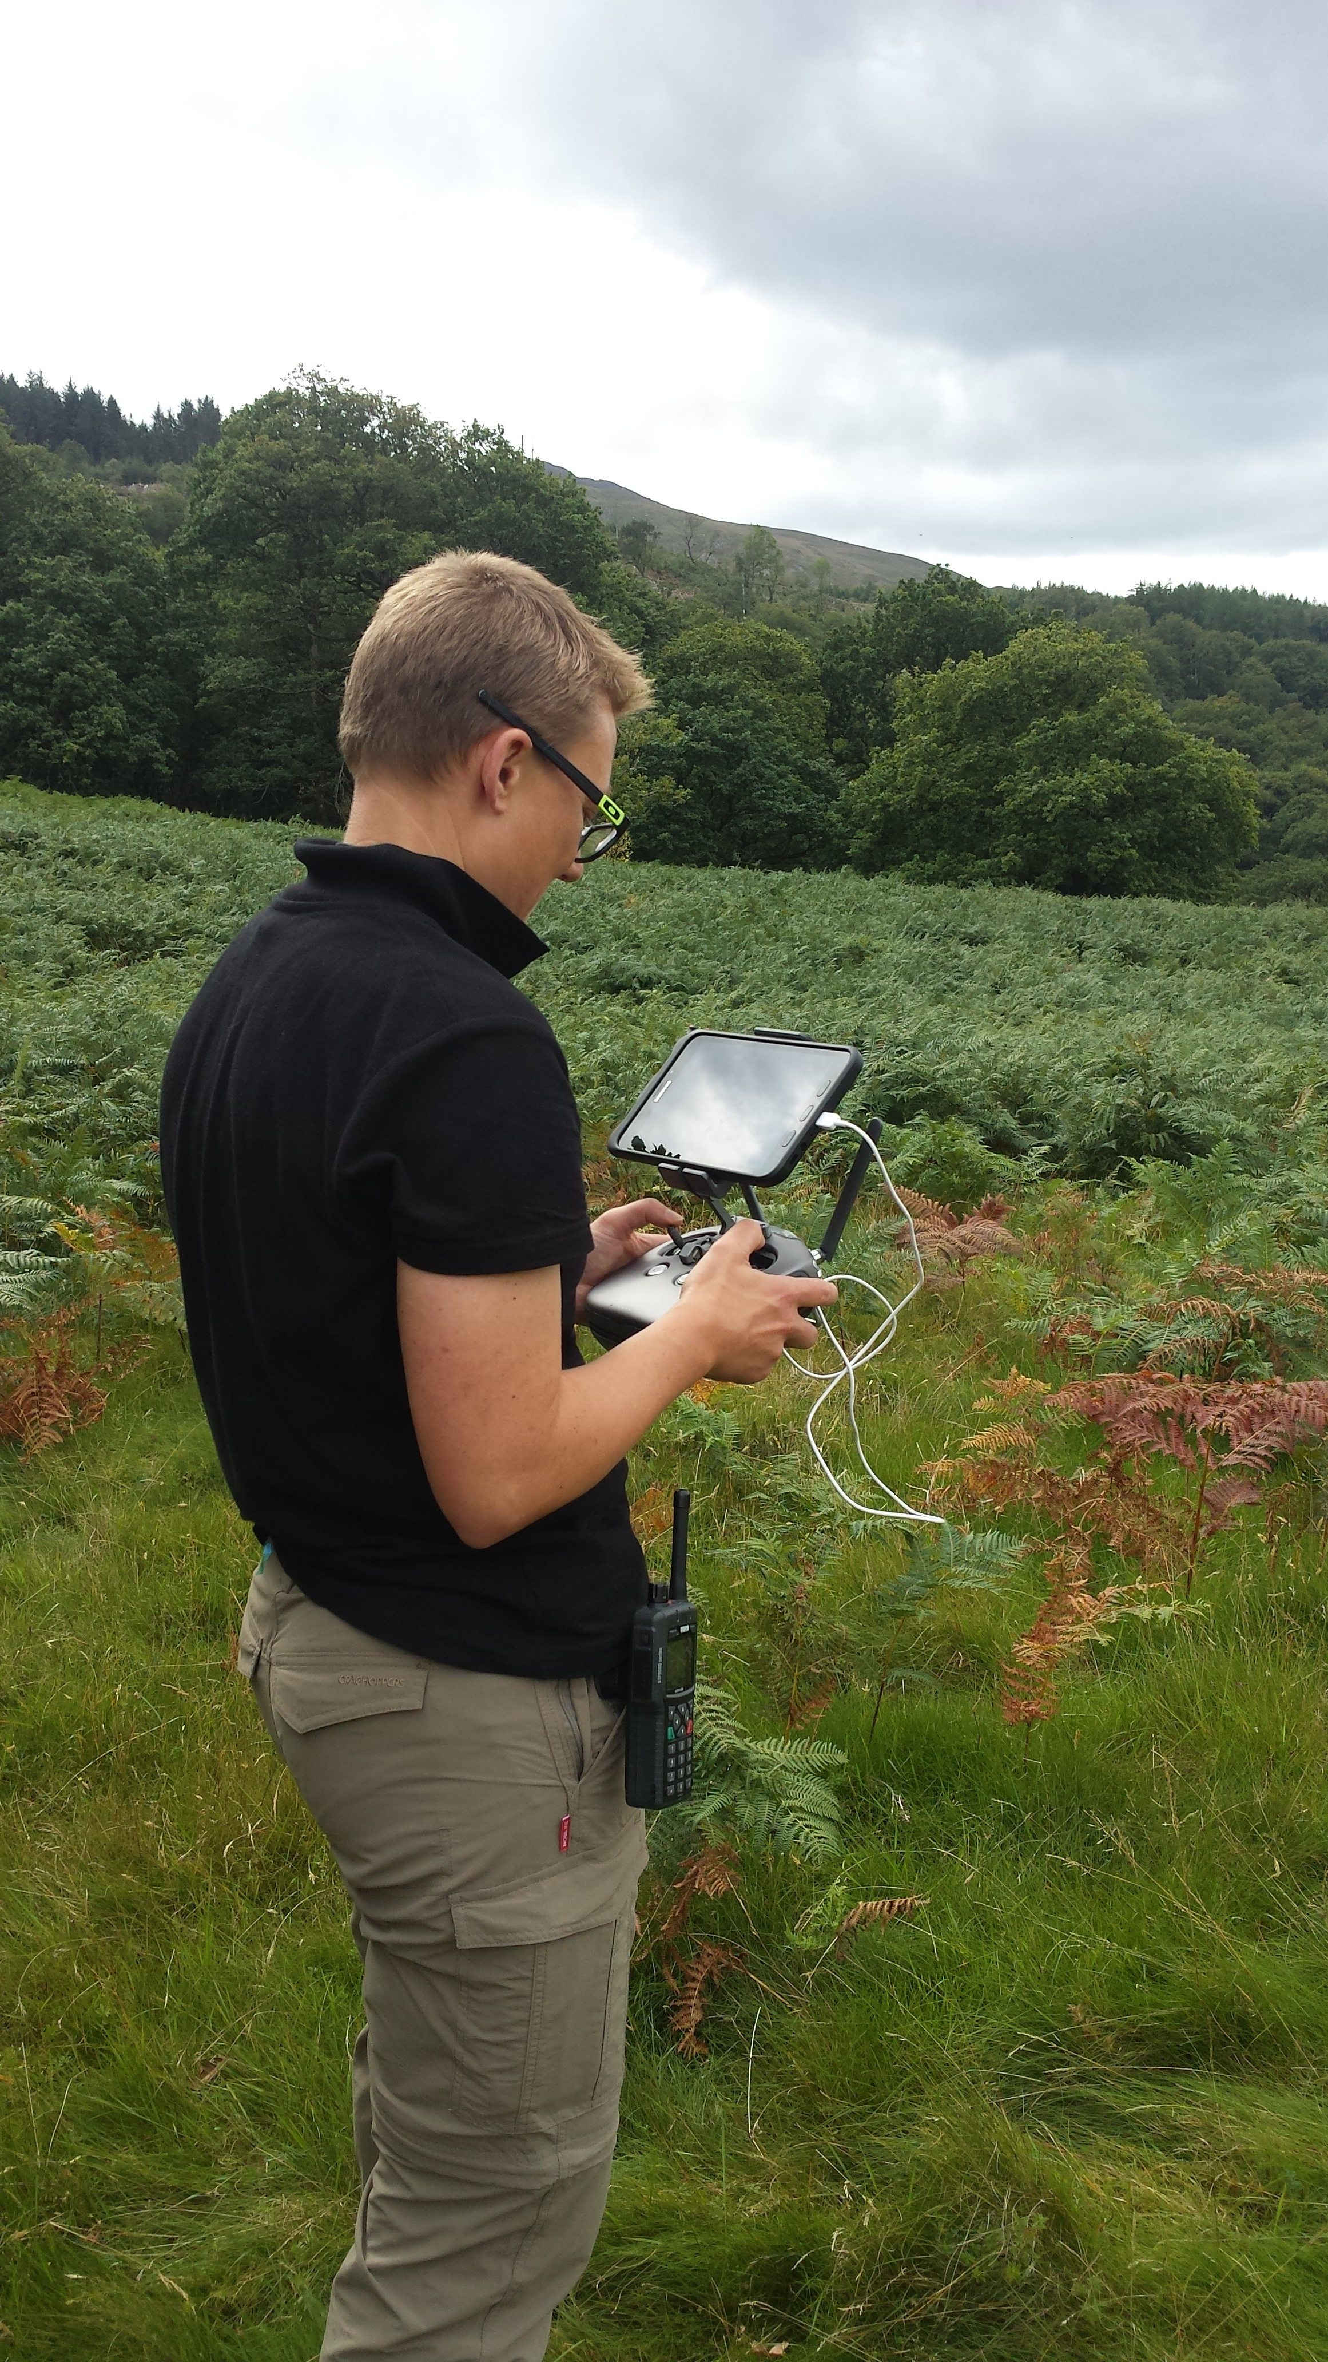
#TeamNRW
Drone Team

Slide 7

Llantysilio Mountain Fire

Slide 8
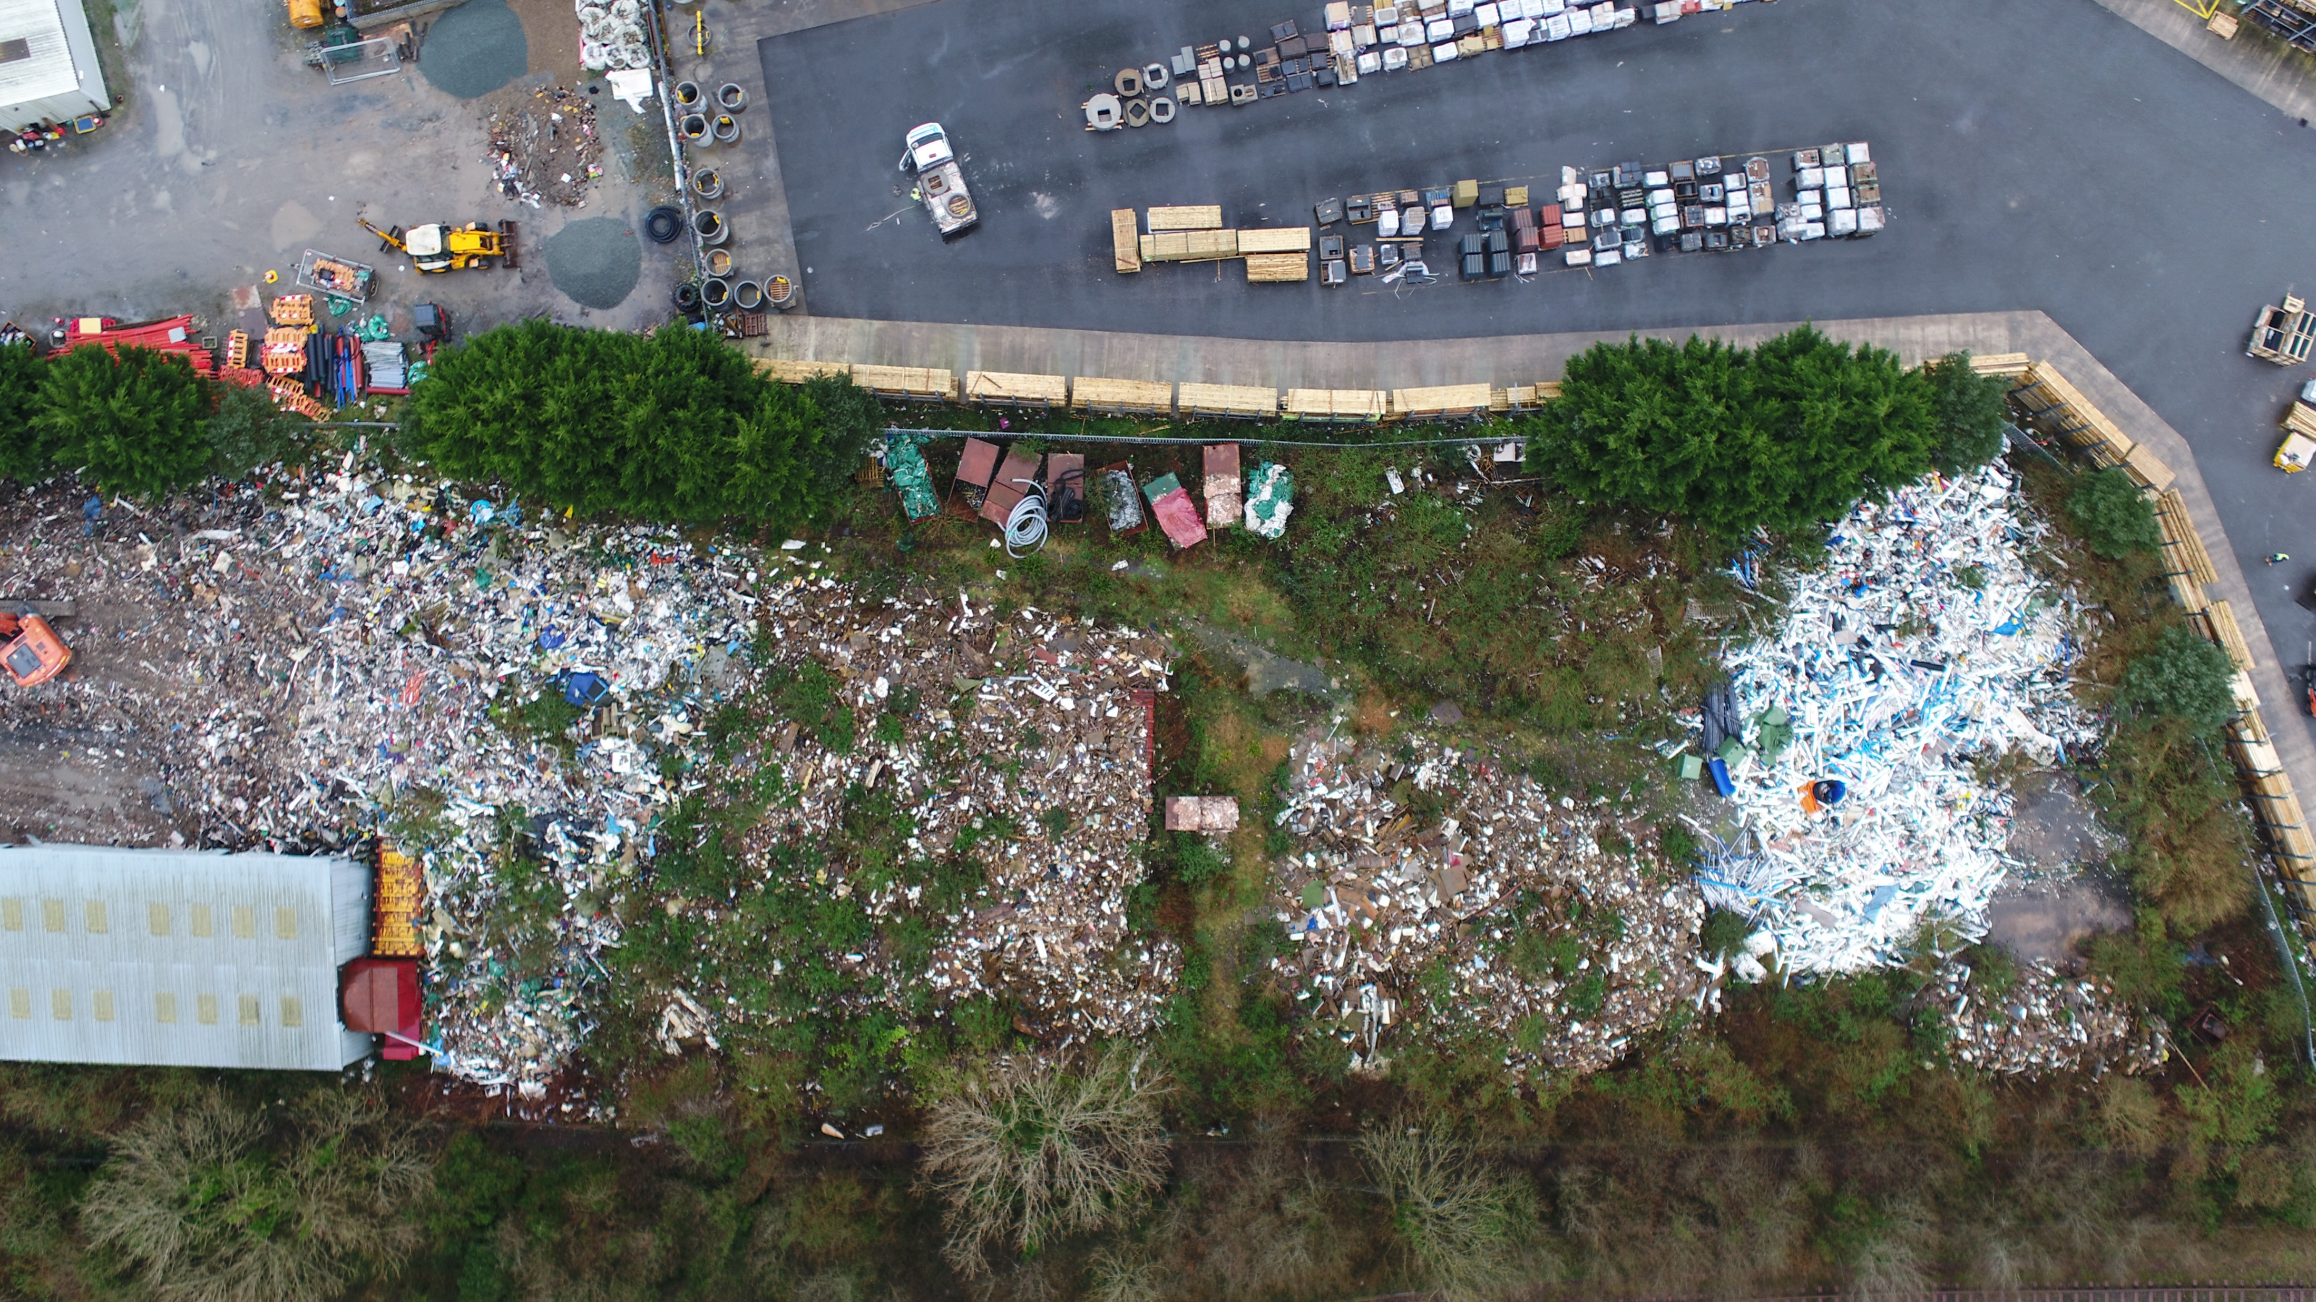
Waste Crime

Slide 9
National Nature Reserves (NNRs)
NRW website – days out pages
https://www.naturalresources.wales/days-out/places-to-visit/south-east-wales/craig-cerrig-gleisiad-nnr/?lang=en
Web app - 360s
Craig Cerrid Glesisad, Ogof ffynon Ddu, Oxwich and Whitford - intention is to collect more over time

Slide 10
Craig Cerrid Glesisad

Slide 11
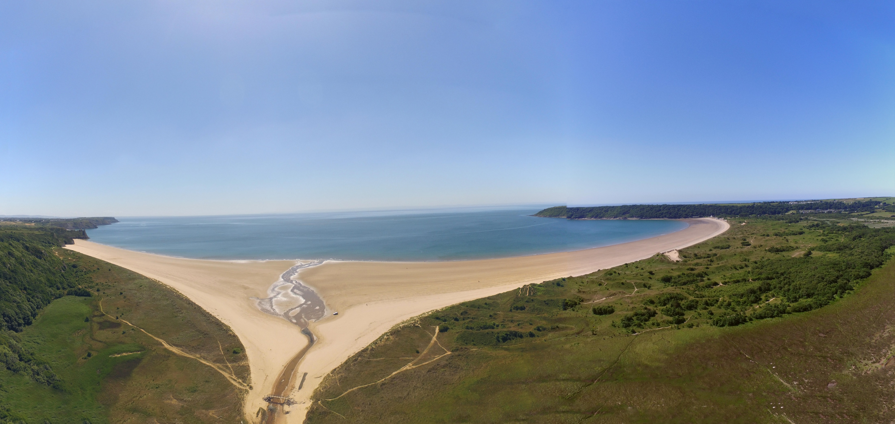
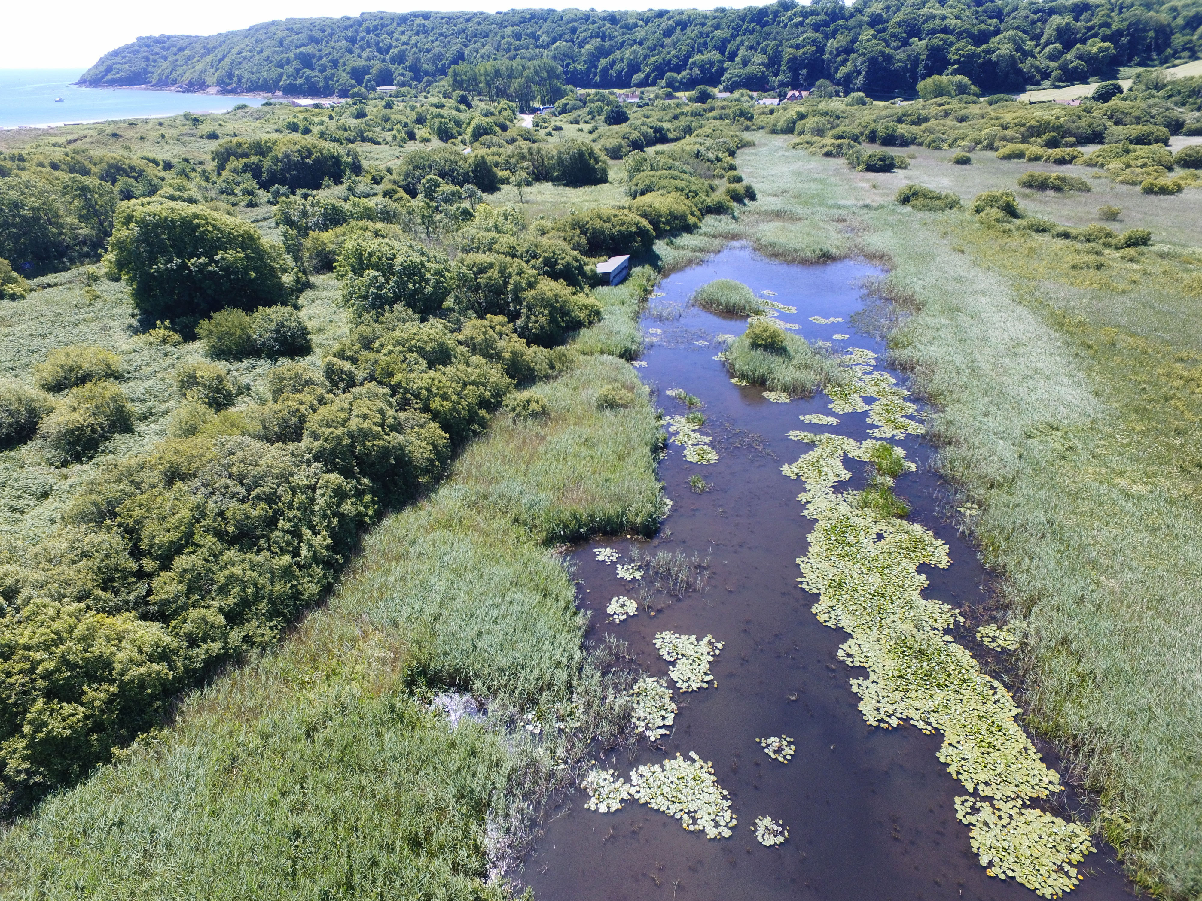

Slide 12
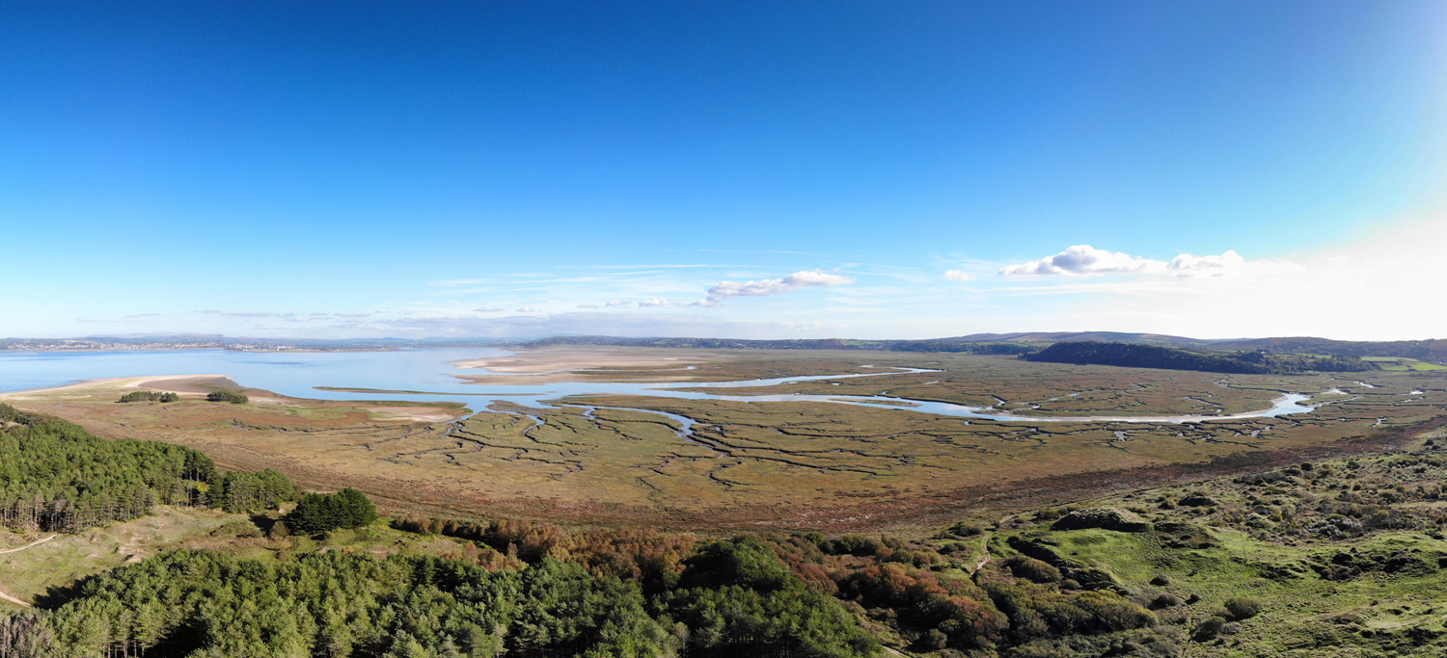

Slide 13
Partnerships
Projects - with academia, other public bodies
Framework contract - contract drone work out to external suppliers
Incidents and emergencies – e.g. Local Resilience Forums
- use of Mid and West Wales Fire and Rescue Service drones

Slide 14




The future?
Contact us
www.cyfoethnaturiol.cymru
www.naturalresources.wales
enquiries@naturalresourceswales.gov.uk
0300 065 3000 (Mon-Fri, 9am-5pm)

