Slide 1
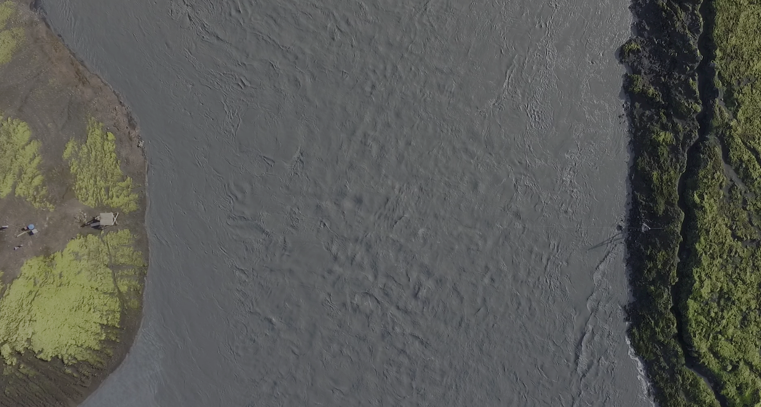
Flood measurements:
Evolution of methods
From Floaters to Drones
& Citizens with Phones
Nick Everard: Environment Agency
ShARE Drones Workshop
January 29th, 2019

Slide 2
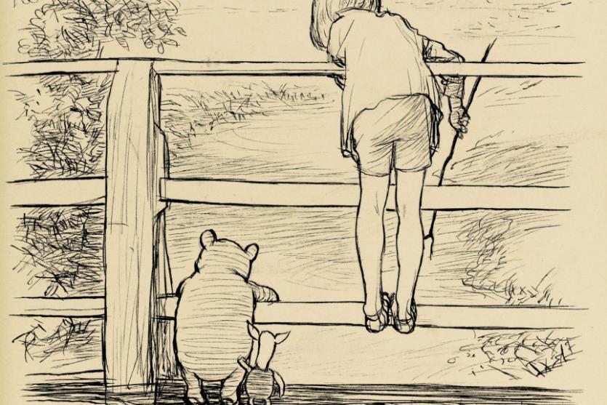
In which Pooh Bear & Piglet solve flooding
(buy a drone and)
[or at least make significant advances in flood quantification techniques]
(With thanks to AA Milne)
Nick Everard: Environment Agency
ShARE Drones Workshop
January 29th, 2019

Slide 3
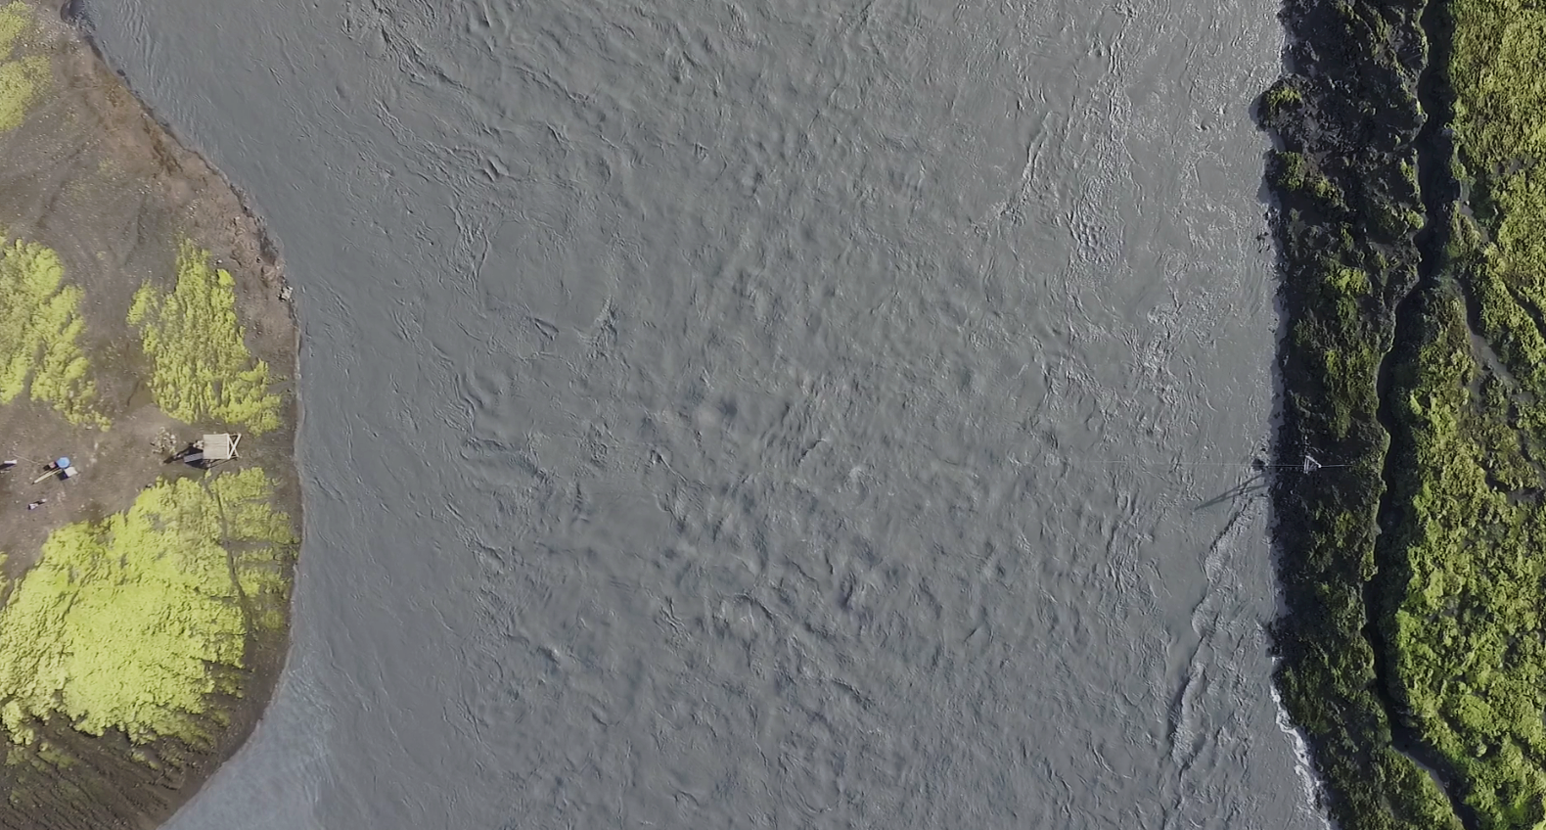
Floods!
Boats!!
Cameras!!
Bears!!
Tech!!!
Collaboration!!!!

Slide 4
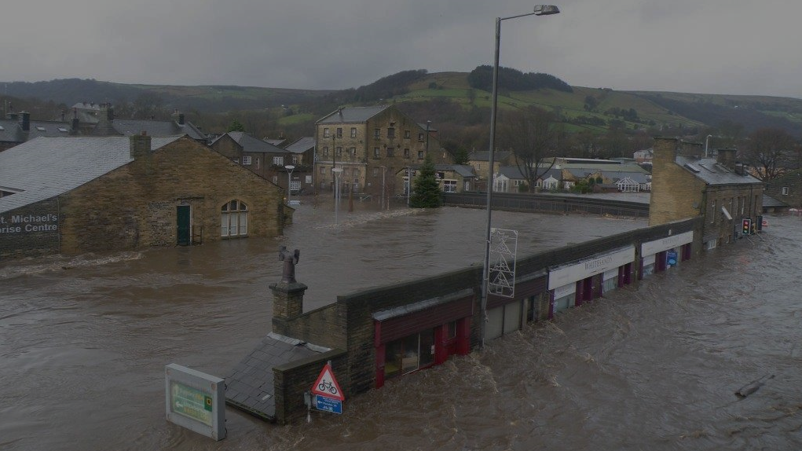
bad
Floods are
They impact:
Homes
Industry
Agriculture
Infrastrucure
People
Mytholmroyd, England, December 2015

Slide 5
Fluvial (river) flooding has the greatest impact of all forms of flooding in England.
{
Impacts of 3 recent flood events in England estimated at
£6.8bn
House of Commons Briefing Paper:
Flood Risk Management and Funding, November 2017
House of Commons Briefing Paper:
Flood Risk Management and Funding, November 2017

Slide 6
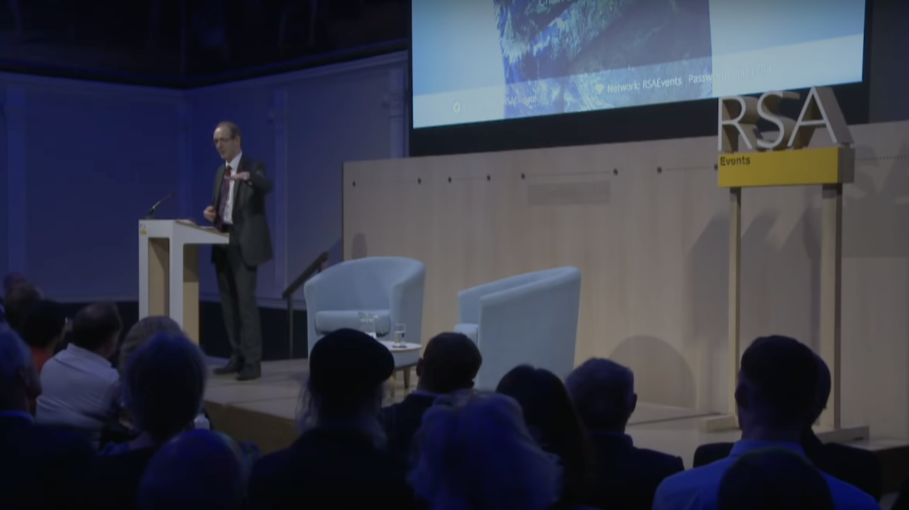
Climate change
“More floods,
Bigger floods,
More extreme rainfall”
(More low flow (drought) problems too)
EA Chief Exec, Sir James Bevan
Royal Society London, September 2018

Slide 7
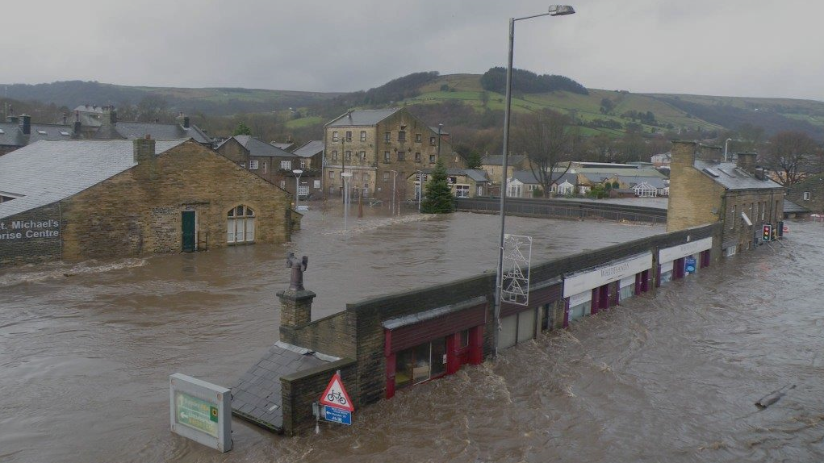
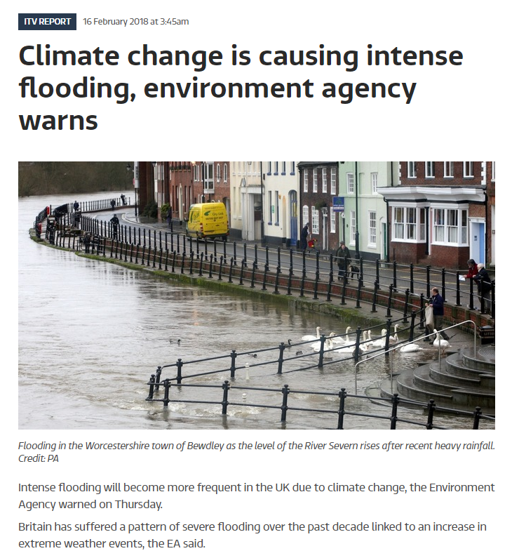
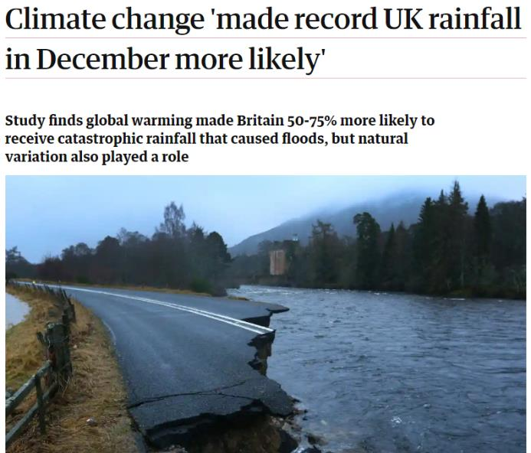
Climate change:
It’s already happening.
And will (probably) get worse.
than ever

Slide 8
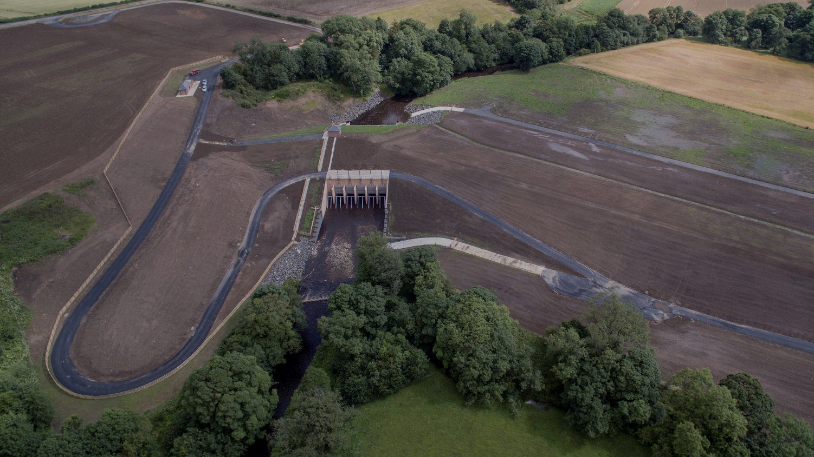
£27m
Morpeth flood scheme

Slide 9

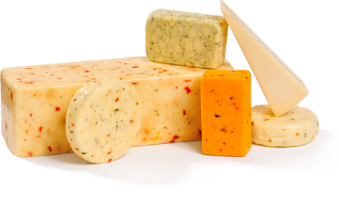
£2bn
Total UK festive cheese expenditure
Source: Arla dairies via BBC

Slide 10
74.07407
The number of Morpeth flood schemes we could build with annual Christmas cheese spend

Slide 11
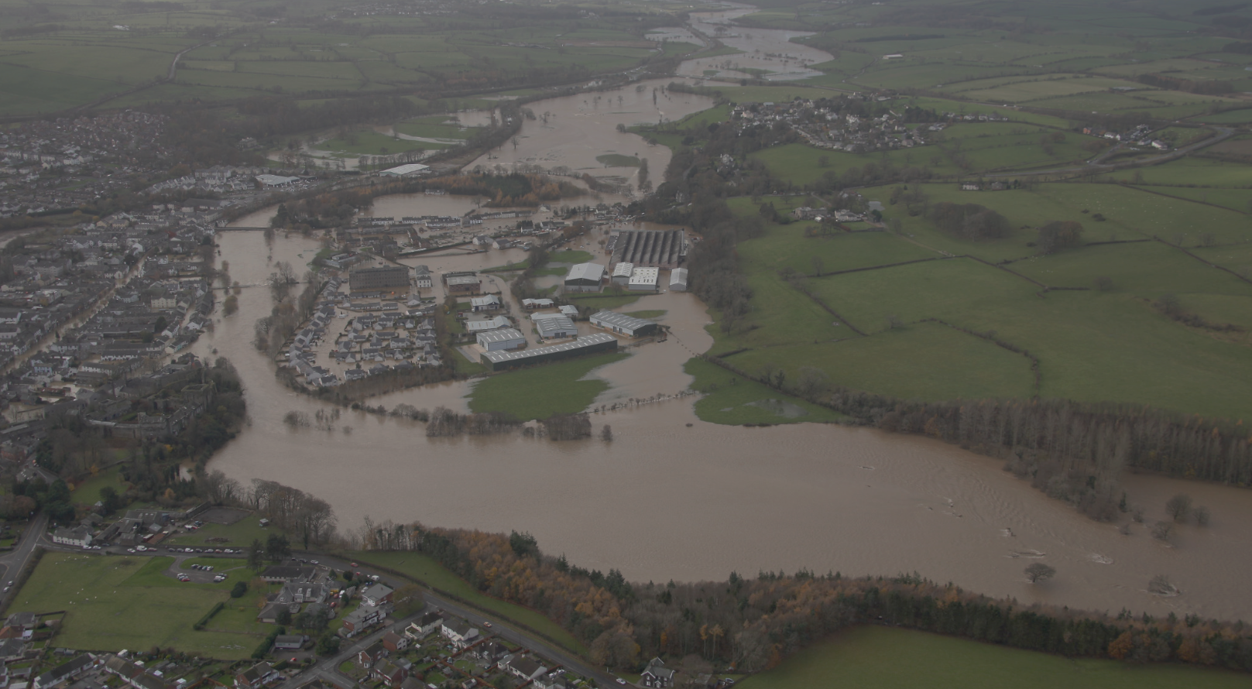
To forecast and manage floods…..
how much water
…we really need to know…..
…is there….

Slide 12
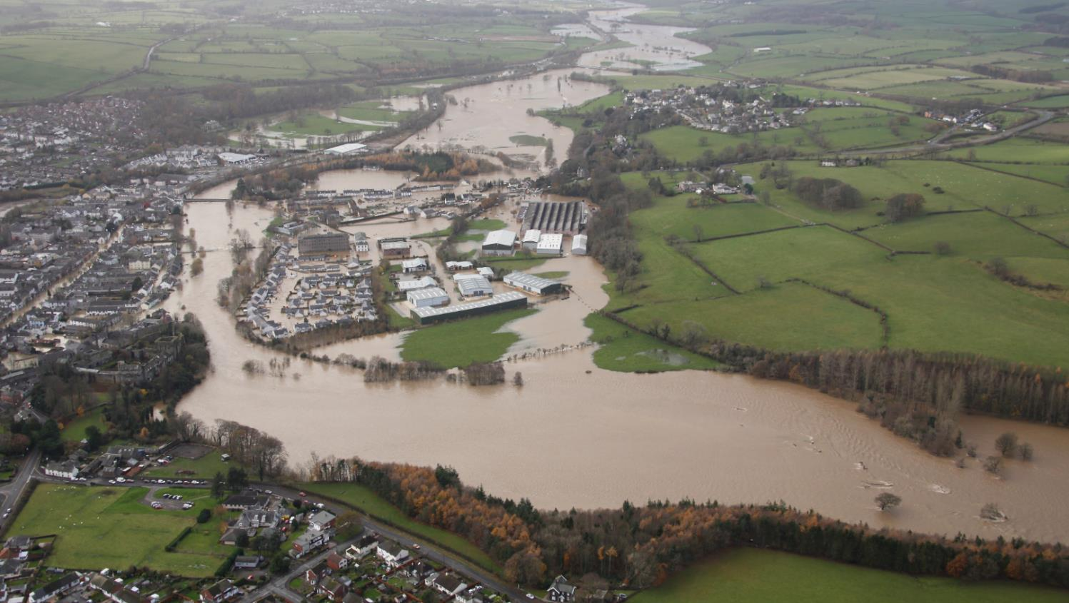
Flow
= the critical parameter
Cockermouth, 2009

Slide 13
important
Our work, our science, our data is more
than ever
Mytholmroyd, England, December 2015

Slide 14
but
Extreme Floods
…with an increase in

Slide 15
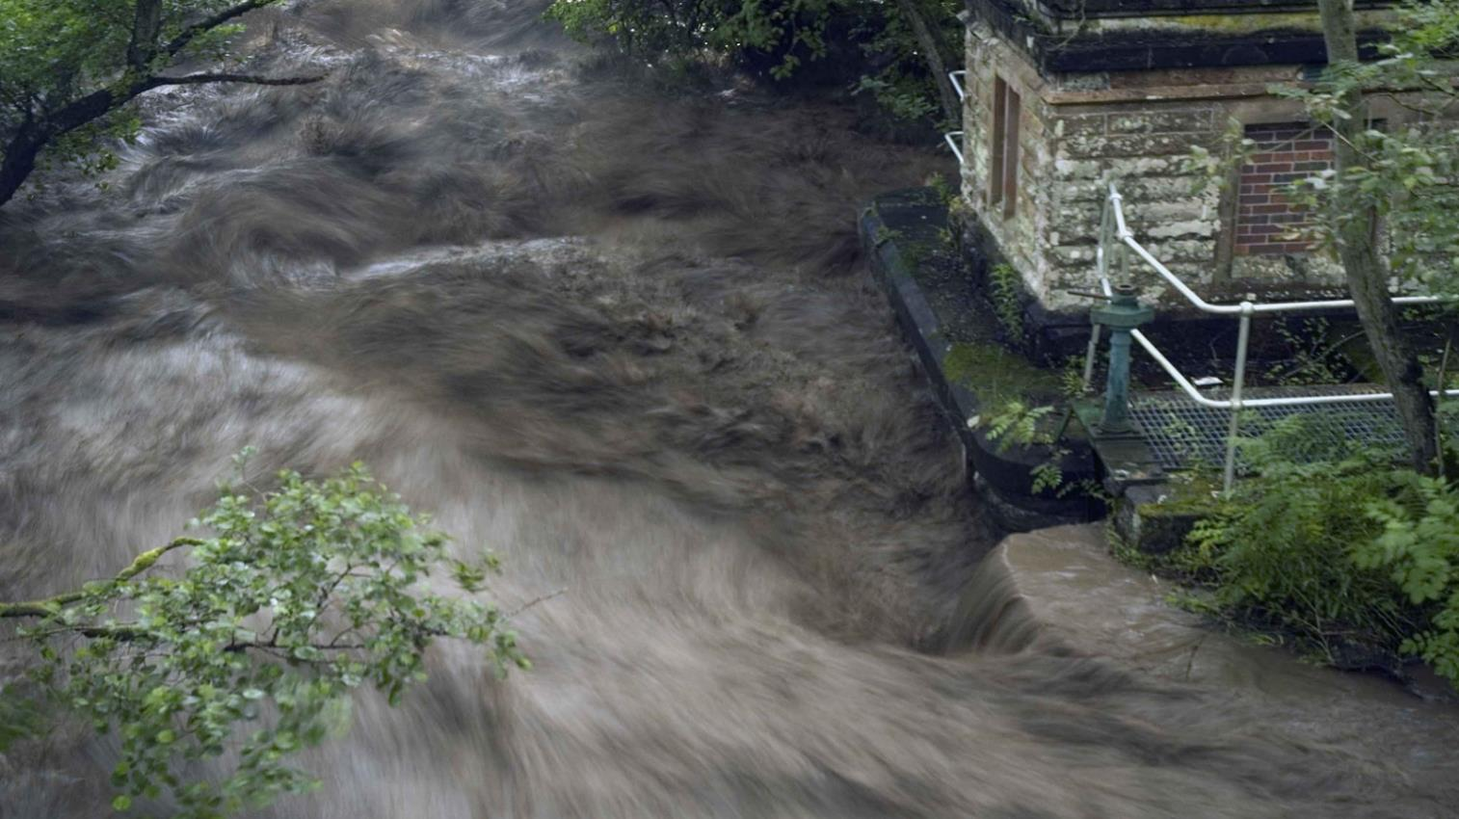
established methods
….many
..cannot cope

Slide 16
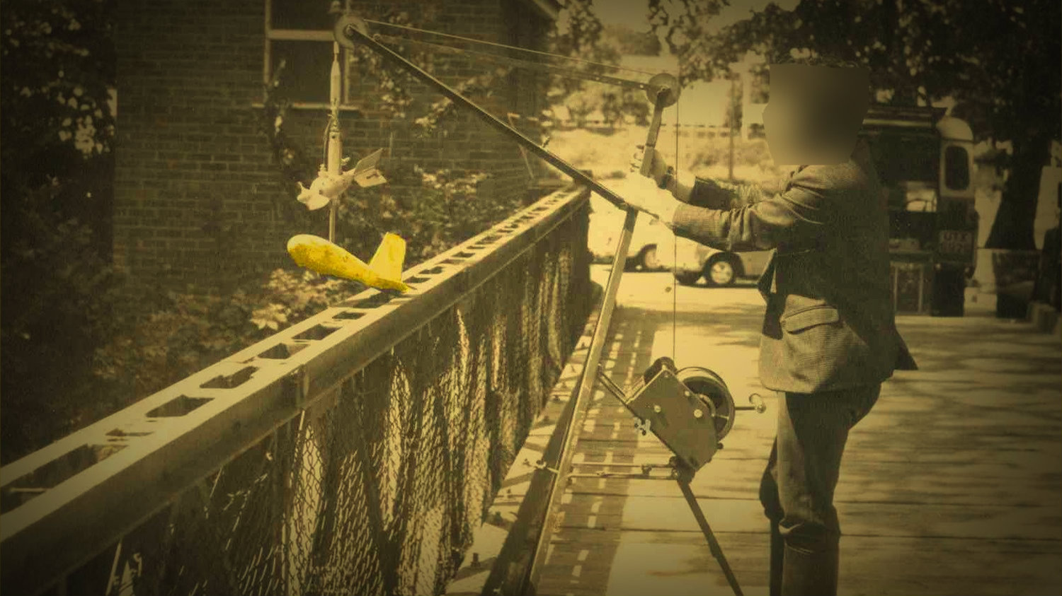
Flow gauging from bridges
Time-consuming and hazardous
(to us, to road traffic and to river users)

Slide 17
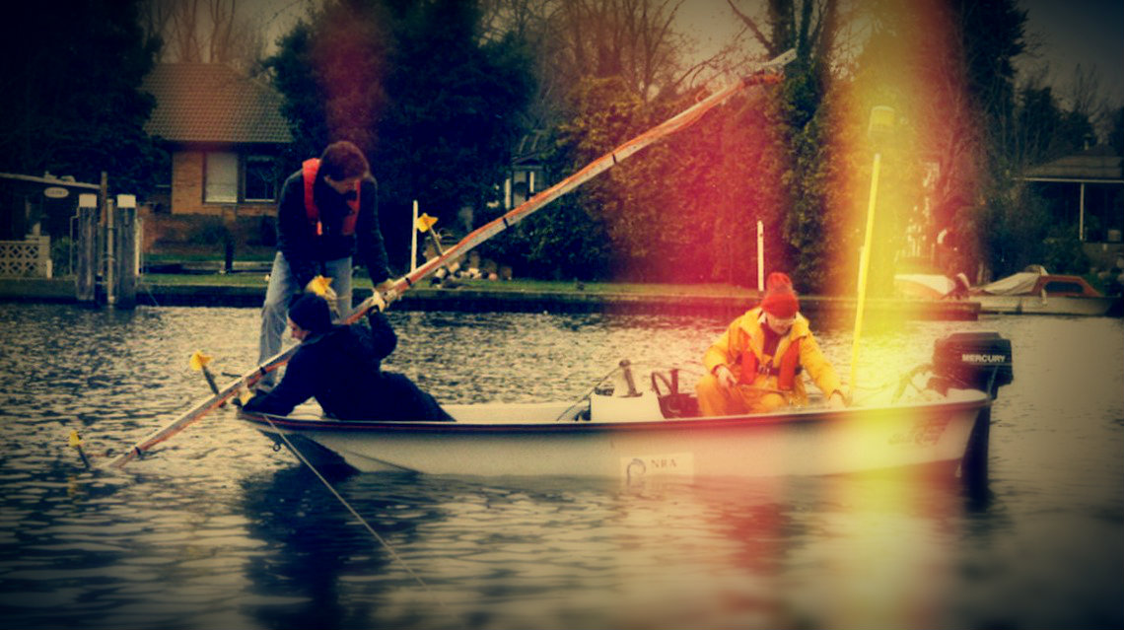
Manned boats: kinda fun, but……..
Dangerous!!!
And very slooooowww

Slide 18
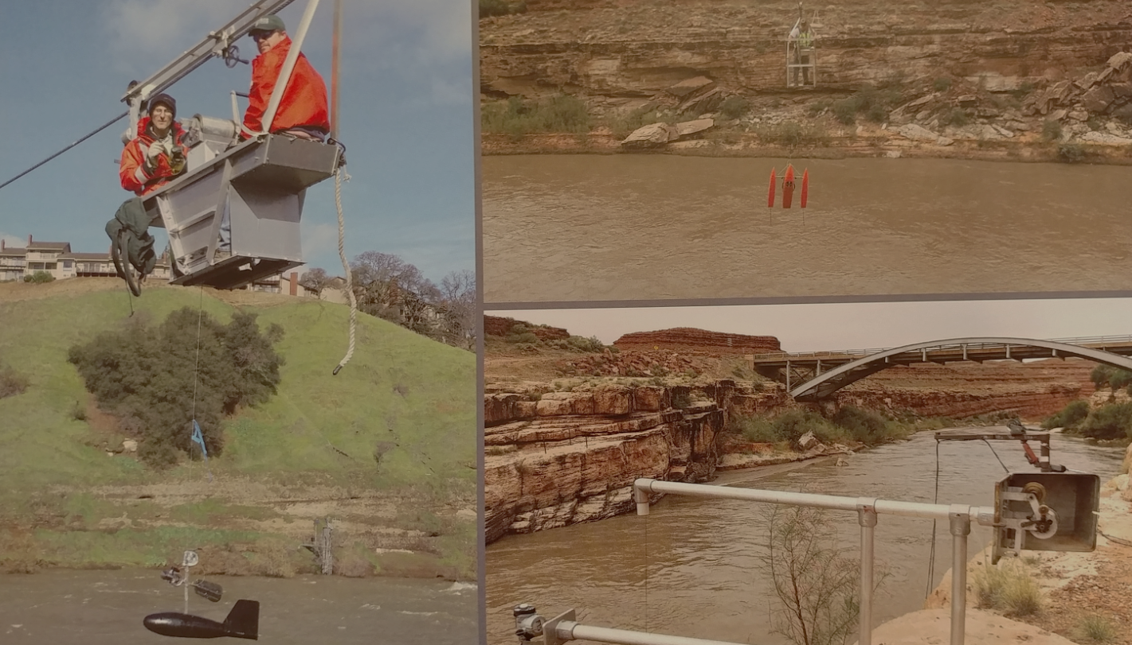
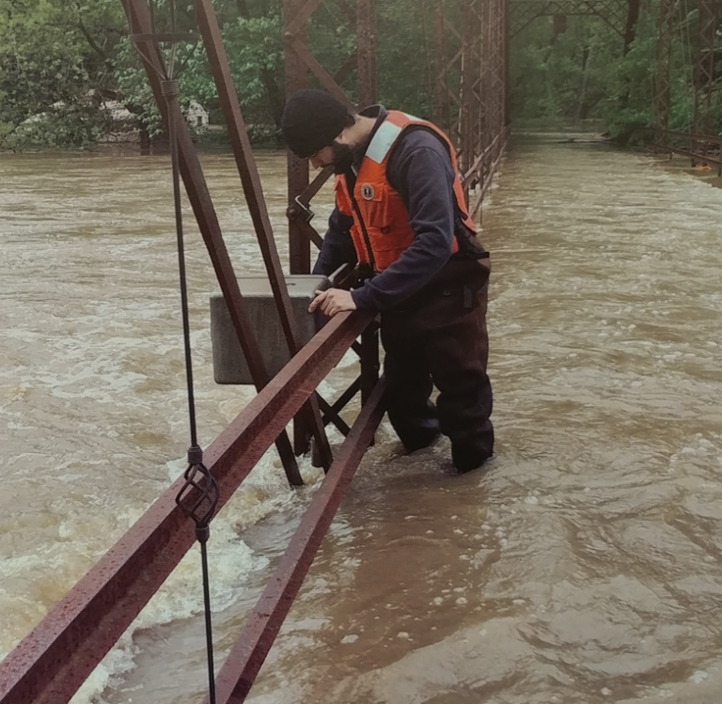
in America…..
Meanwhile…..
Anybody….?

Slide 19
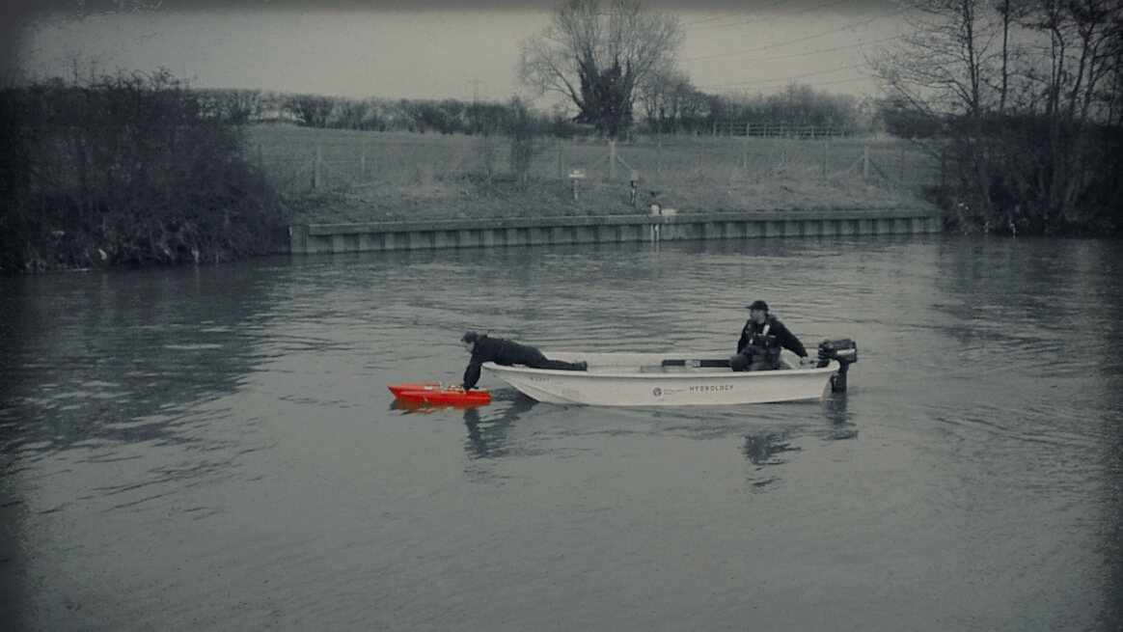
Acoustic instruments
From 2002
Much better, but
people still had to go in boats
[even in floods]

Slide 20
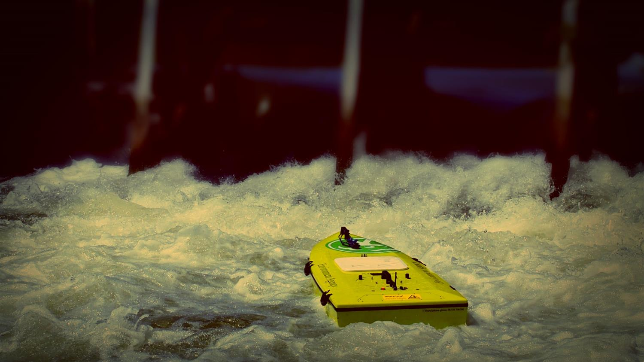
ARC-Boat
2010
Fast. Safe. Fun.
Developed for Environment Agency by HR Wallingford

Slide 21
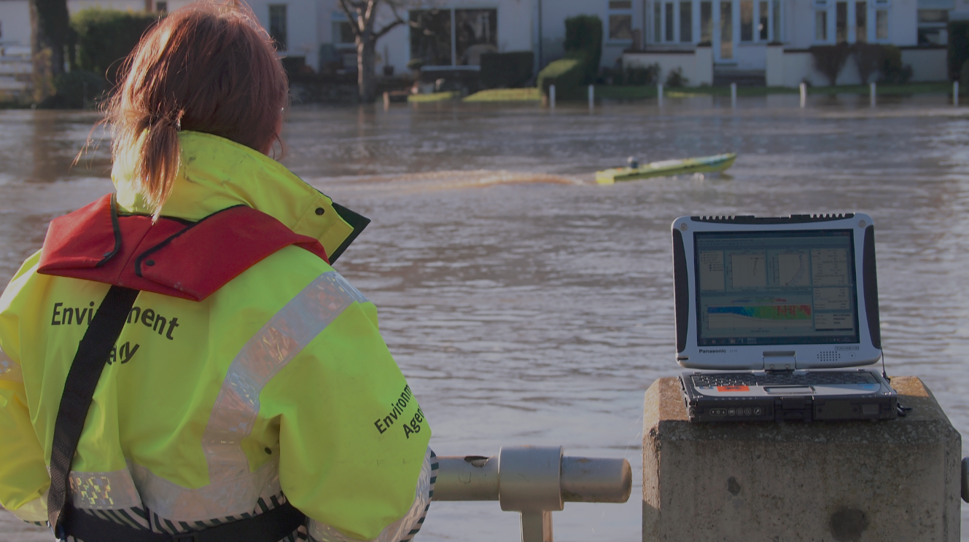
ARC-Boat & ADCP
Up to 15x
more efficient

Slide 22

2018
Surface velocity

Slide 23
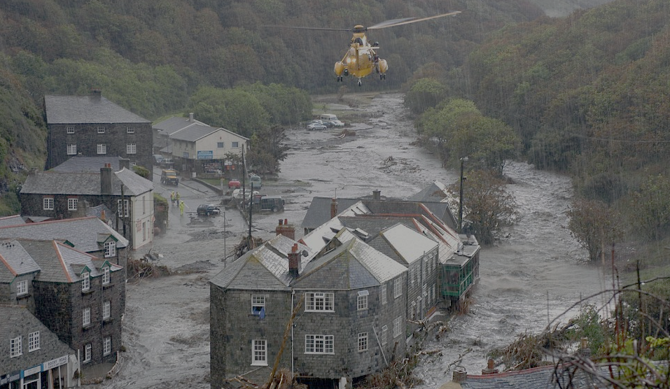
Boscastle 2004
‘if we could just time those Transit vans floating down the main street’…..

Slide 24
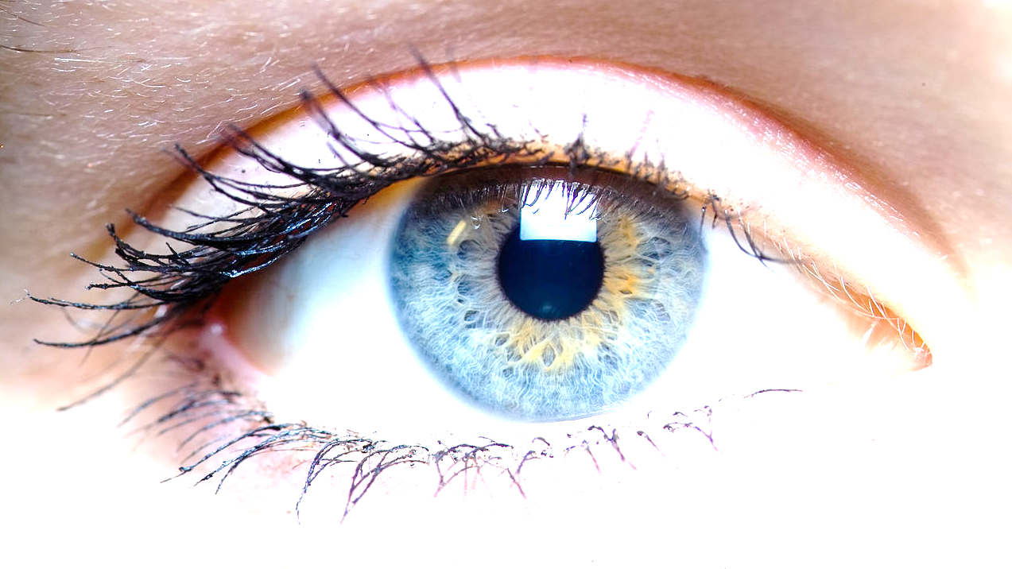
If you can see the flow
….so can a
computer algorithm

Slide 25
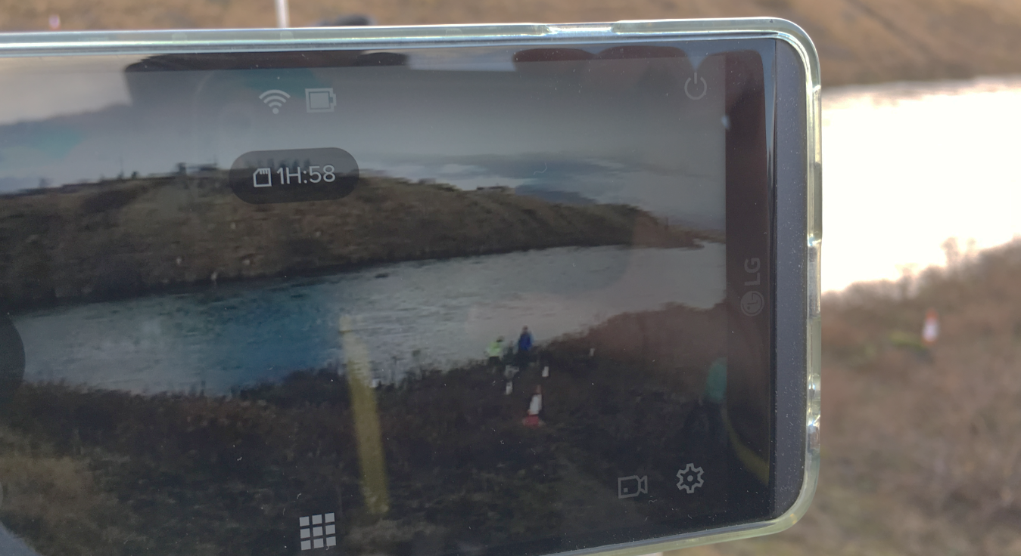
Video the river
So, we

Slide 26
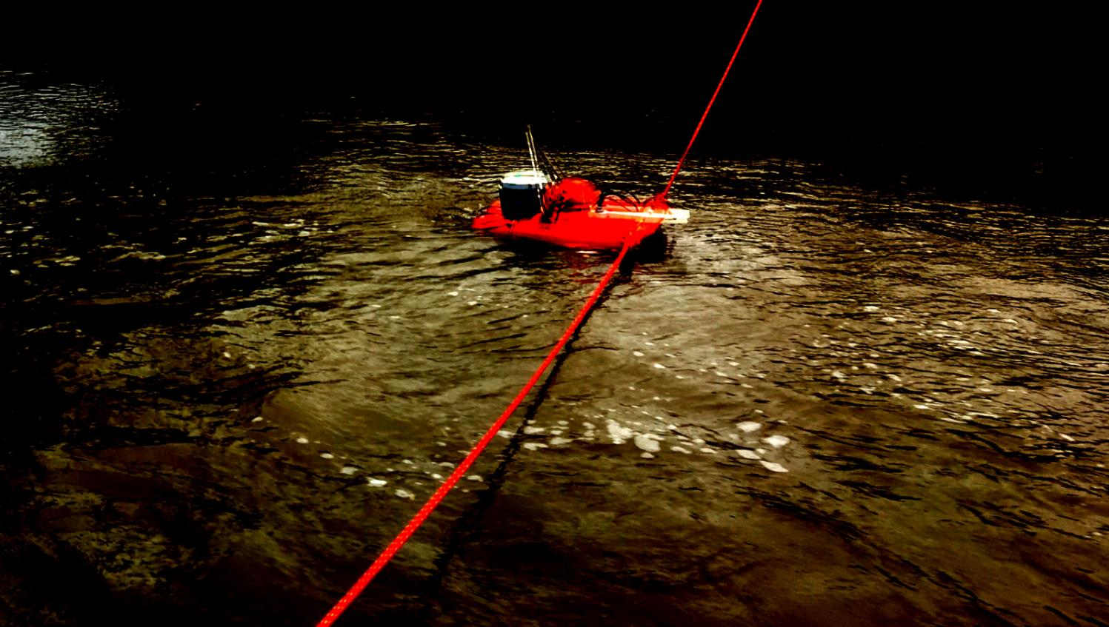
We look for
movement between
successive frames
..of video

Slide 27
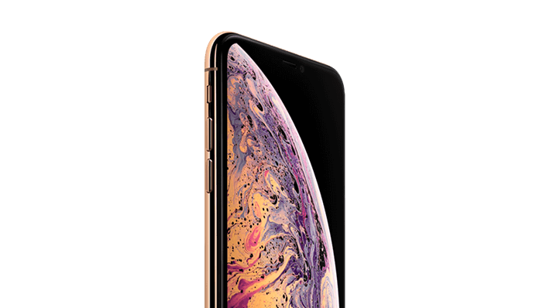
Got an iPhone?
Go do some measurements

Slide 28
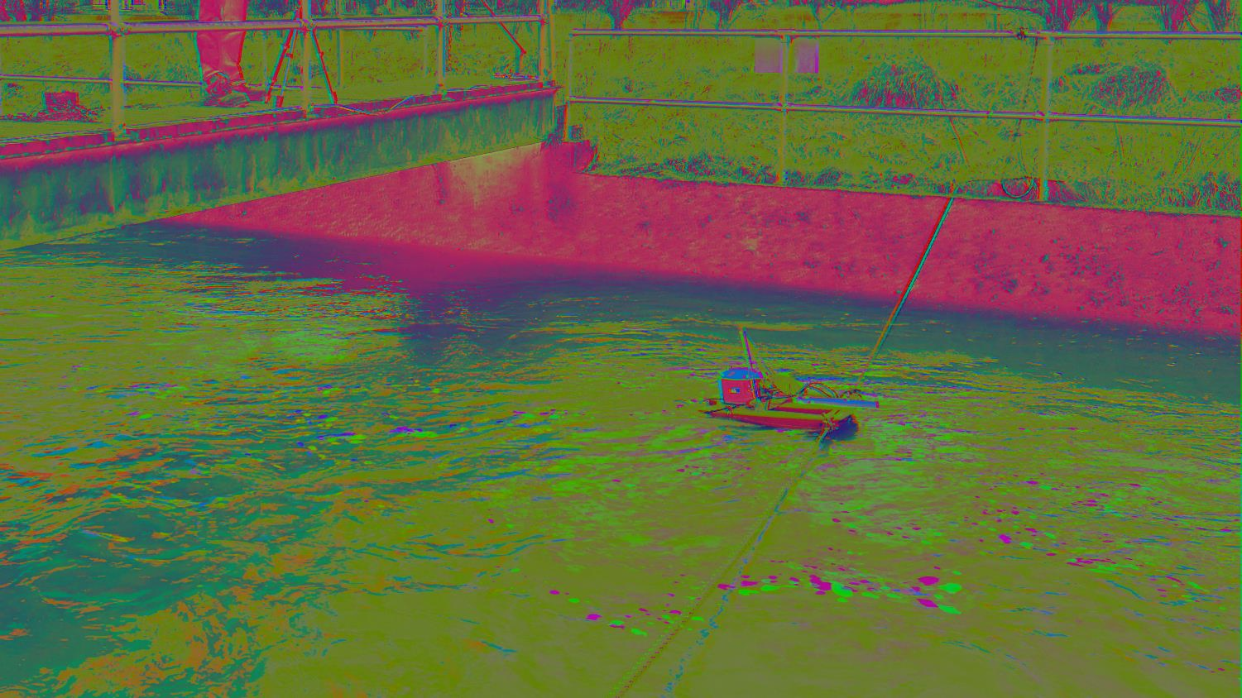
measure a river…!
Turn on HDR and

Slide 29
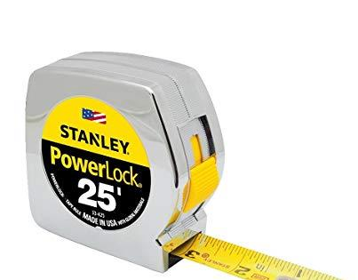
The big
challenge

Slide 30
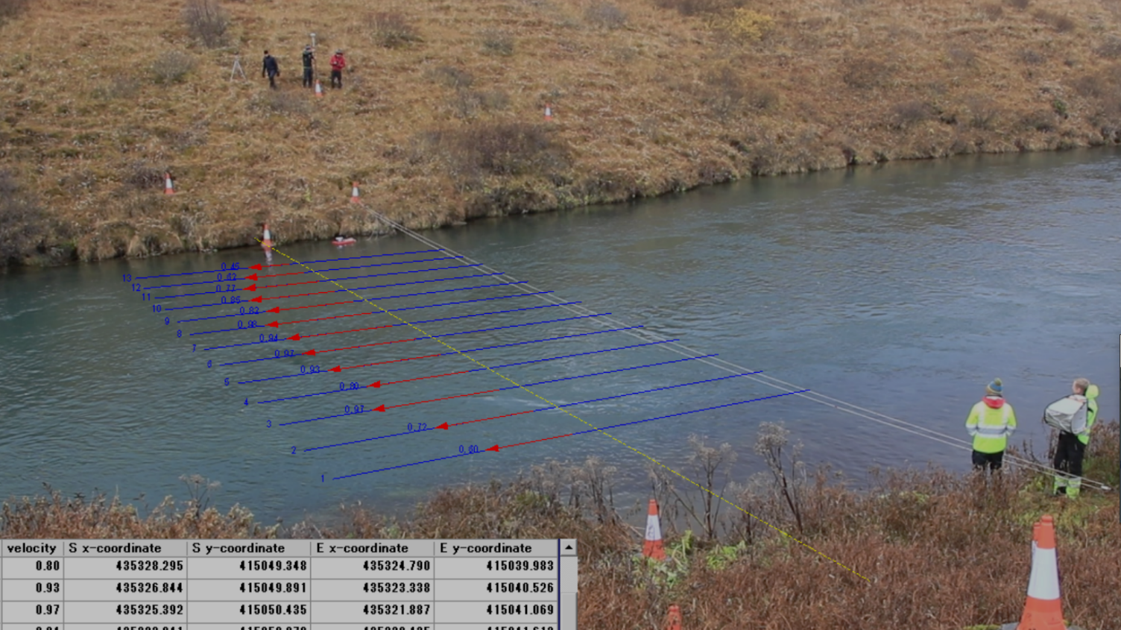
Pixel scaling
Converting pixel coordinates
to on the ground coordinates

Slide 31
Pixel scaling
Correction for range
Correction for angle of view

Slide 32
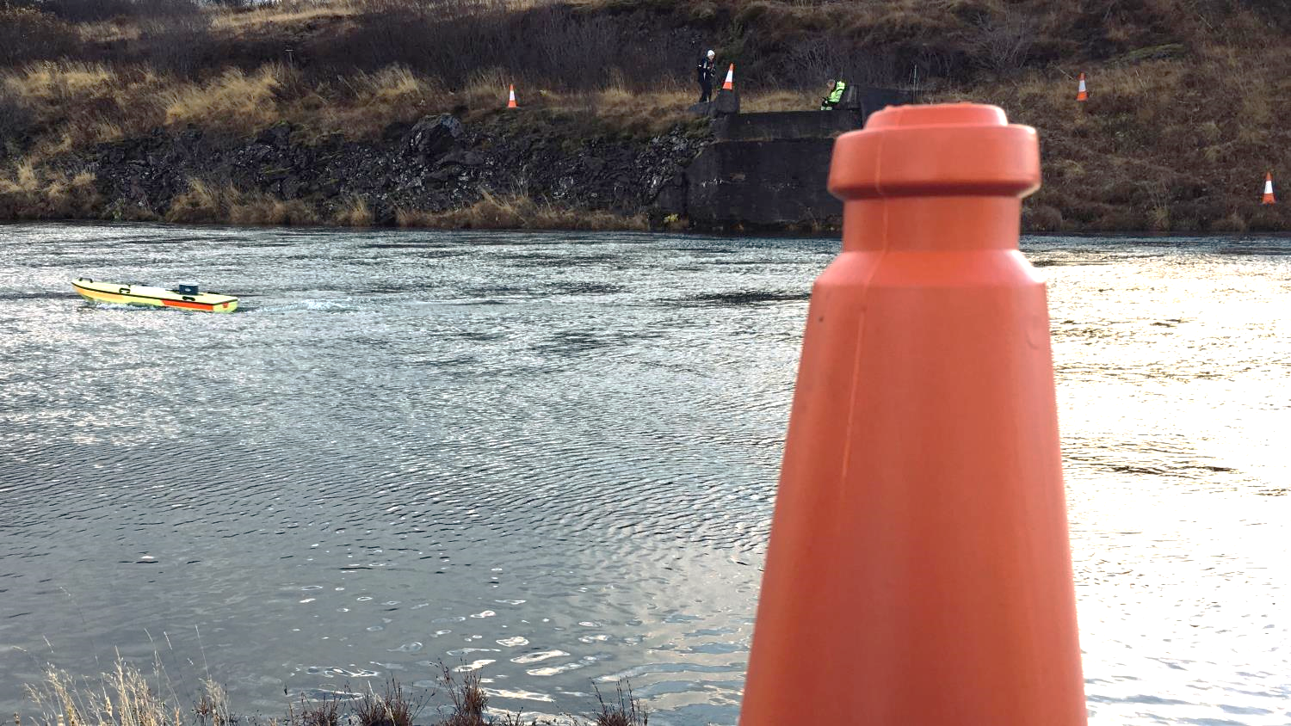
Traditionally done by…..
dumping traffic
cones on Iceland
[or wherever
you happen
to be working]

Slide 33
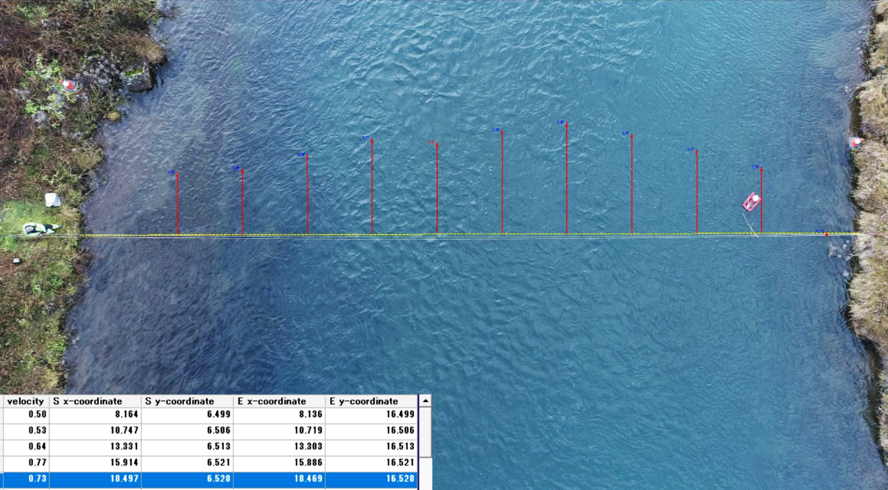
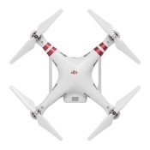
Drones
can help
reduce geometric distortion
Looking straight down, there is much less geometric distortion to deal with
Image courtesy Mark Randall, DNRME Australia

Slide 34
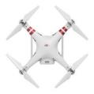
Drones
can help with
Pixel scaling
River width measured using Phantom 4 Pro GPS!
Image courtesy Mark Randall, DNRME Australia

Slide 35
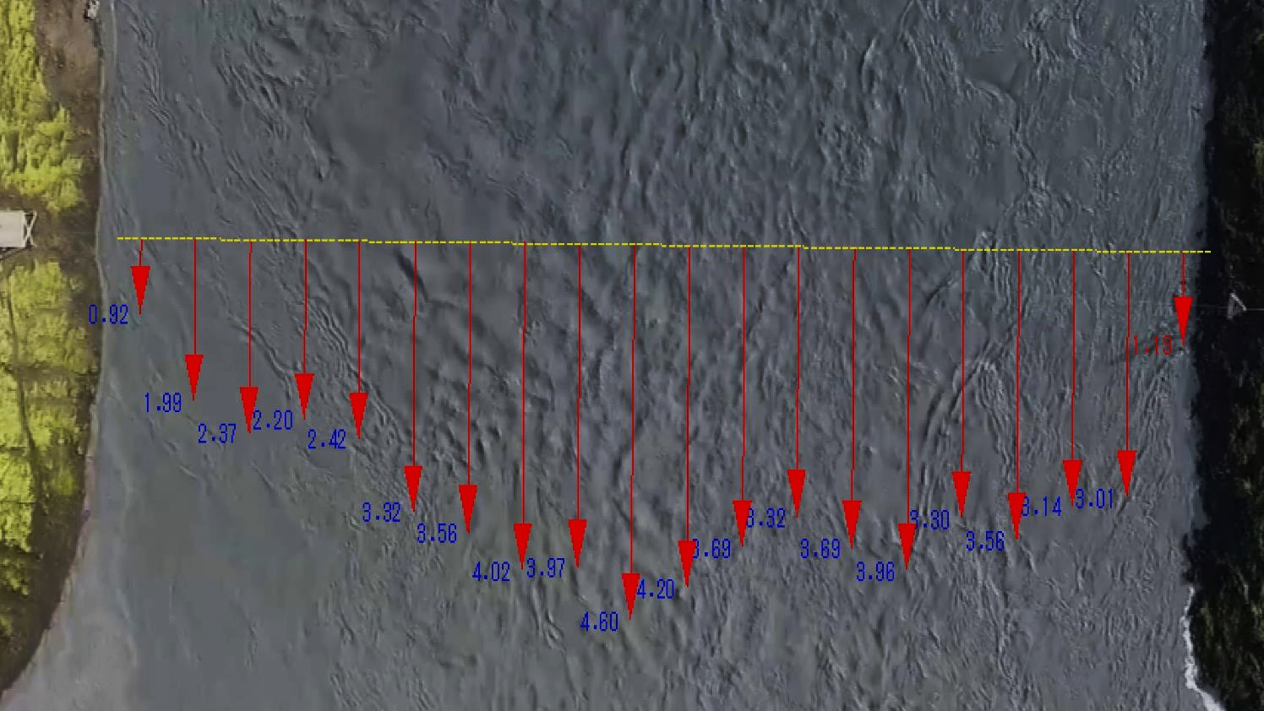
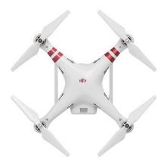
…drones
We can use
Glacial outburst flood.
Iceland, August 2018

Slide 36
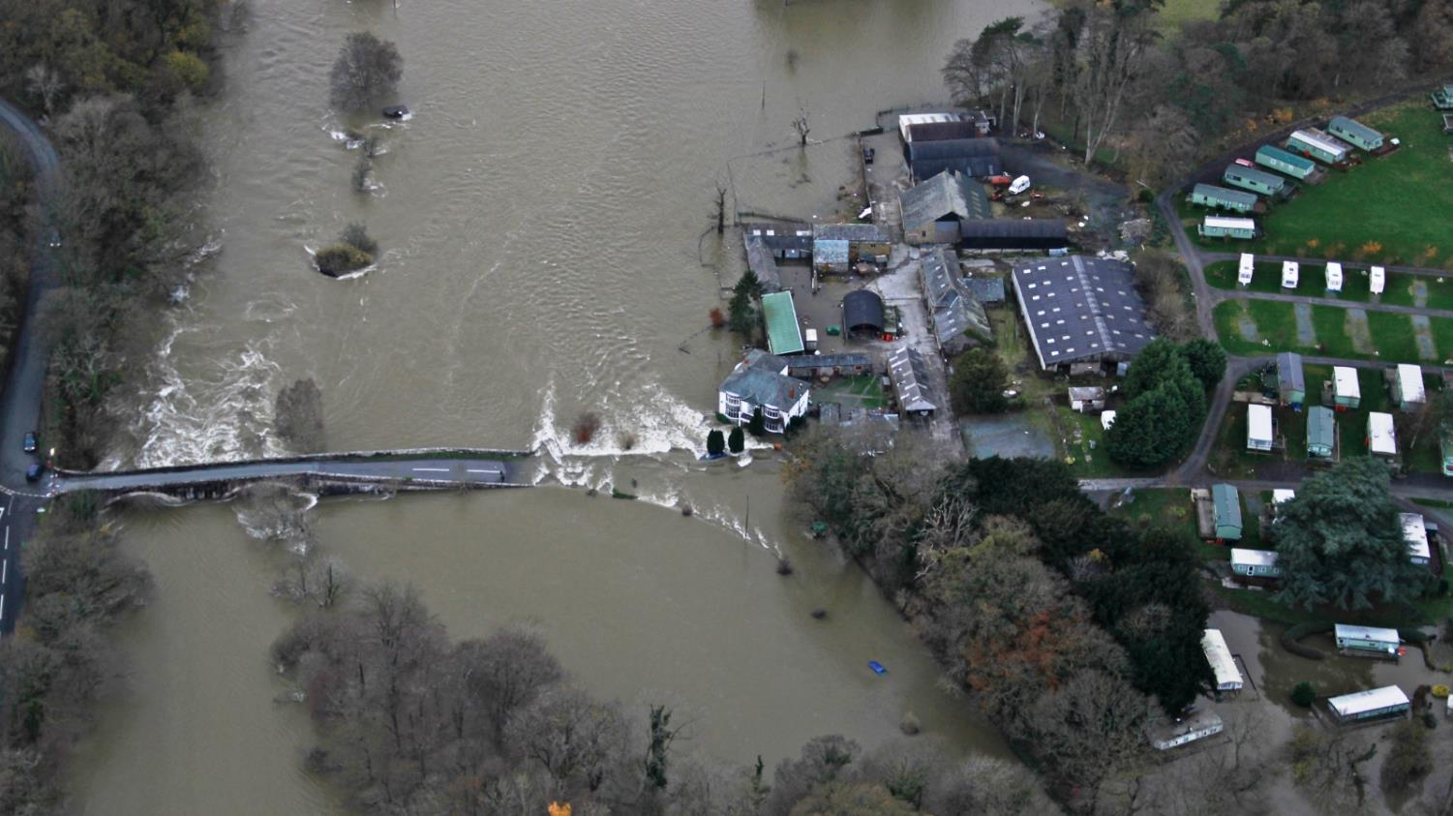

Drones
safely
can
get to where we can’t

Slide 37
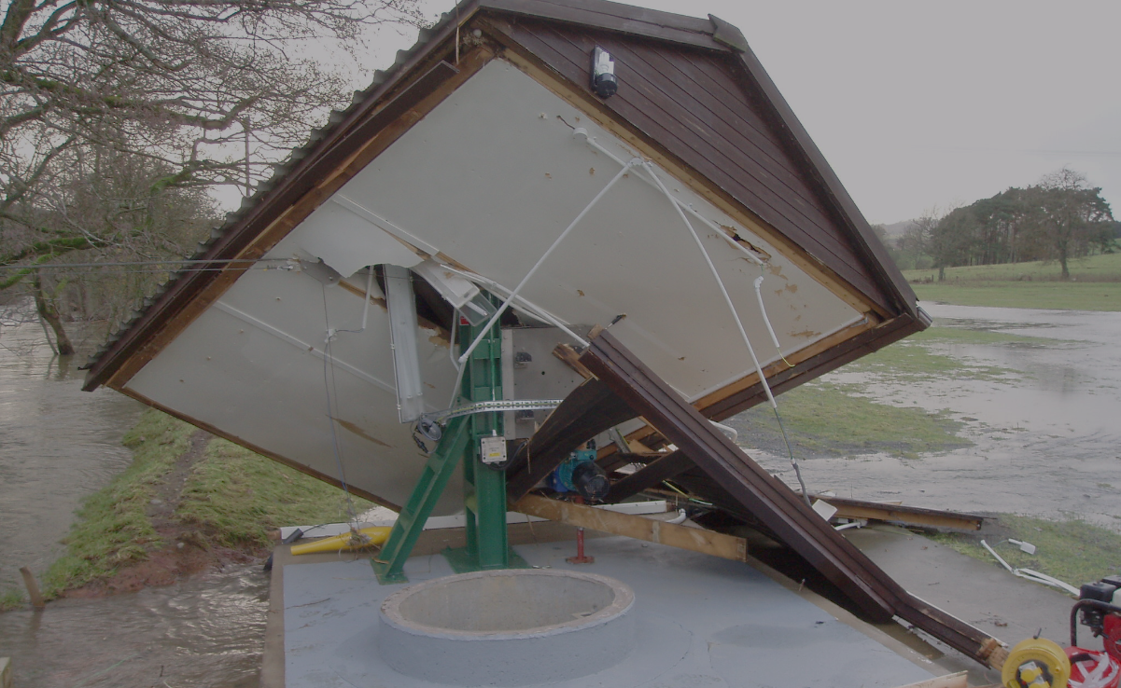
if we did get there
And
wish we hadn’t
we might

Slide 38
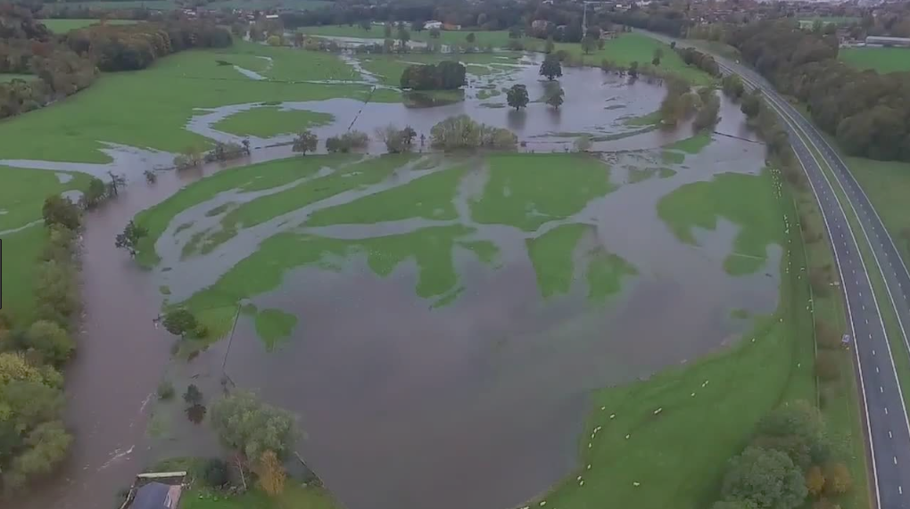
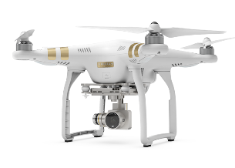
Drones
can measure
water that’s not in the river
[But we still have to scale the imagery manually….]

Slide 39
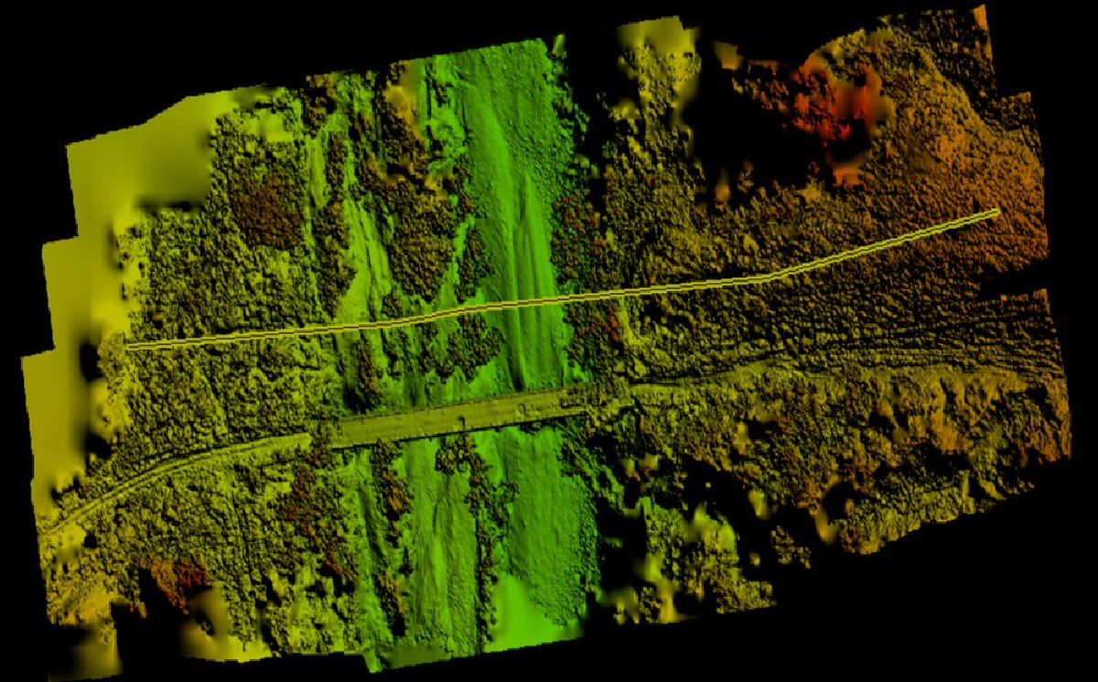
Use your drone
You can
develop your DEM
to
Image courtesy Mark Randall, DNRME Australia

Slide 40
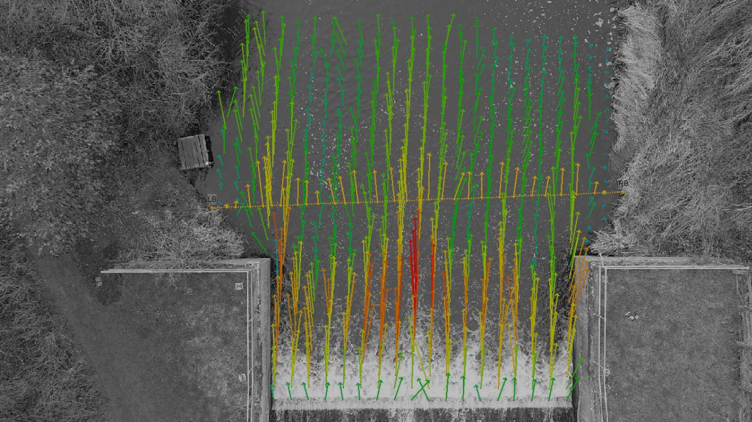


Drones
map velocity
can
where other methods won’t work……
Image courtesy Sophie Pearce,
Worcester University

Slide 41
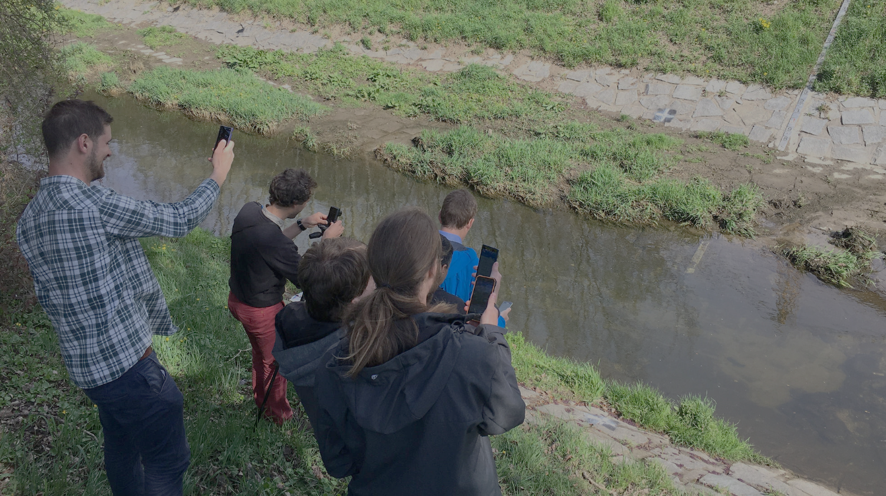
smartphones
And of course we can use
[But…. You guessed it…..
Zzzzzzzzzz….]

Slide 42
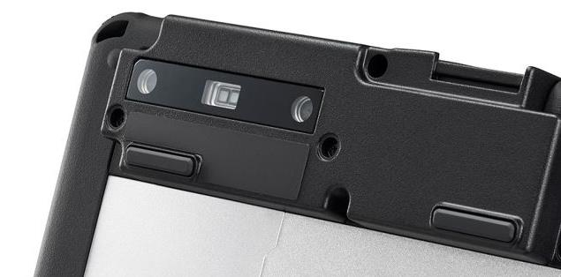
FZ-M1
Introducing
RealSense
3D camera

Slide 43

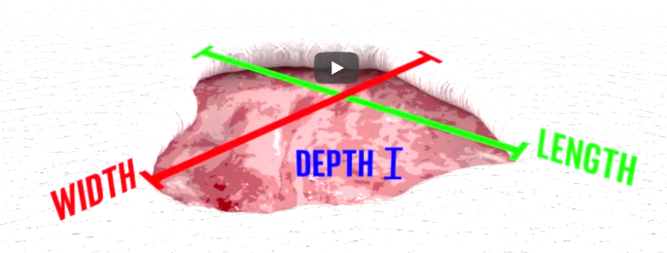
Horrible pictures of wounds…

Slide 44
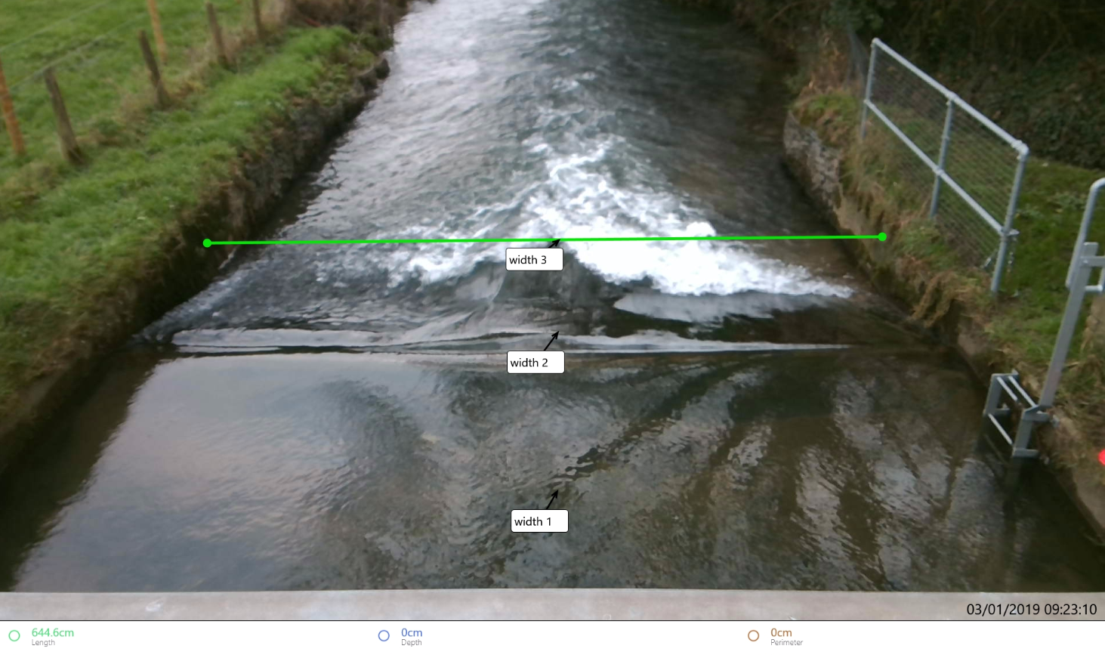
Scales the imagery
Now, the camera

Slide 45
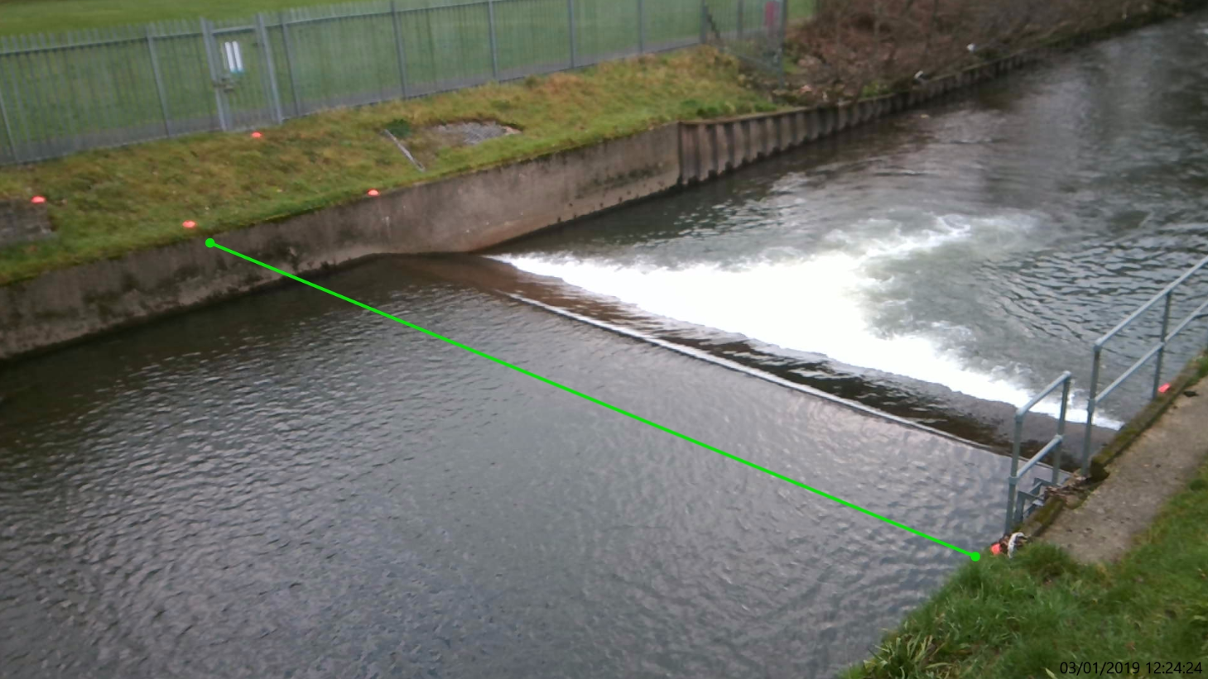
50x* as efficient
This can make the process up to
*Scientific Wild-A55 Guess

Slide 46
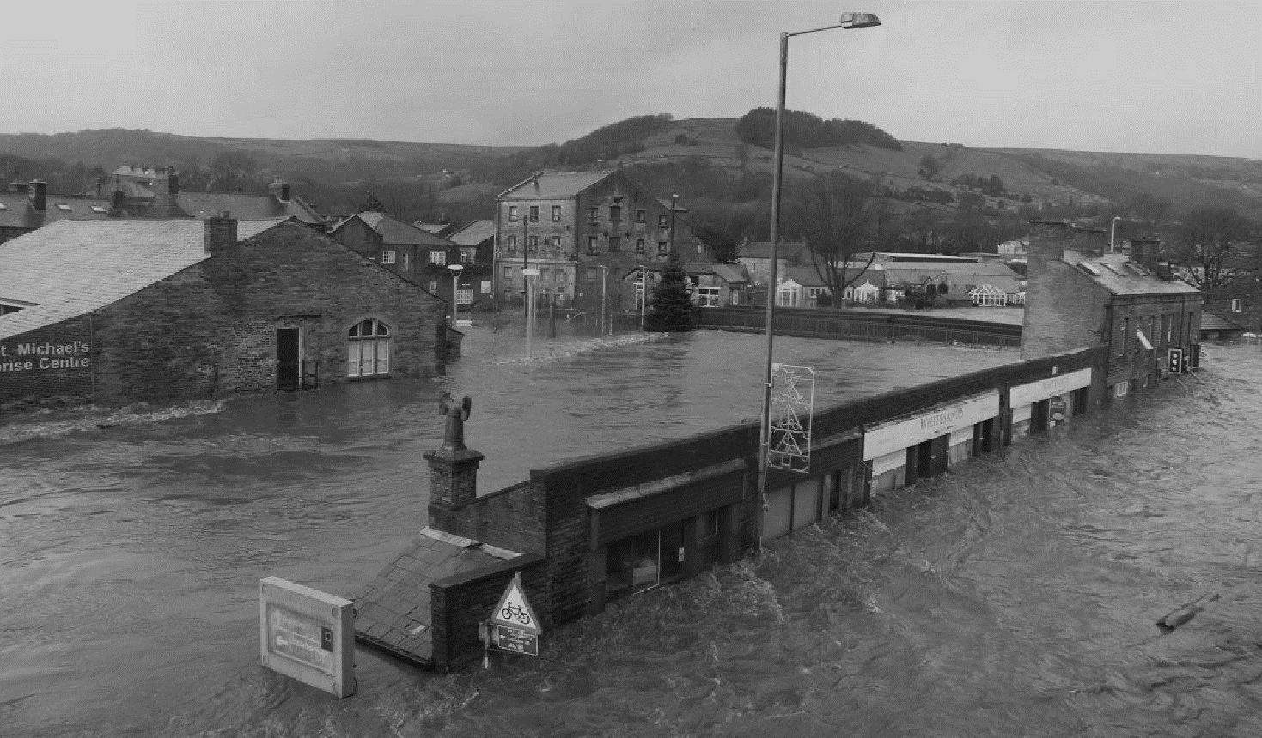
Drones
allow measurements
…can
where no cones can be dumped….

Slide 47
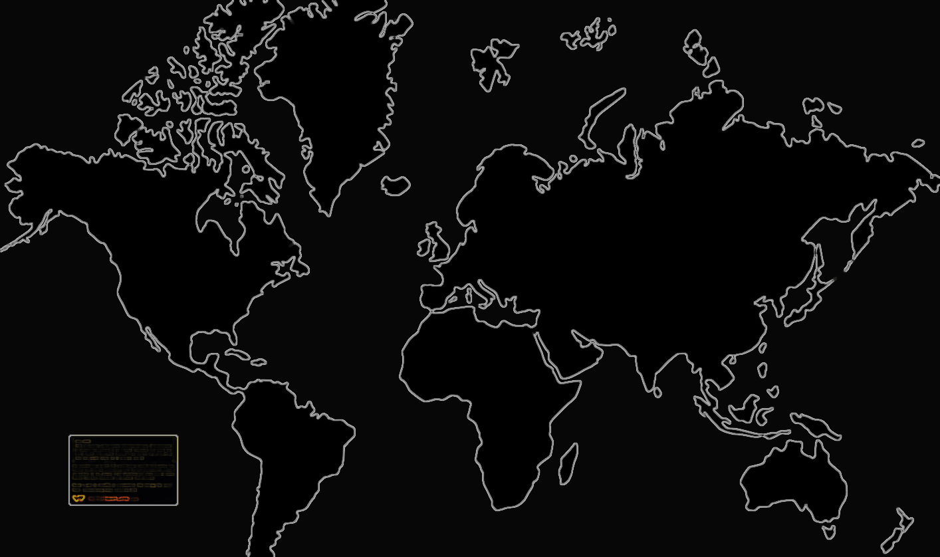

collaborating
globally
We are
International Hydrometry network. 300 members in 20+ countries
…to develop and refine
these methods

Slide 48










Slide 49
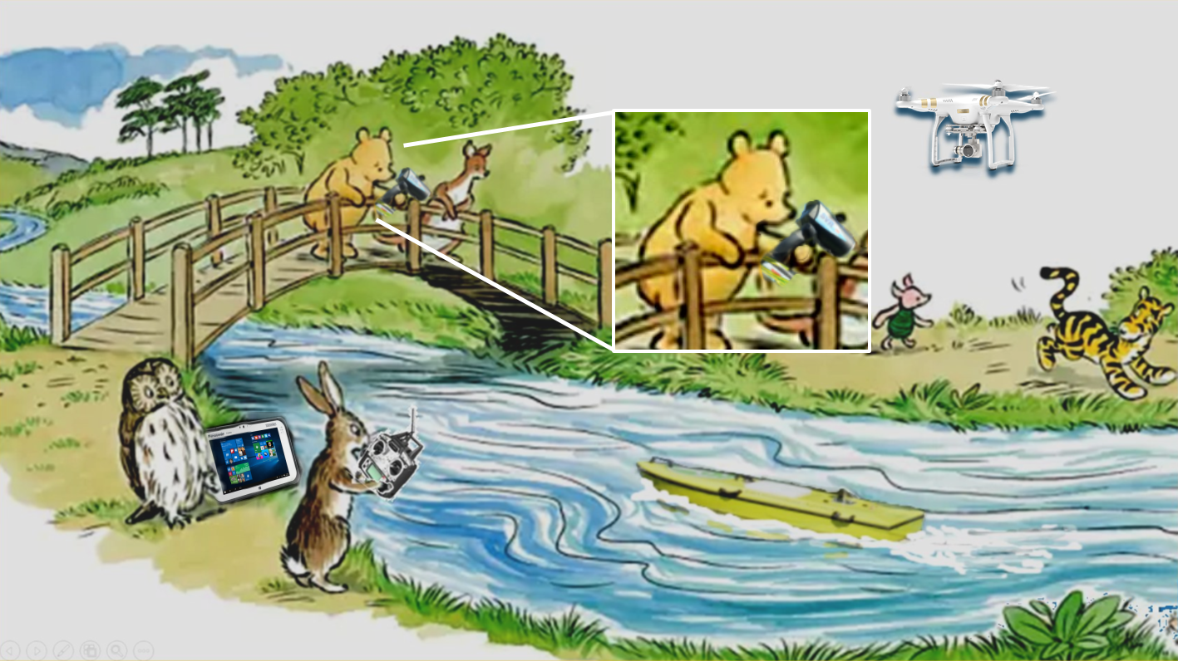
Pooh and friends
Visionary hydrologists

