Slide 1
UAV data as a supporting tool in environmental inspections
iCUD Project and experiences at IGAMAOT
UKEOF-ShARE Drones Workshop
Glyndwr University, Jan 29th-30th

Slide 2
UAV data as a supporting tool in environmental inspections
CONTENTS
4
Questions
…
3
1
Products
Orthomosaics
3D models
Thermic images
2
The iCUD
project
Equipments
and workflow
UKEOF-ShARE Drones Workshop
Glyndwr University, Jan 29th-30th

Slide 3
UAV data as a supporting tool in environmental inspections
CONTENTS
1
The iCUD
project
UKEOF-ShARE Drones Workshop
Glyndwr University, Jan 29th-30th

Slide 5
Inspecting using Copernicus and UAV Data
UKEOF-ShARE Drones Workshop
Glyndwr University, Jan 29th-30th

Slide 6
Inspecting using Copernicus and UAV Data
Project lead by
General Inspectorate for the Ministries of Environment, Spatial Planning, Agriculture and Sea (IGAMAOT)
Funded and framed within
European Union Network for the Implementation and Enforcement of Environmental Law
(IMPEL Network)
UKEOF-ShARE Drones Workshop
Glyndwr University, Jan 29th-30th

Slide 7
?
Who are the users of the space based data acquired through UAV (“Drones”)?
Who are the users of the remote sensing data based on Copernicus Services?
Are UAV (“Drones”) used as a tool in environmental inspections?
How?
Are Copernicus Services used as a tool in environmental inspections?
How?
Is the data collected through these two technologies used as evidence in court?

Slide 8
Identify users of this data and their methodologies by seeking examples used in other public entities
(…)
Identify best practices, methods, legal applications and inner knowledge/capabilities to use these tools for environmental compliance
Widening the search at a european level by presenting a project to the IMPEL network

Slide 9
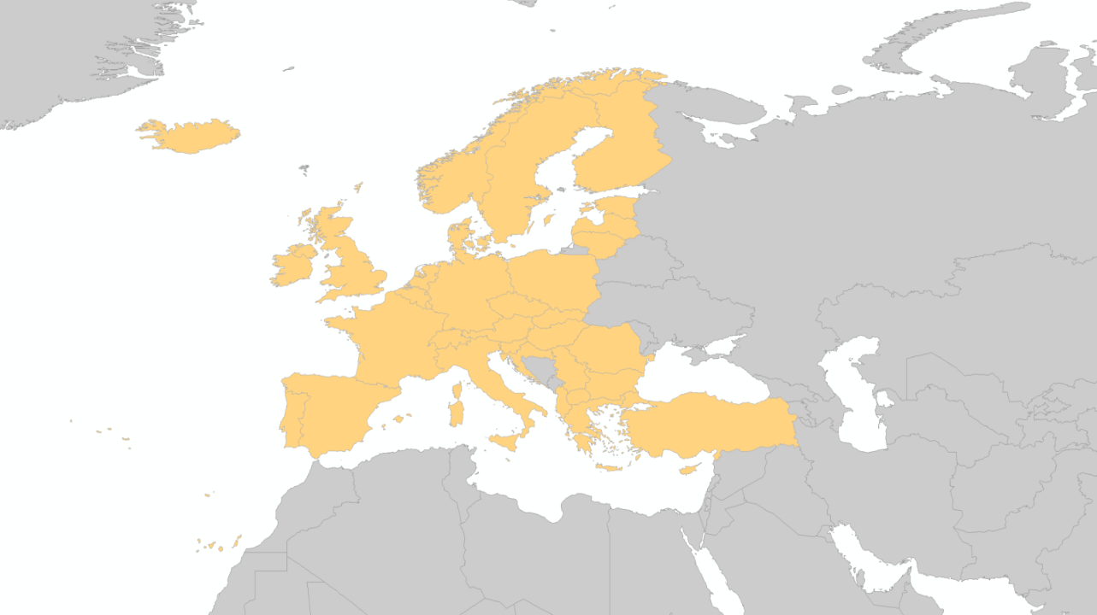
IMPEL NETWORK
International non-profit association of environmental authorities
53 members
36 countries
(all EU Member States, the former Yugoslav Republic of Macedonia, Serbia, Turkey, Iceland, Kosovo, Albania, Switzerland and Norway)
- ensuring a more effective application of environmental legislation
- concern awareness raising, capacity building, peer review,
exchange of information and experiences
- promoting and supporting the practicability and enforceability of European environmental legislation.

Slide 10
PROJECT OBJECTIVES
Evaluate the use of Copernicus services and UAV data as supporting tool to ensure
compliance with environmental legislation:
- licensing,
- monitoring,
- inspection,
Share information and good practices regarding the use of these technologies;
- Share methodologies and technical knowledge;
- Increase the use of these technologies in the support and planning of inspections;
- Identify the probative value of the use of these technology.
UKEOF-ShARE Drones Workshop
Glyndwr University, Jan 29th-30th

Slide 11
PROJECT TIMELINE
QUESTIONNAIRE
EVENT PREPARATION
FINAL REPORT
KICK OFF MEETING
WORKSHOP
JANUARY - APRIL
MAY
JUNE - SEPTEMBER
OCTOBER
NOVEMBER
DECEMBER
REPORTING
FINAL MEETING
REPORTING

Slide 12
PROJECT TIMELINE
QUESTIONNAIRE
Preparing the survey;
Gahtering answers;
Analising the results;
Selecting the project team;
EVENT PREPARATION
FINAL REPORT
KICK OFF MEETING
WORKSHOP
JANUARY - APRIL
MAY
JUNE - SEPTEMBER
OCTOBER
NOVEMBER
DECEMBER
REPORTING
FINAL MEETING
REPORTING
Notes:
The questionnaire was sent to all participants in order to evaluate their experience in the use of Copernicus and UAV data / services in an insightful context.

Slide 13
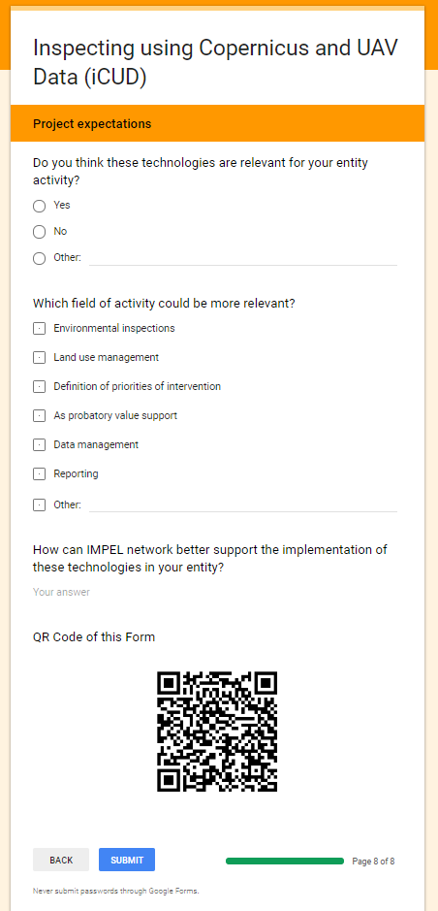
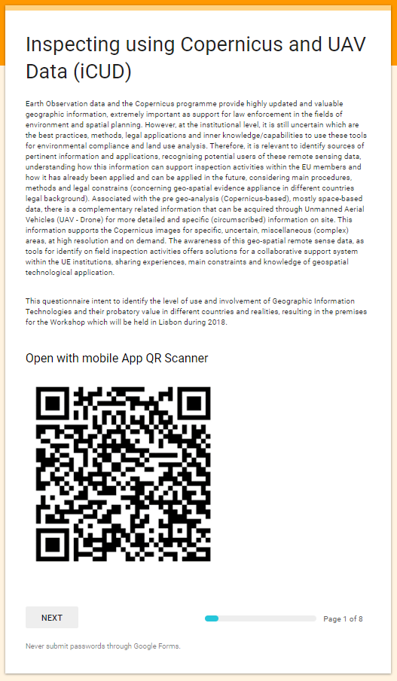
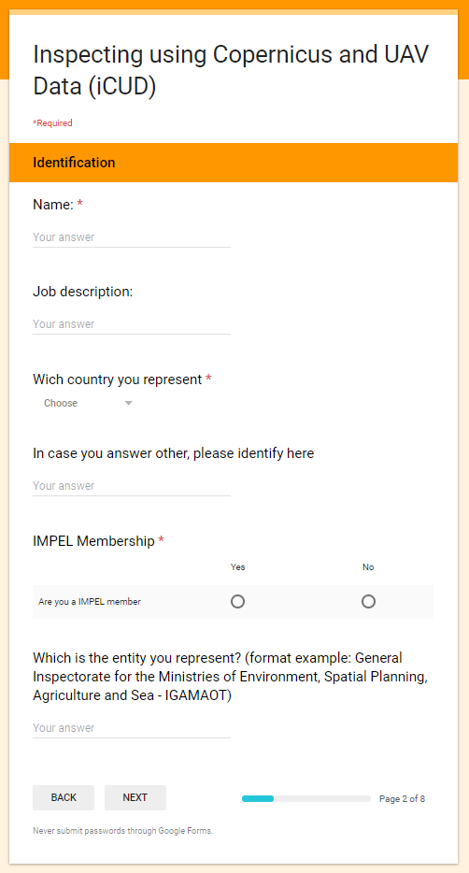
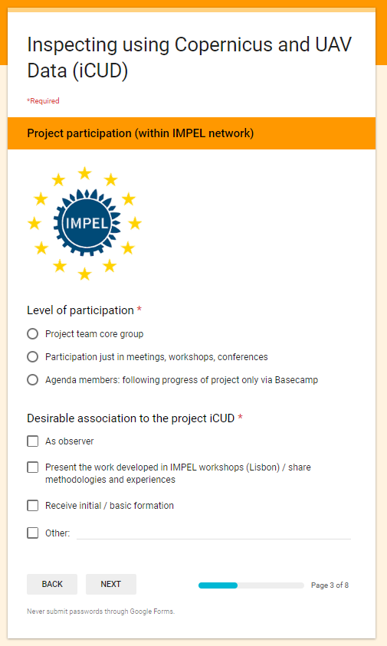
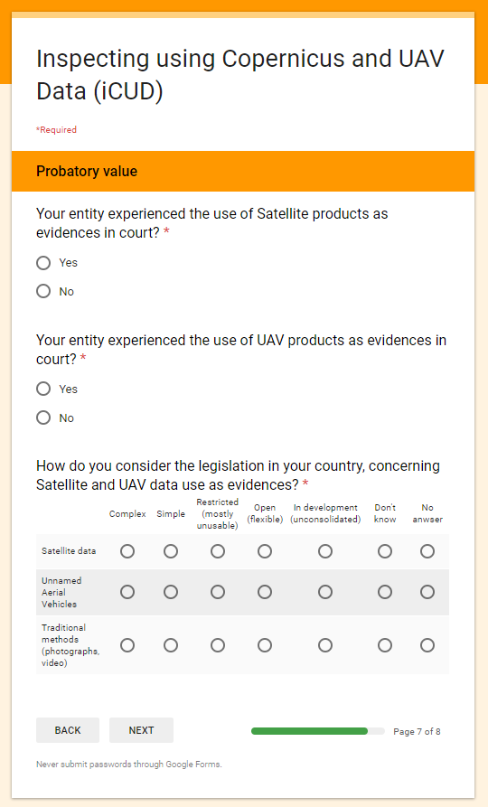
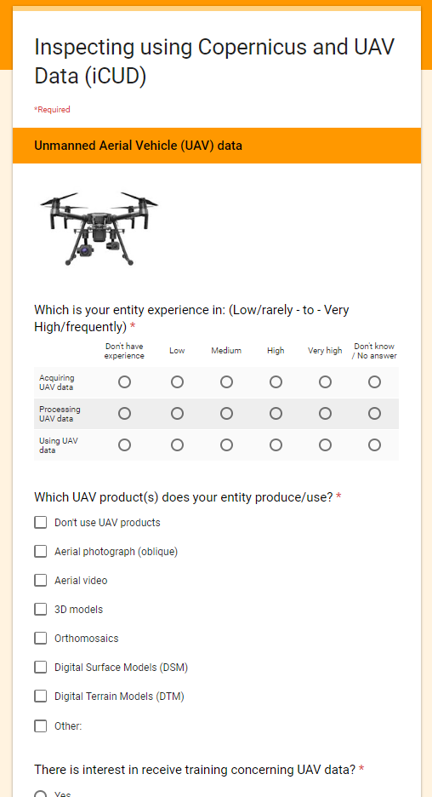
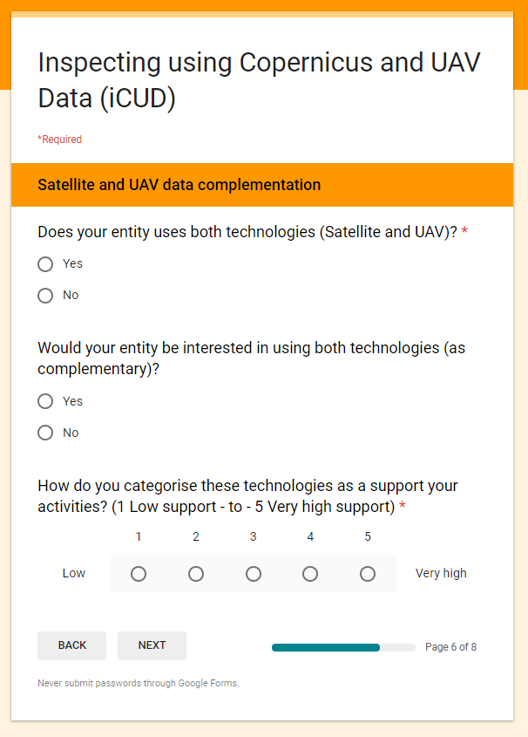
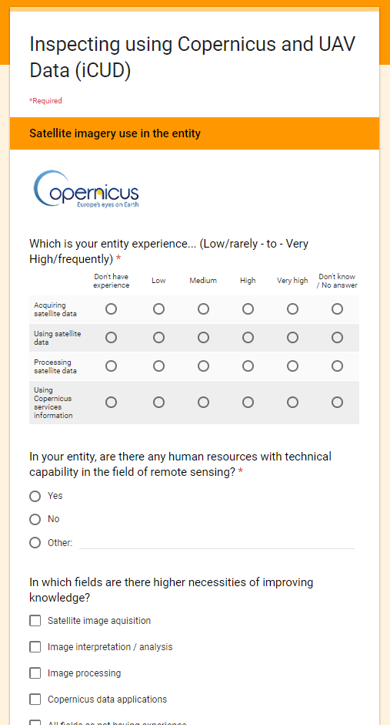
Gathering information (questionnaire)
Analysis of Results

Slide 14
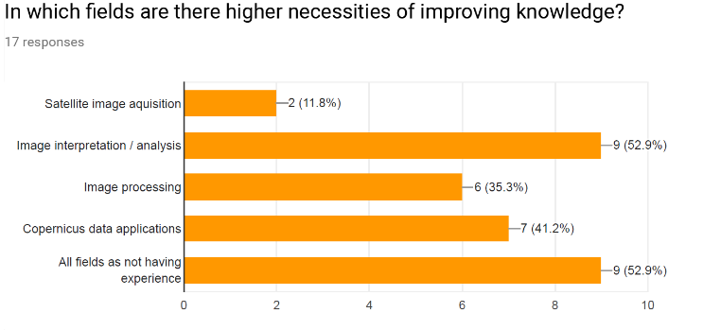
RESULTS

Slide 15
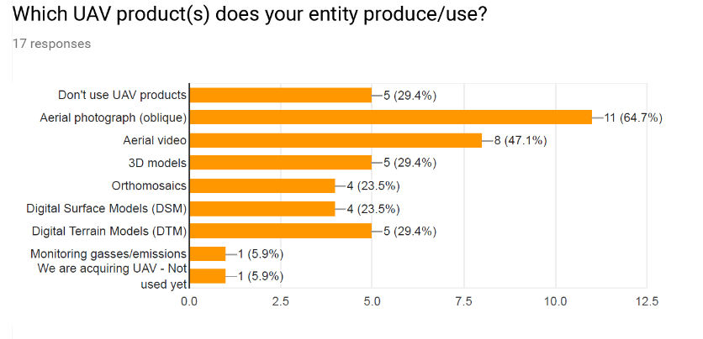
RESULTS

Slide 16
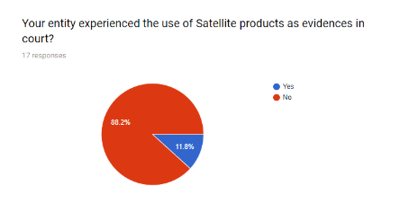
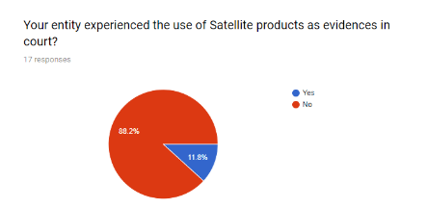
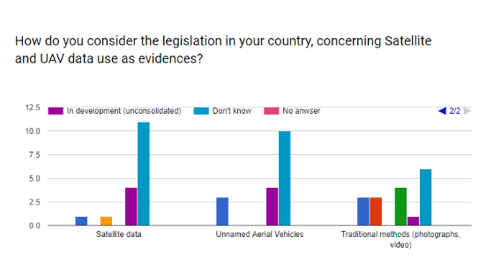
RESULTS

Slide 17
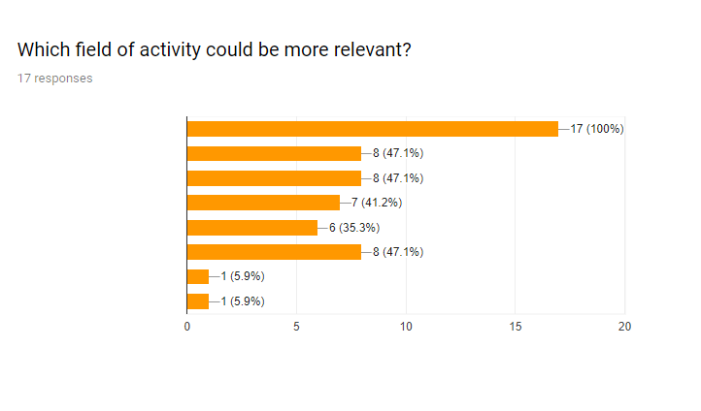
RESULTS
Environmental Inspections
Land use management
Definition of priorities
As probatory value support
Data management
Reporting
Other
Other

Slide 18
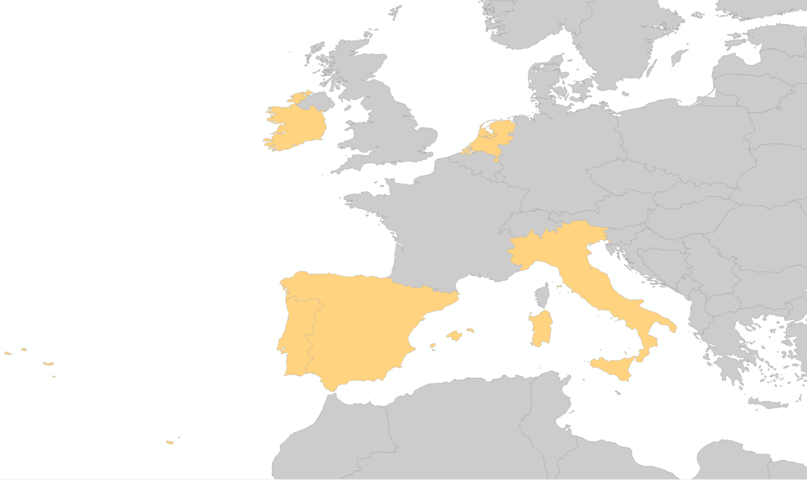
PROJECT TEAM

Slide 19
PROJECT TIMELINE
QUESTIONNAIRE
EVENT PREPARATION
FINAL REPORT
KICK OFF MEETING
- Presentation and analysis of the results of the survey;
- Presentations from the project team;
- Discussing main techniques and methodologies used in the scope of remote sensing and UAV;
- Planning next activities (Workshop);
WORKSHOP
JANUARY - APRIL
MAY
JUNE - SEPTEMBER
OCTOBER
NOVEMBER
DECEMBER
REPORTING
FINAL MEETING
REPORTING

Slide 20
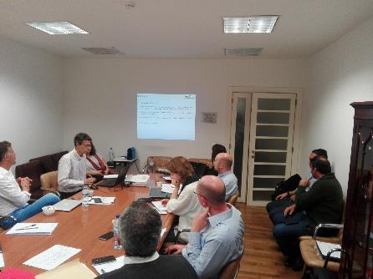
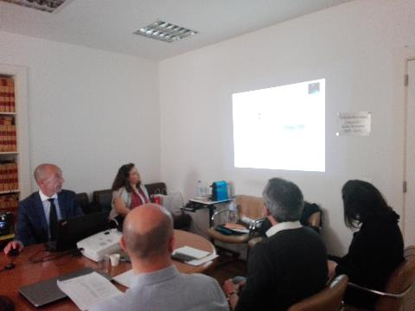
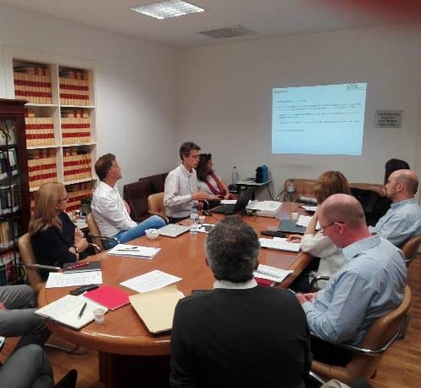
UKEOF-ShARE Drones Workshop
Glyndwr University, Jan 29th-30th

Slide 21
PROJECT TIMELINE
QUESTIONNAIRE
EVENT PREPARATION
FINAL REPORT
KICK OFF MEETING
WORKSHOP
17th
- Training session on satellite data acquisition and processing;
18th
- Presentation and demonstration of methodologies developed by team members;
JANUARY - APRIL
MAY
JUNE - SEPTEMBER
OCTOBER
NOVEMBER
DECEMBER
17th-18th
Lisbon
REPORTING
FINAL MEETING
REPORTING

Slide 22
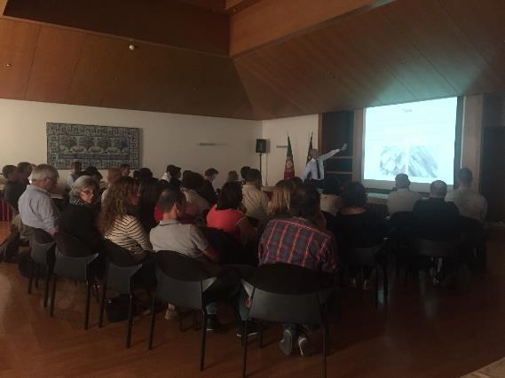
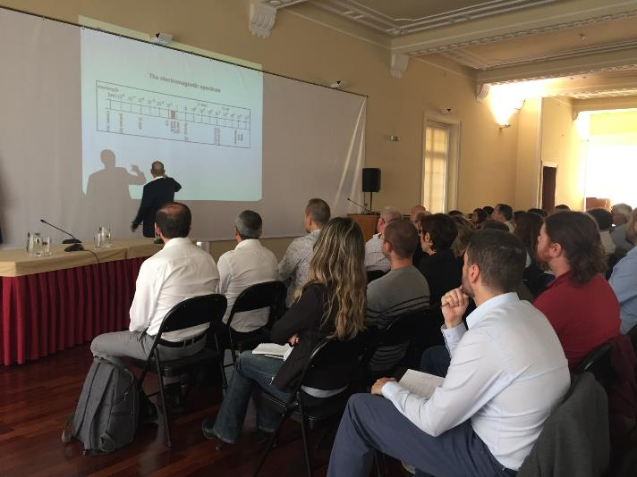

Slide 23
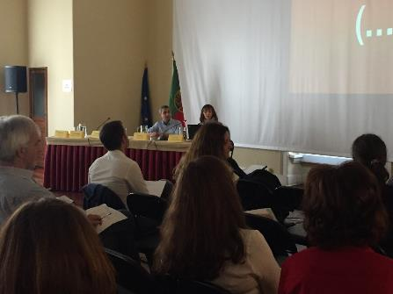
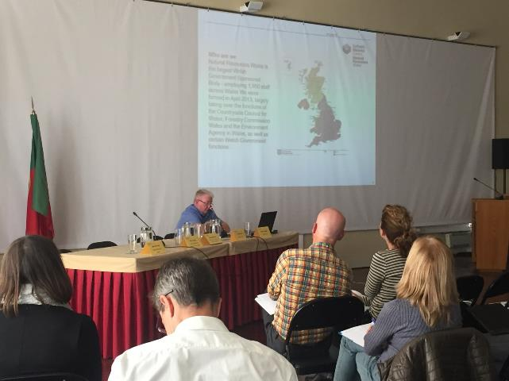
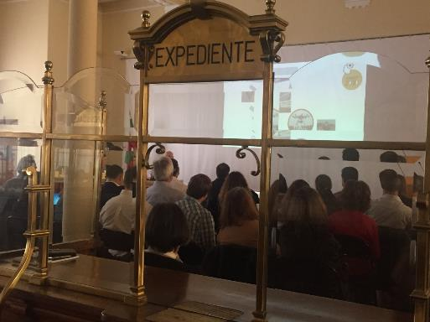
UKEOF-ShARE Drones Workshop
Glyndwr University, Jan 29th-30th

Slide 25
The (possible) answer(s)
Are Copernicus Services used as a tool in environmental inspections? How?
Yes,
Pre-analisis and planning of inspections
Monitor and detect land use changes
Are UAV (“Drones”) used as a tool in environmental inspections? How?
Yes,
Monitor and detect land use changes
Monitor waste areas/volumes on sites
Waste water discharges (thermic data)
Computation is still limited when it comes to dealing with large volumes of data with the additional problem of storage
Is the data collected through these two technologies used as evidence in court? Where?
Still unsure,
Most participant countries have not yet used the collected data as evidence

Slide 26
Using UAV in environmental inspections
CONTENTS
1
2
The iCUD
project
Equipments
and workflow
UKEOF-ShARE Drones Workshop
Glyndwr University, Jan 29th-30th

Slide 27
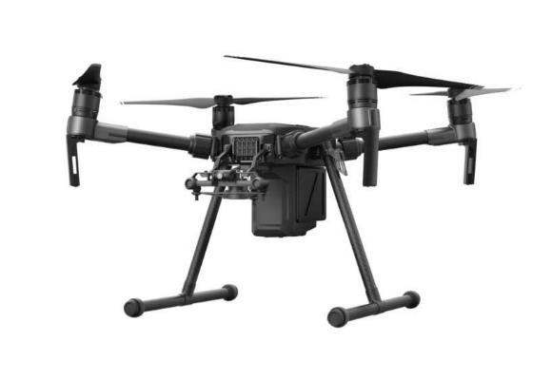
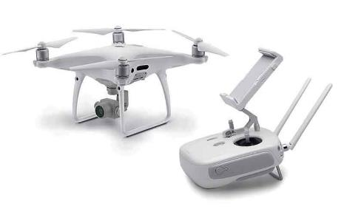
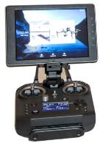
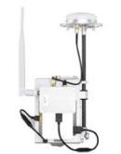
EQUIPMENTS
Dji Phantom 4 Pro+
Matrice 210 RTK
UKEOF-ShARE Drones Workshop
Glyndwr University, Jan 29th-30th

Slide 28
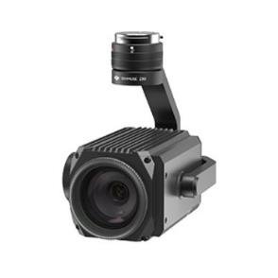
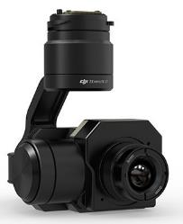
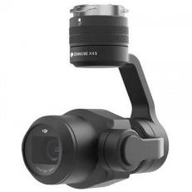
EQUIPMENTS
Zenmuse Z30
Zenmuse XT2
Zenmuse X5S
UKEOF-ShARE Drones Workshop
Glyndwr University, Jan 29th-30th

Slide 29
WORKFLOW
Inspection
Scheduled
Unscheduled
Area recognition / Flight constraints (Civil/Military)
Normal Flight Authorization
Urgent Flight Authorization
UAV Preparation: firmware, calibration, batteries, SD card, flight plan…
Field recognition: weather; interferences; other constraints
Flight plan (data acquisition / requirements: Image; video…)
Automatic / manual
Post processing products required: 3D; Orthomosaic; NDVI…
Processing
Product
Technical document
UKEOF-ShARE Drones Workshop
Glyndwr University, Jan 29th-30th

Slide 30
WORKFLOW
Inspection
Scheduled
Unscheduled
Area recognition / Flight constraints (Civil/Military)
Normal Flight Authorization
Urgent Flight Authorization
UAV Preparation: firmware, calibration, batteries, SD card, flight plan…
Field recognition: weather; interferences; other constraints
Flight plan (data acquisition / requirements: Image; video…)
Automatic / manual
Post processing products required: 3D; Orthomosaic; NDVI…
Processing
Product
Technical document
UKEOF-ShARE Drones Workshop
Glyndwr University, Jan 29th-30th

Slide 31
WORKFLOW
Inspection
Scheduled
Unscheduled
Area recognition / Flight constraints (Civil/Military)
Normal Flight Authorization
Urgent Flight Authorization
UAV Preparation: firmware, calibration, batteries, SD card, flight plan…
Field recognition: weather; interferences; other constraints
Flight plan (data acquisition / requirements: Image; video…)
Automatic / manual
Post processing products required: 3D; Orthomosaic; NDVI…
Processing
Product
Technical document
UKEOF-ShARE Drones Workshop
Glyndwr University, Jan 29th-30th

Slide 32
WORKFLOW
Inspection
Scheduled
Unscheduled
Area recognition / Flight constraints (Civil/Military)
Normal Flight Authorization
Urgent Flight Authorization
UAV Preparation: firmware, calibration, batteries, SD card, flight plan…
Field recognition: weather; interferences; other constraints
Flight plan (data acquisition / requirements: Image; video…)
Automatic / manual
Post processing products required: 3D; Orthomosaic; NDVI…
Processing
Product
Technical document
UKEOF-ShARE Drones Workshop
Glyndwr University, Jan 29th-30th

Slide 33
WORKFLOW
Inspection
Scheduled
Unscheduled
Area recognition / Flight constraints (Civil/Military)
Normal Flight Authorization
Urgent Flight Authorization
UAV Preparation: firmware, calibration, batteries, SD card, flight plan…
Field recognition: weather; interferences; other constraints
Flight plan (data acquisition / requirements: Image; video…)
Automatic / manual
Post processing products required: 3D; Orthomosaic; NDVI…
Processing
Product
Technical document
UKEOF-ShARE Drones Workshop
Glyndwr University, Jan 29th-30th

Slide 34
FLIGHT PROCEDURES
Check location through geographic coordinates and collect data about the flight:
Date;
Time;
Area to be covered;
Flight altitude;
Type of data to be collected:
Photo;
Video;
Thermic data;
UKEOF-ShARE Drones Workshop
Glyndwr University, Jan 29th-30th

Slide 35
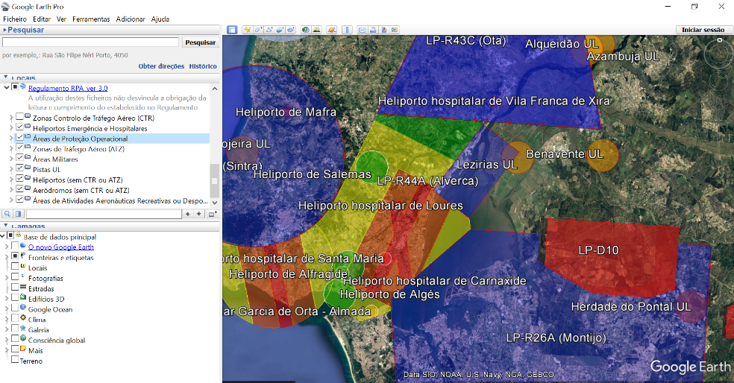
FLIGHT PROCEDURES
Check flight constraints at Portugal Civil Aviation Authority
KMZ file (Google Earth) with no-fly zones

Slide 36
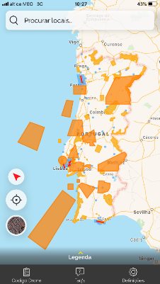
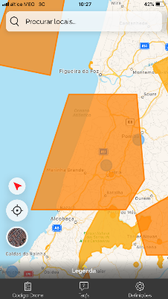
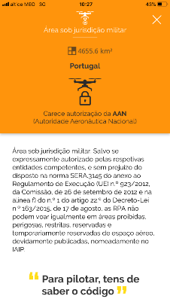
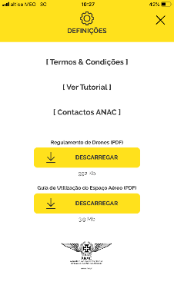
FLIGHT PROCEDURES
Check flight constraints at Portugal Civil Aviation Authority
Mobile App (available for IOS and Android)
UKEOF-ShARE Drones Workshop
Glyndwr University, Jan 29th-30th

Slide 37
WORKFLOW
Inspection
Scheduled
Unscheduled
Area recognition / Flight constraints (Civil/Military)
Normal Flight Authorization
Urgent Flight Authorization
UAV Preparation: firmware, calibration, batteries, SD card, flight plan…
Field recognition: weather; interferences; other constraints
Flight plan (data acquisition / requirements: Image; video…)
Automatic / manual
Post processing products required: 3D; Orthomosaic; NDVI…
Processing
Product
Technical document
UKEOF-ShARE Drones Workshop
Glyndwr University, Jan 29th-30th

Slide 38
WORKFLOW
Inspection
Scheduled
Unscheduled
Area recognition / Flight constraints (Civil/Military)
Normal Flight Authorization
Urgent Flight Authorization
UAV Preparation: firmware, calibration, batteries, SD card, flight plan…
Field recognition: weather; interferences; other constraints
Flight plan (data acquisition / requirements: Image; video…)
Automatic / manual
Post processing products required: 3D; Orthomosaic; NDVI…
Processing
Product
Technical document
UKEOF-ShARE Drones Workshop
Glyndwr University, Jan 29th-30th

Slide 39
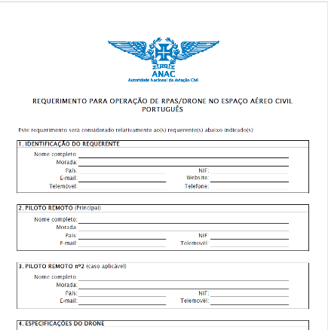
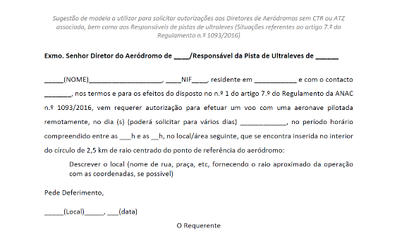
FLIGHT PROCEDURES
Request flight authorizations:
Nacional Aviation Authority (AAN): whenever you need to collect images;
Portugal Civil Aviation Authority (ANAC): depending on flight restrictions;
UKEOF-ShARE Drones Workshop
Glyndwr University, Jan 29th-30th

Slide 40
WORKFLOW
Inspection
Scheduled
Unscheduled
Area recognition / Flight constraints (Civil/Military)
Normal Flight Authorization
Urgent Flight Authorization
UAV Preparation: firmware, calibration, batteries, SD card, flight plan…
Field recognition: weather; interferences; other constraints
Flight plan (data acquisition / requirements: Image; video…)
Automatic / manual
Post processing products required: 3D; Orthomosaic; NDVI…
Processing
Product
Technical document
UKEOF-ShARE Drones Workshop
Glyndwr University, Jan 29th-30th

Slide 41
WORKFLOW
Inspection
Scheduled
Unscheduled
Area recognition / Flight constraints (Civil/Military)
Normal Flight Authorization
Urgent Flight Authorization
UAV Preparation: firmware, calibration, batteries, SD card, flight plan…
Field recognition: weather; interferences; other constraints
Flight plan (data acquisition / requirements: Image; video…)
Automatic / manual
Post processing products required: 3D; Orthomosaic; NDVI…
Processing
Product
Technical document
UKEOF-ShARE Drones Workshop
Glyndwr University, Jan 29th-30th

Slide 42
WORKFLOW
Inspection
Scheduled
Unscheduled
Area recognition / Flight constraints (Civil/Military)
Normal Flight Authorization
Urgent Flight Authorization
UAV Preparation: firmware, calibration, batteries, SD card, flight plan…
Field recognition: weather; interferences; other constraints
Flight plan (data acquisition / requirements: Image; video…)
Automatic / manual
Post processing products required: 3D; Orthomosaic; NDVI…
Processing
Product
Technical document
UKEOF-ShARE Drones Workshop
Glyndwr University, Jan 29th-30th

Slide 43
WORKFLOW
Inspection
Scheduled
Unscheduled
Area recognition / Flight constraints (Civil/Military)
Normal Flight Authorization
Urgent Flight Authorization
UAV Preparation: firmware, calibration, batteries, SD card, flight plan…
Field recognition: weather; interferences; other constraints
Flight plan (data acquisition / requirements: Image; video…)
Automatic / manual
Post processing products required: 3D; Orthomosaic; NDVI…
Processing
Product
Technical document
UKEOF-ShARE Drones Workshop
Glyndwr University, Jan 29th-30th

Slide 44
WORKFLOW
Inspection
Scheduled
Unscheduled
Area recognition / Flight constraints (Civil/Military)
Normal Flight Authorization
Urgent Flight Authorization
UAV Preparation: firmware, calibration, batteries, SD card, flight plan…
Field recognition: weather; interferences; other constraints
Flight plan (data acquisition / requirements: Image; video…)
Automatic / manual
Post processing products required: 3D; Orthomosaic; NDVI…
Processing
Product
Technical document
UKEOF-ShARE Drones Workshop
Glyndwr University, Jan 29th-30th

Slide 45
WORKFLOW
Inspection
Scheduled
Unscheduled
Area recognition / Flight constraints (Civil/Military)
Normal Flight Authorization
Urgent Flight Authorization
UAV Preparation: firmware, calibration, batteries, SD card, flight plan…
Field recognition: weather; interferences; other constraints
Flight plan (data acquisition / requirements: Image; video…)
Automatic / manual
Post processing products required: 3D; Orthomosaic; NDVI…
Processing
Product
Technical document
UKEOF-ShARE Drones Workshop
Glyndwr University, Jan 29th-30th

Slide 46
WORKFLOW
Inspection
Scheduled
Unscheduled
Area recognition / Flight constraints (Civil/Military)
Normal Flight Authorization
Urgent Flight Authorization
UAV Preparation: firmware, calibration, batteries, SD card, flight plan…
Field recognition: weather; interferences; other constraints
Flight plan (data acquisition / requirements: Image; video…)
Automatic / manual
Post processing products required: 3D; Orthomosaic; NDVI…
Processing
Product
Technical document
UKEOF-ShARE Drones Workshop
Glyndwr University, Jan 29th-30th

Slide 47
Using UAV in environmental inspections
CONTENTS
3
1
Products
Orthomosaics
3D models
Thermic images
2
The iCUD
project
Equipments
and workflow
UKEOF-ShARE Drones Workshop
Glyndwr University, Jan 29th-30th

Slide 48
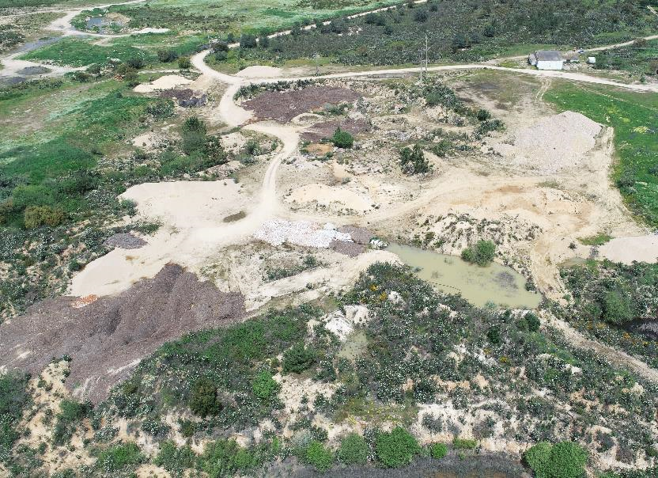
PRODUCTS
MISSION 1
Equipment: Matrice 210 RTK, Phantom 4
Type: Landfill
Area: 180.000 m2
Date: April 2018
Photos: 933
Videos: 10
PRODUCTS
3D Model
Orthomosaic
Thermic Data

Slide 49
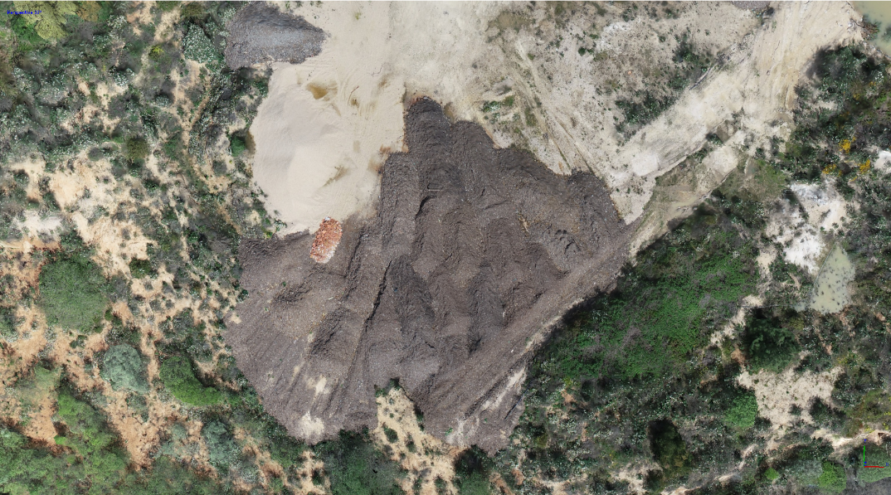
PRODUCTS
3D model

Slide 50
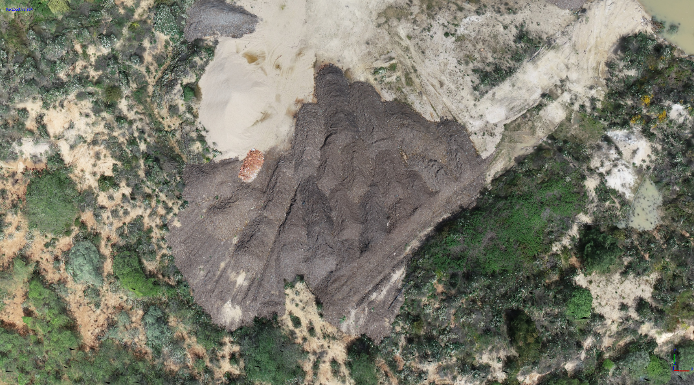
PRODUCTS
3D model

Slide 51
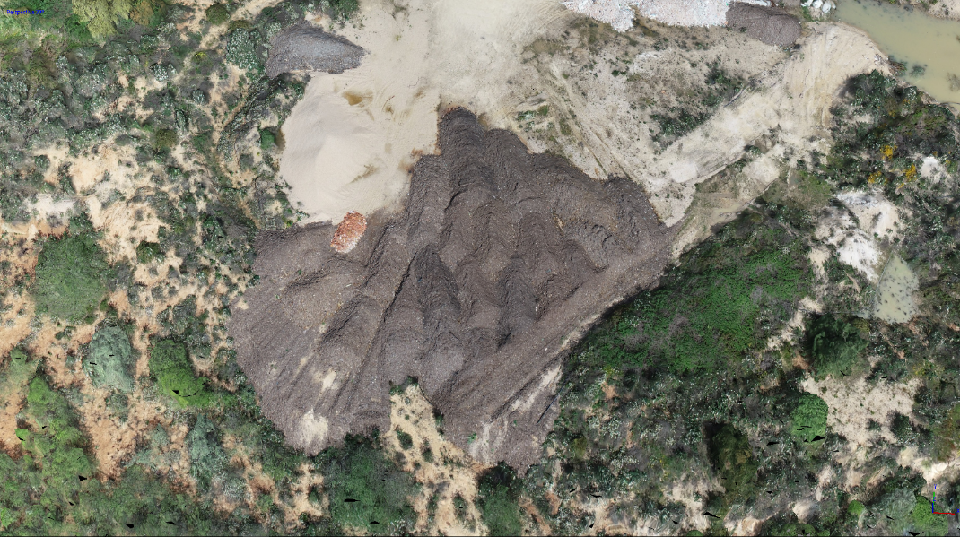
PRODUCTS
3D model

Slide 52
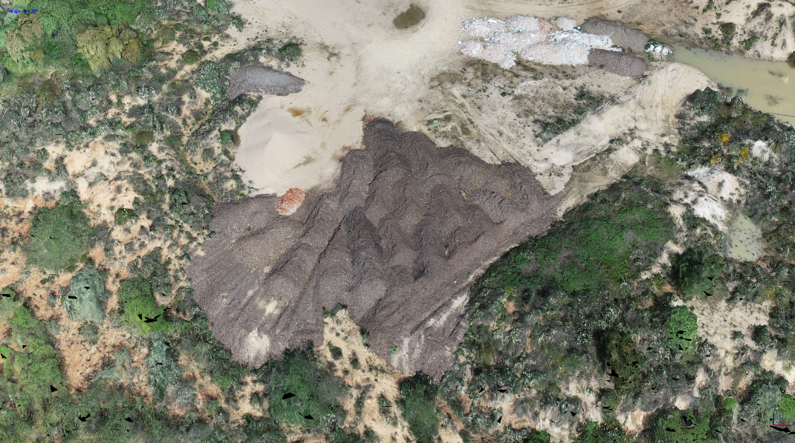
PRODUCTS
3D model

Slide 53
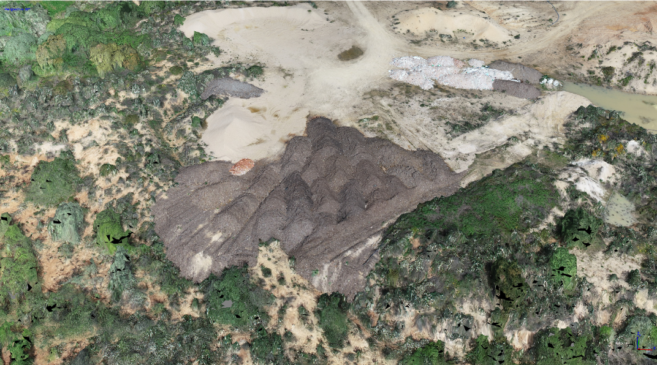
PRODUCTS
3D model

Slide 54
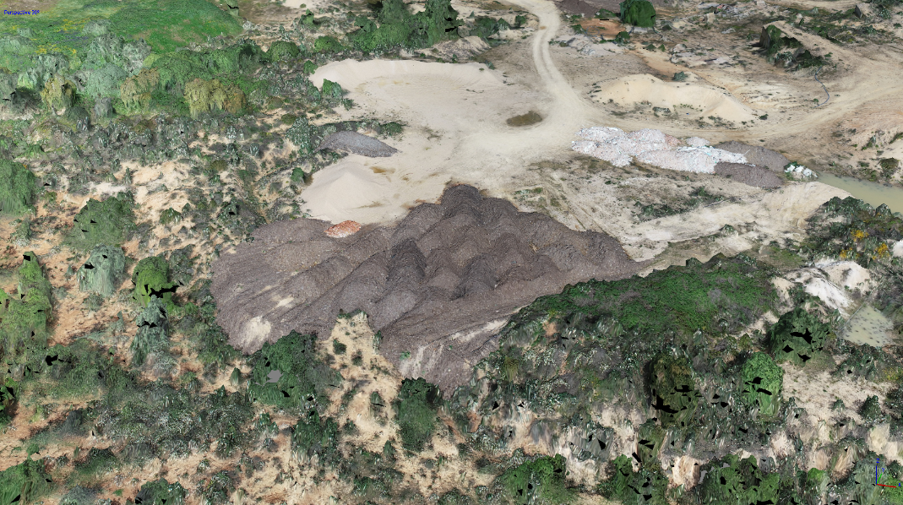
PRODUCTS
3D model

Slide 55
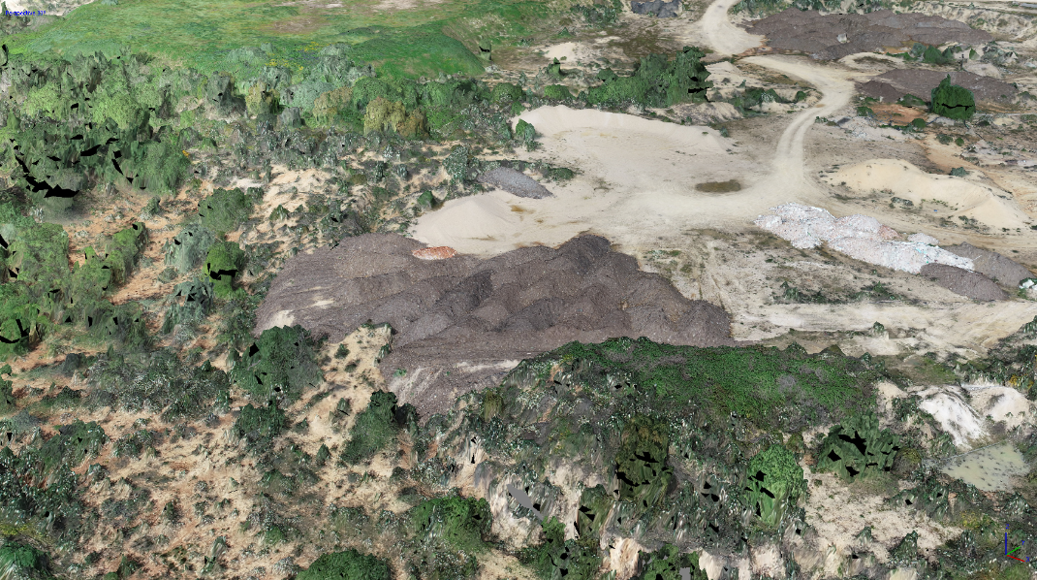
PRODUCTS
3D model

Slide 56
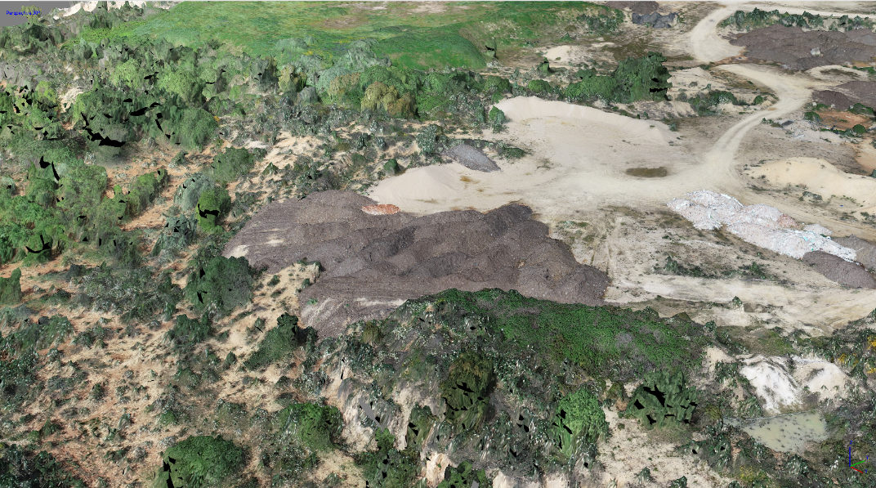
PRODUCTS
3D model

Slide 57
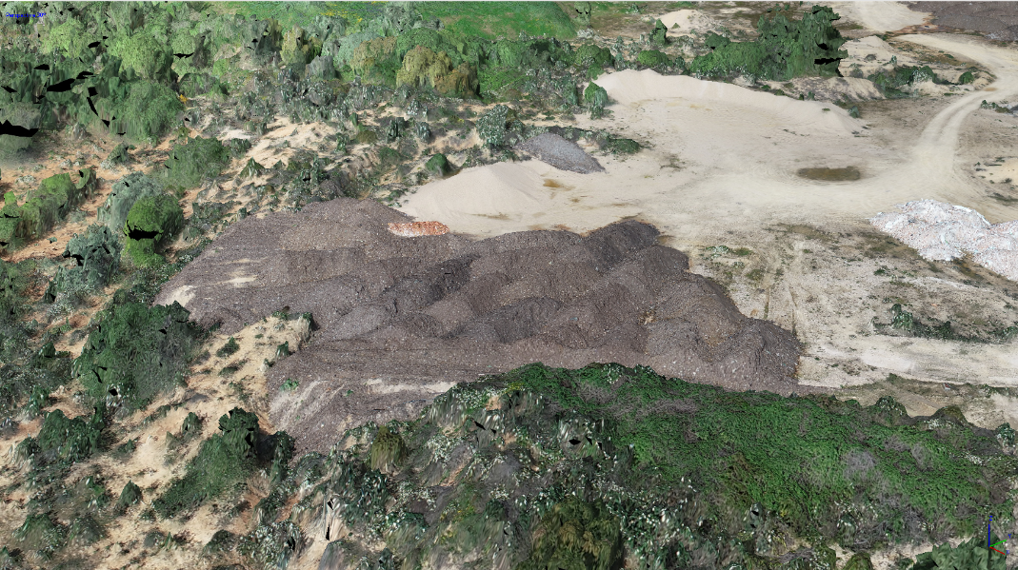
PRODUCTS
3D model

Slide 58
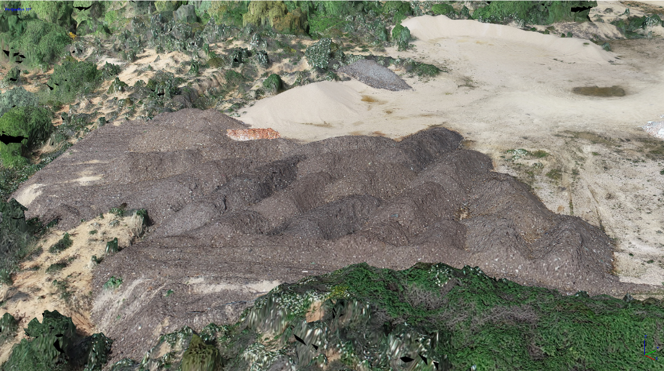
PRODUCTS
3D model

Slide 59
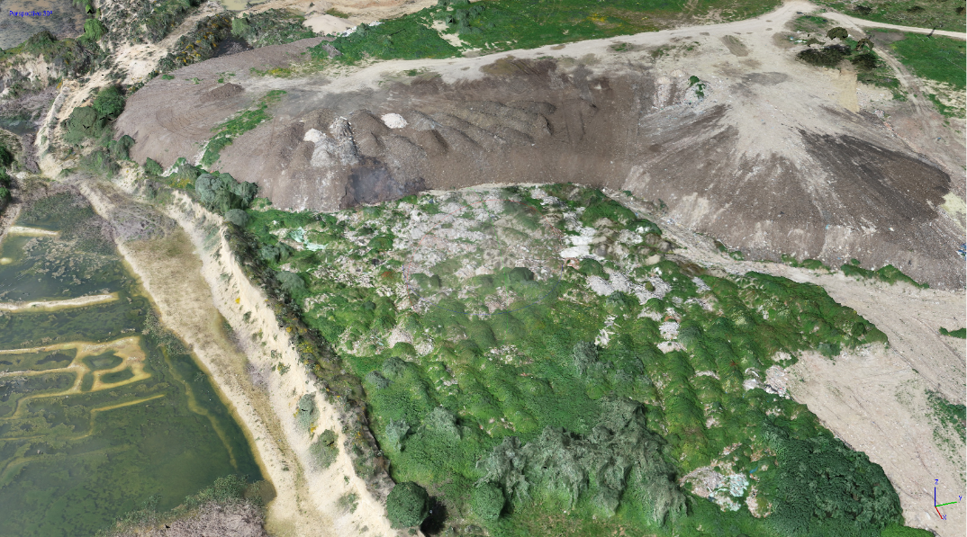
PRODUCTS
3D model

Slide 60
PRODUCTS
3D model

Slide 61
PRODUCTS
3D model

Slide 62
PRODUCTS
3D model

Slide 63
PRODUCTS
3D model

Slide 64
PRODUCTS
Orthomosaic
Technical Data:
Photos:
678
Flight altitude: 81m
Precision:
2cm

Slide 65
PRODUCTS
Orthomosaic
Technical Data:
Photos:
678
Flight altitude: 81m
Precision:
2cm

Slide 66
PRODUCTS
Orthomosaic – calculating areas

Slide 67
PRODUCTS
Orthomosaic – calculating areas

Slide 68
PRODUCTS
Orthomosaic – calculating areas

Slide 69
PRODUCTS
Orthomosaic – calculating volumes

Slide 70
PRODUCTS
Thermic Data

Slide 71
PRODUCTS
Thermic Data

Slide 72
PRODUCTS
Thermic Data

Slide 73
PRODUCTS
Thermic Data

Slide 74
PRODUCTS
MISSION 2
Equipment: Matrice 210 RTK, Phantom 4
Type: Reservoir
Area: 700.000 m2
Date: July 2018
Photos:
Videos:
PRODUCTS
3D Model
Orthomosaic

Slide 75
PRODUCTS
Orthomosaic
Technical Data:
Photos:
796
Flight altitude: 85m
Precision:
2cm

Slide 77
PRODUCTS
MISSION 3
Equipment: Phantom Pro 4+
Type: Quarry
Area: 90.000 m2
Date: November 2018 and January 2019
Photos: 650
Videos: 10
PRODUCTS
Orthomosaic

Slide 78
PRODUCTS
Orthomosaic
Technical Data:
Photos:
611
Flight altitude: 80m
Precision:
2cm

Slide 79
Using UAV in environmental inspections
CONTENTS
4
Questions
…
3
1
Products
Orthomosaics
3D models
Thermic images
2
The iCUD
project
Equipments
and workflow
UKEOF-ShARE Drones Workshop
Glyndwr University, Jan 29th-30th

Slide 80
Questions
?
UKEOF-ShARE Drones Workshop
Glyndwr University, Jan 29th-30th

Slide 81
UAV data as a supporting tool in environmental inspections
iCUD Project and experiences at IGAMAOT
Cláudia Morgado
Eduardo Amaro
Eduardo Robalo
Susana Silva
UKEOF-ShARE Drones Workshop
Glyndwr University
Jan 29th-30th
2019

