Slide 1
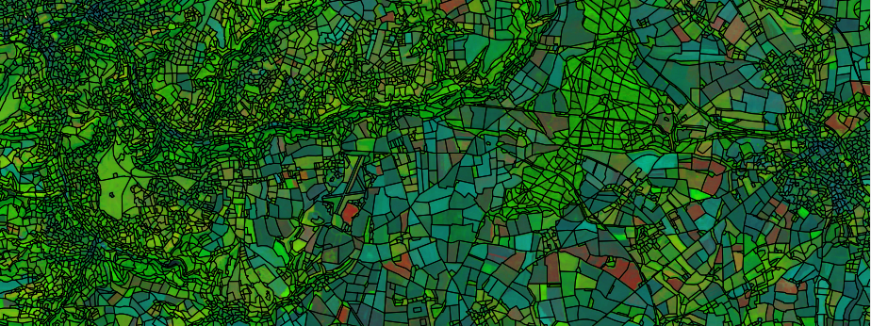
Rapid Land Cover Mapping
Optimal use of new satellite resources.
Research funded by NERC/CEH and JNCC.

Slide 2
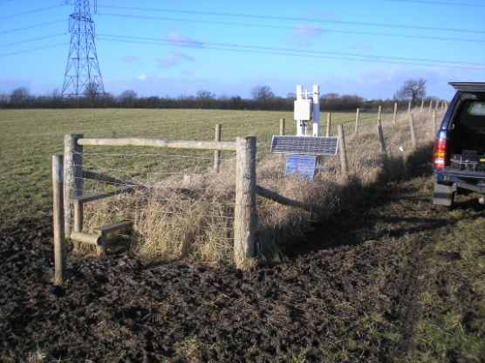
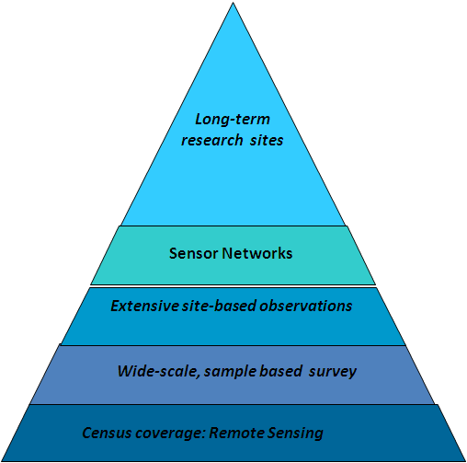
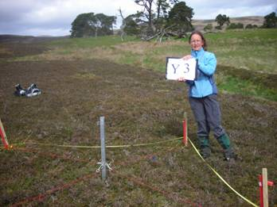
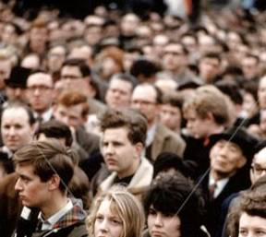
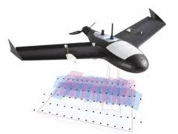
Remote sensing:
a key component of CEH’s integrated UK observing capability
UK Environmental Change Network
UK-Atmospheric Chemistry and Air Quality Monitoring Network,
Carbon Catchments
UK Upland waters Monitoring Network
Cumbrian Lakes Monitoring
Wetland Core Monitoring,
Isle of May Long Term Study,
Soil observatories
Conwy Source to Sea
COSMOS Soil Moisture Network
UK Lake Ecological Observatories
UK Butterfly Monitoring Scheme,
Predatory Bird Monitoring Scheme
Biological Records Centre
Welsh Govt. Environmental Monitoring
Countryside Survey
UK Land Cover Map

Slide 3
National LCM – traditional recipe
Ingredients:
Prepared satellite images
Spatial framework
Schema
Field-data
A maximum likelihood classifier

Slide 4
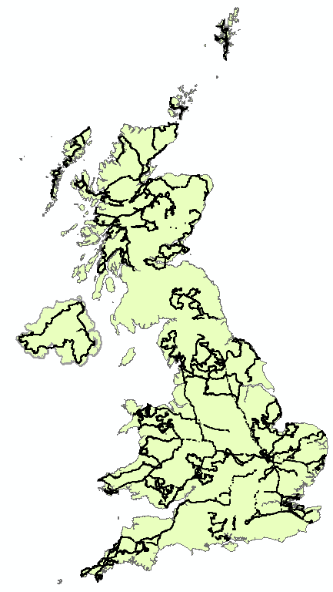
Training and Validation: field campaign
LCM2007:
<20,000 useable training and validation points

Slide 5
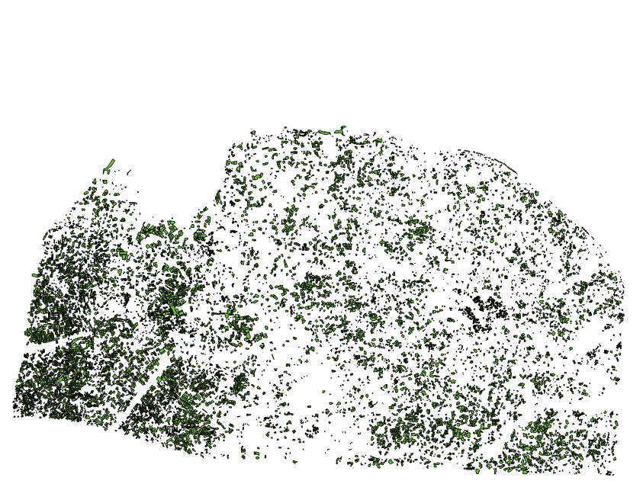
Training: History from 3 CEH LCMs
A region of Norfolk, Suffolk: ~21,000 training polygons; > 1.25 million training pixels

Slide 6
Machine Learning
  WEKA toolkit from University of Waikato, NZ
  Explored a range of Machine Learning algorithms: Decision Trees, Boosting, Support Vector Machines, Random Forest
  Random Forest performed best

Slide 7
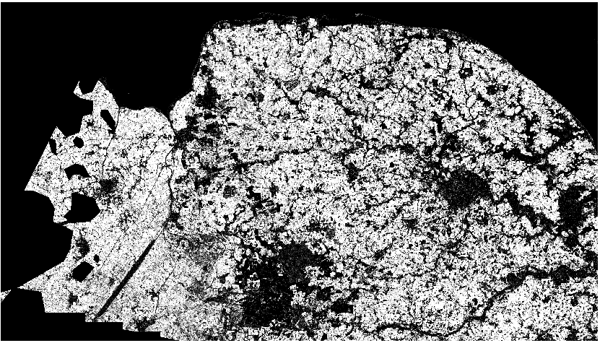
Surface probability for each type, Arable

Slide 8
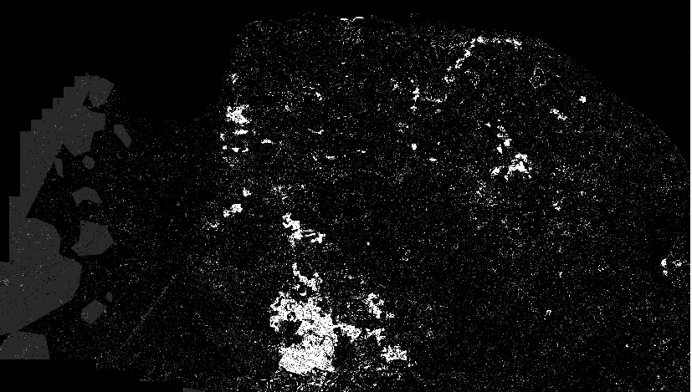
Surface probability, Coniferous Woodland

Slide 9
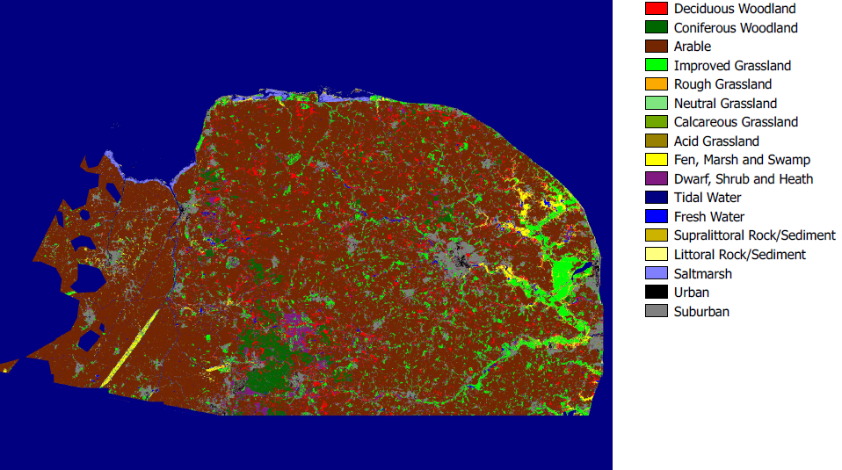
Results: < 1hr (previously 2-4 weeks)

Slide 10
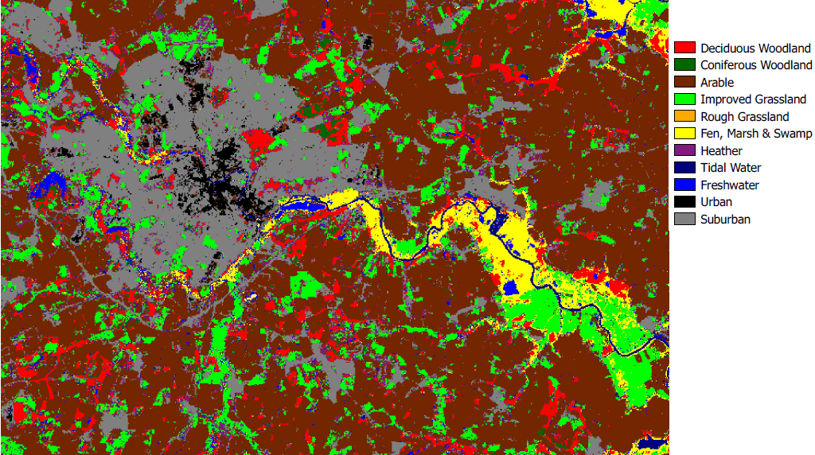
Norwich in 2002 as pixels

Slide 11
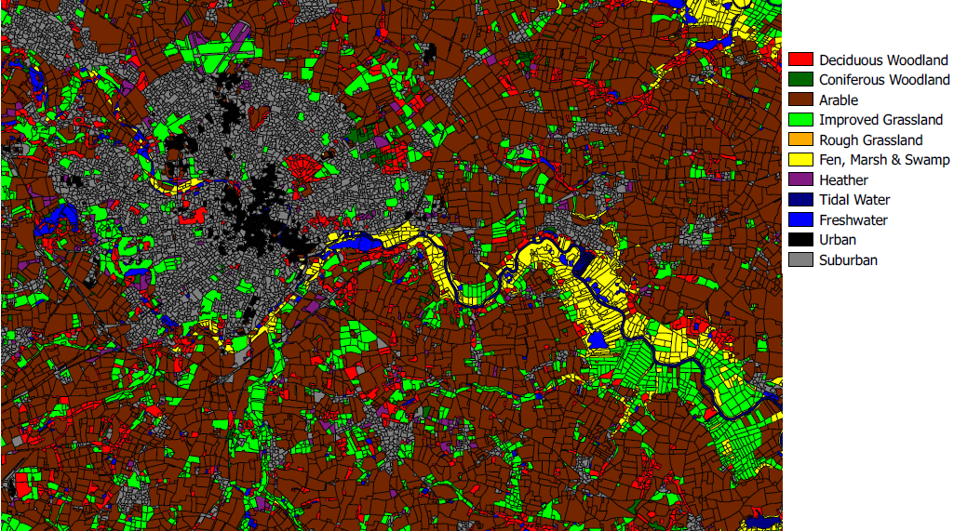
Norwich as Land Parcels

Slide 12
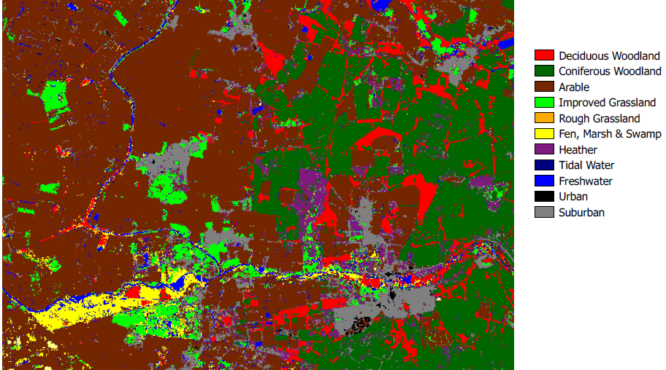
Lakenheath, Thetford Forest

Slide 13
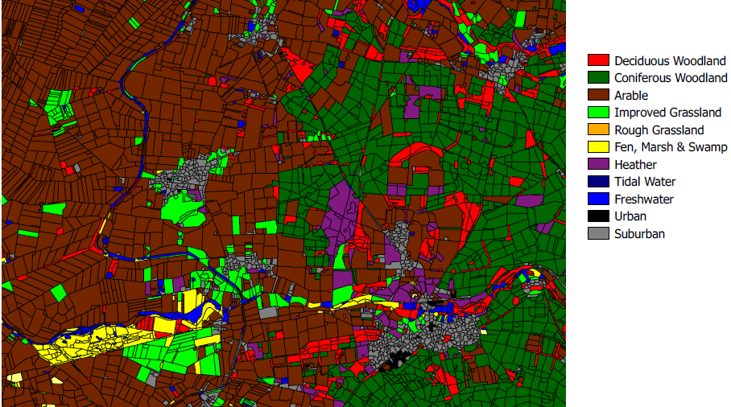
Lakenheath, Thetford Forest

Slide 14
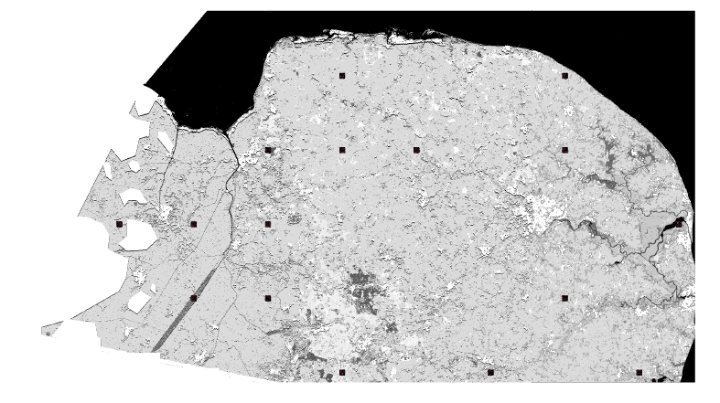
Accuracy

Slide 15
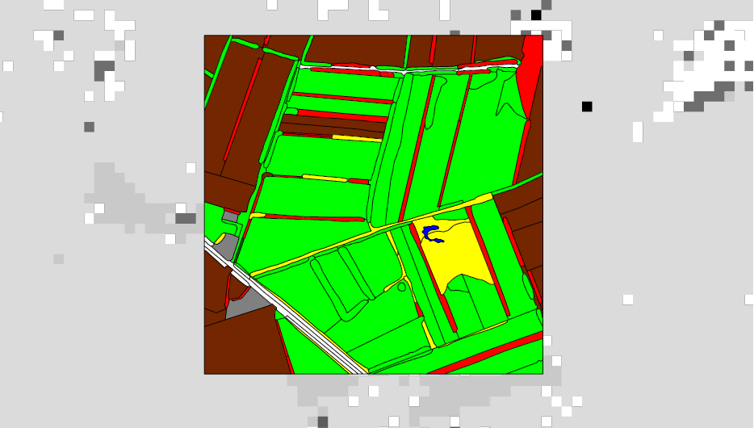
Correspondence with CS

Slide 16
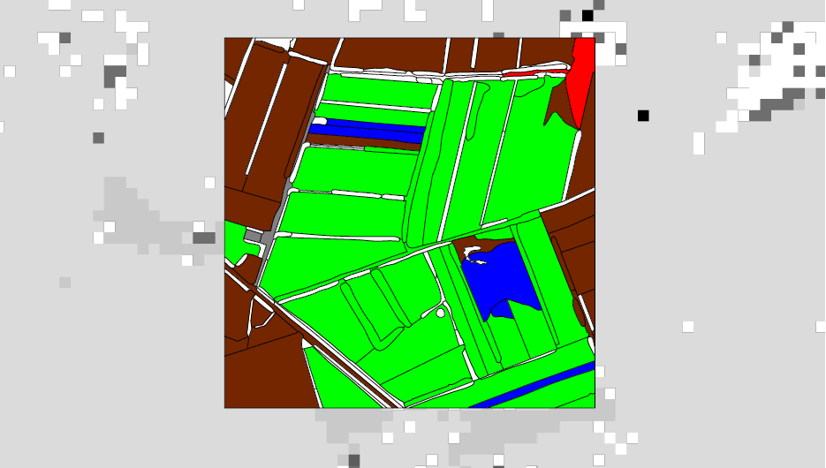
Correspondence with CS

Slide 17
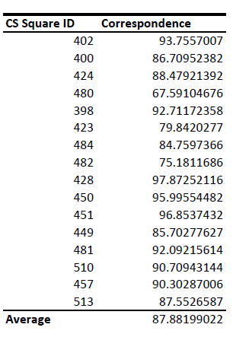
Areal correspondence CS1998, Norfolk 2002

Slide 18
Key points
  Land cover history produces a richer set of training information than conventional field campaigns and almost cost-free
  Used with non-parametric classification techniques rapid, more accurate classifications
  Stable training sites enable multiple classifications using the same training polygons (classify historical images).
  Consistent training sites, classification methods, thematic descriptions, spatial structure supports change detection
  Near real-time classification a sensible aspiration
  Field observations still essential for product validation

