Slide 1
Environmental Monitoring Challenges
Space for Smarter Government: Environmental Monitoring
21st March 2014

Slide 2
Environmental Observations
Vital source of information from global to local scale for:
understanding and managing our changing environment
guiding current and future policy, science and innovation
economic benefit and quality of life
Notes:
Why do we need observations?
But what is being observed, by whom and why?

Slide 3
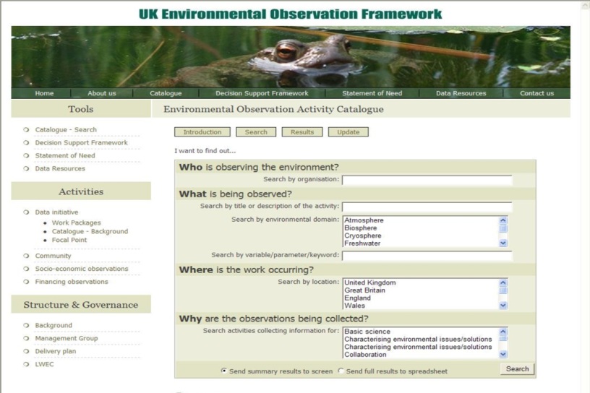
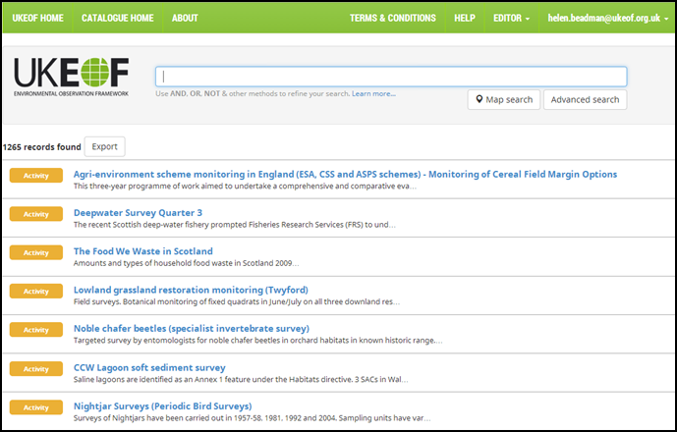
UKEOF Observation Catalogue
Online searchable database
Holds information on who is doing what, where and why, of over 1200 activities
Only UK overview of environmental observations
New catalogue – demo at lunch

Slide 4
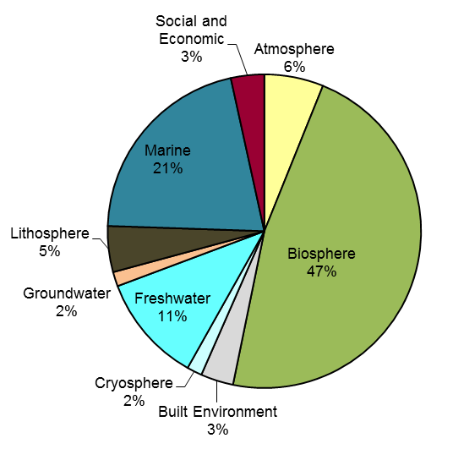
What is being observed?
Nearly half of the observations in the catalogue monitor the biosphere
Many observations fall under more than one environmental domain
NB record may be programme or activity (approximately 20% are programmes 75% activities)

Slide 5
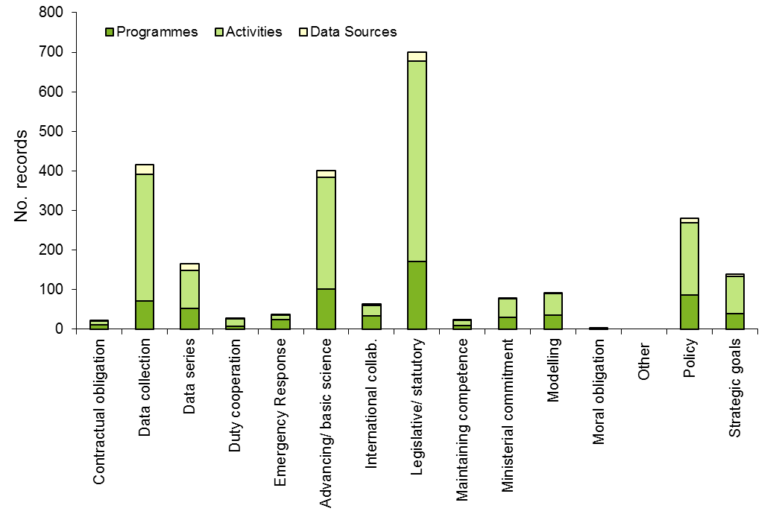
Why are they being observed?
Many are undertaken for more than one purpose
But some 200 are only collected for legislative/ statutory reasons

Slide 6
Who are making the observations?
The public sector is leading on around 50% of the records
And funding around the same proportion
Lead
Organisation
Funding Organisation
NB record may be programme or activity (approximately 20% are programmes 75% activities)
Notes:
Over 400 organisations named in the catalogue
Over 100 funders

Slide 7
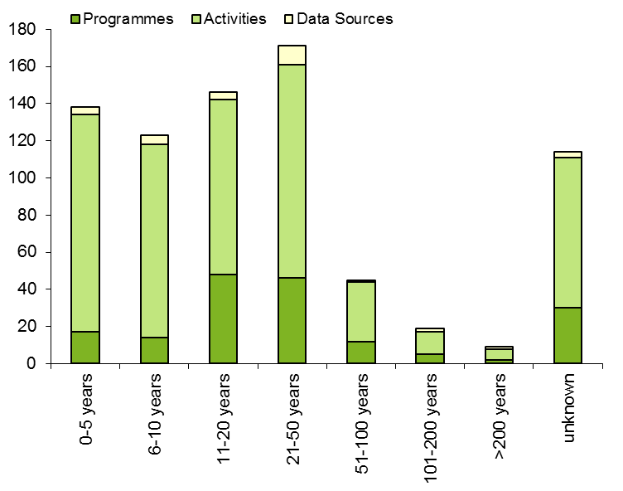
How long have observations been running?
78 running for over 50 years of which 29 for over 100 years
Longest running are recording schemes or public engagement type activities
Not all of the observations are still on-going
No. records

Slide 8
Complex monitoring landscape
Diverse array of monitoring activities across the environmental domains, some that have been on-going for long periods of time
Activities serve many purposes
Large number of organisations involved in both funding and delivering the observations

Slide 9
The Challenge
Increased drive for efficiency in evidence gathering, but recognising:
Legislative requirements
Different solutions required for diverse needs
Need for compatibility with long term activities
Complexity of organisations involved
Notes:
Legislative requirements – increasing, have to do some things, and some monitoring has to be done in a certain way
No silver bullet – will need to think innovatively
Long term monitoring – need to preserve the ability to compare past measurement with future
Many organisations involved serving multiple needs, so good communication needed with any proposed changes

Slide 10
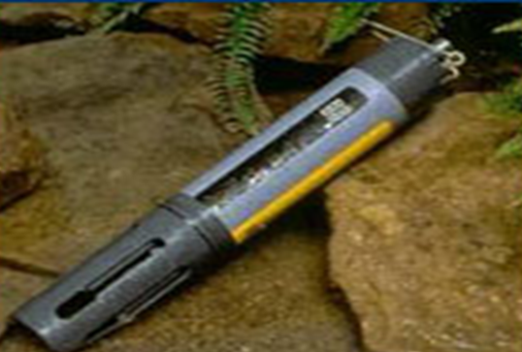
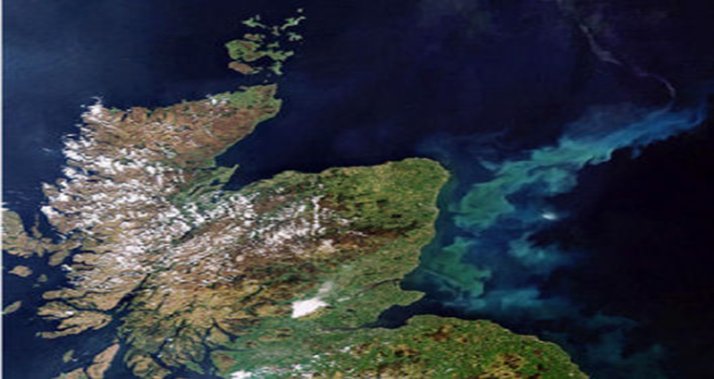
Meeting the challenges
New technologies e.g.
Environmental DNA
New instrumentation
Satellite imagery
Other satellite applications

Slide 11
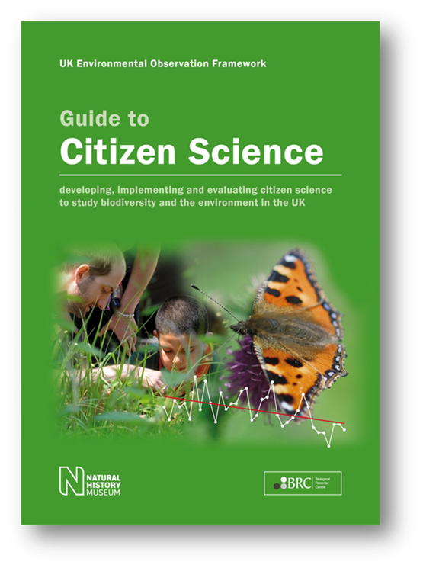
Meeting the challenges
New approaches
Rapid increase in the number of citizen science projects
Combining approaches e.g. Cropland capture: using citizen scientists to look at satellite images of the Earth’s surface and note whether they see cropland in the image or not

Slide 12
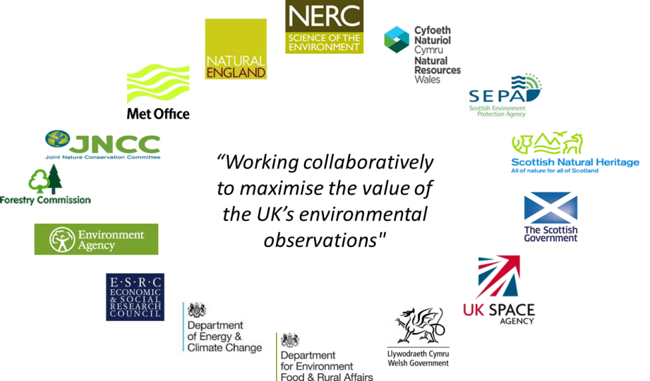
Meeting the challenges
Partnerships
Identifying where there is value working together
Making best use of current partnerships
Looking to other sectors

Slide 13
Questions?

